Slide 1
Microorganisms

Slide 2
Standard
S5L4. Obtain, evaluate, and communicate information about how microorganisms benefit or harm larger organisms. (Clarification statement: Possible microorganisms could include Tardigrades, Lactobacillus, Probiotics, Rotifers, Salmonella, Clostridium botulinum (Botox), E-coli, Algae, etc. Students are not expected to know these specific organisms. This list is provided to give teachers examples.)
a. Construct an argument using scientific evidence to support a claim that microorganisms are beneficial.
b. Construct an argument using scientific evidence to support a claim that microorganisms are harmful.

Slide 3
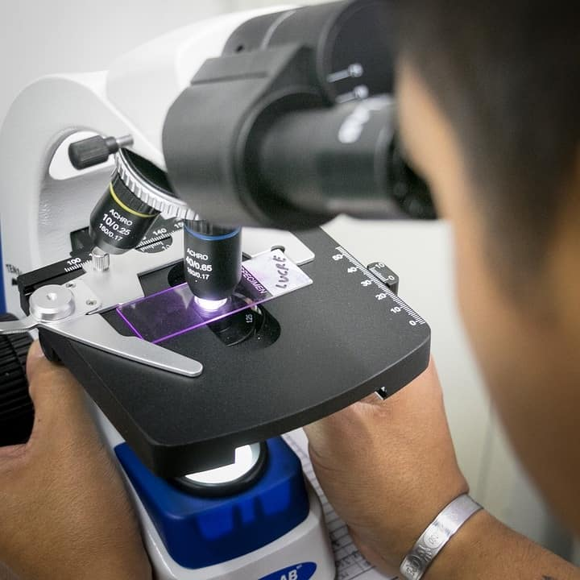
Microorganisms
Microorganisms are so small that they can only be seen under a microscope.
These include a huge range of organisms such as bacteria, viruses, fungi, algae, protozoa, etc.
These microbes can be harmful or beneficial.

Slide 4
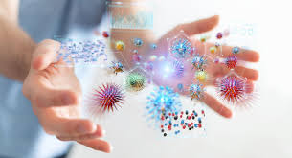
Microorganisms
Microorganisms are everywhere: in the air we breathe, the food we eat, the water we drink, the floor where we stand, and even inside our bodies.
Few microorganisms can withstand extreme conditions like a place as hot as boiling water, or a place as cold as ice (ex. Tardigrades).
Some microorganisms are found alone, while others are found in colonies.

Slide 5
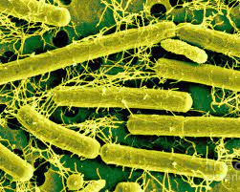
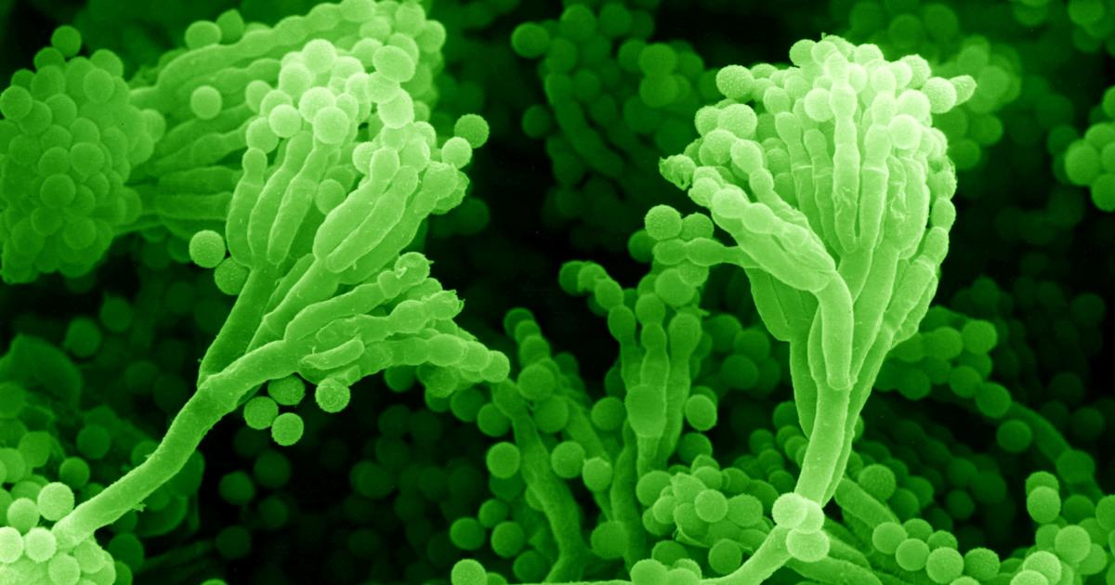
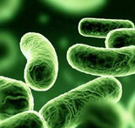
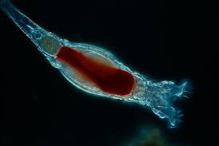
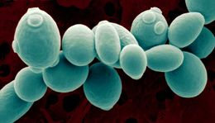
Microorganisms
Harmful and beneficial types of bacteria are both present, but very few people know about the beneficial bacteria:
Lactobacillus bacteria
Penicillium mold
Probiotics (Lactobacillus acidophilus )
Rotifers
Yeasts

Slide 6
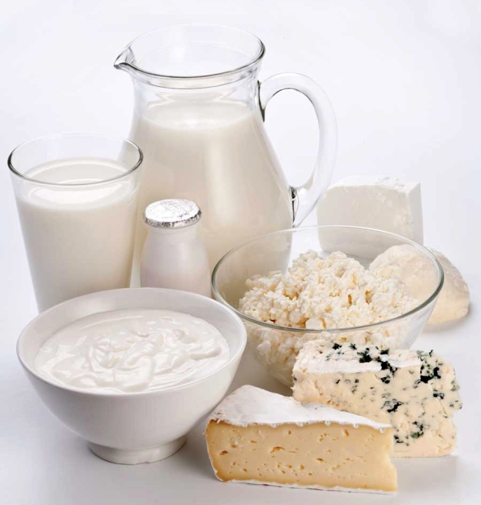
Beneficial Microorganisms
Lactobacillus bacteria – This bacteria produces lactic acid which is used in the production of sour milks (buttermilk), cheeses, and yogurt.

Slide 7
Beneficial Microorganisms
Penicillium - One of the first and still one of the most widely used antibiotic agents. Penicillin, which comes from the Penicillium mold, is used in the treatment of throat infections, and various other infections.

Slide 8
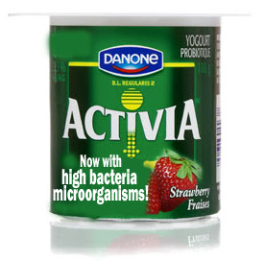
Beneficial Microorganisms
Probiotics – Live microorganisms that have health benefits when consumed or applied to the body. They can be found in yogurt and other fermented foods, supplements, and beauty products.

Slide 9
Beneficial Microorganisms
Yeasts – Microscopic fungi that are used in cooking and fermentation.
This Photo by Unknown Author is licensed under CC BY-SA

Slide 10
Beneficial Microorganisms
Rotifers – A microscopic, aquatic invertebrate that plays an important part in the freshwater zooplankton ecosystem, being a major food source and with many species also contributing to the decomposition of soil organic matter.

Slide 11
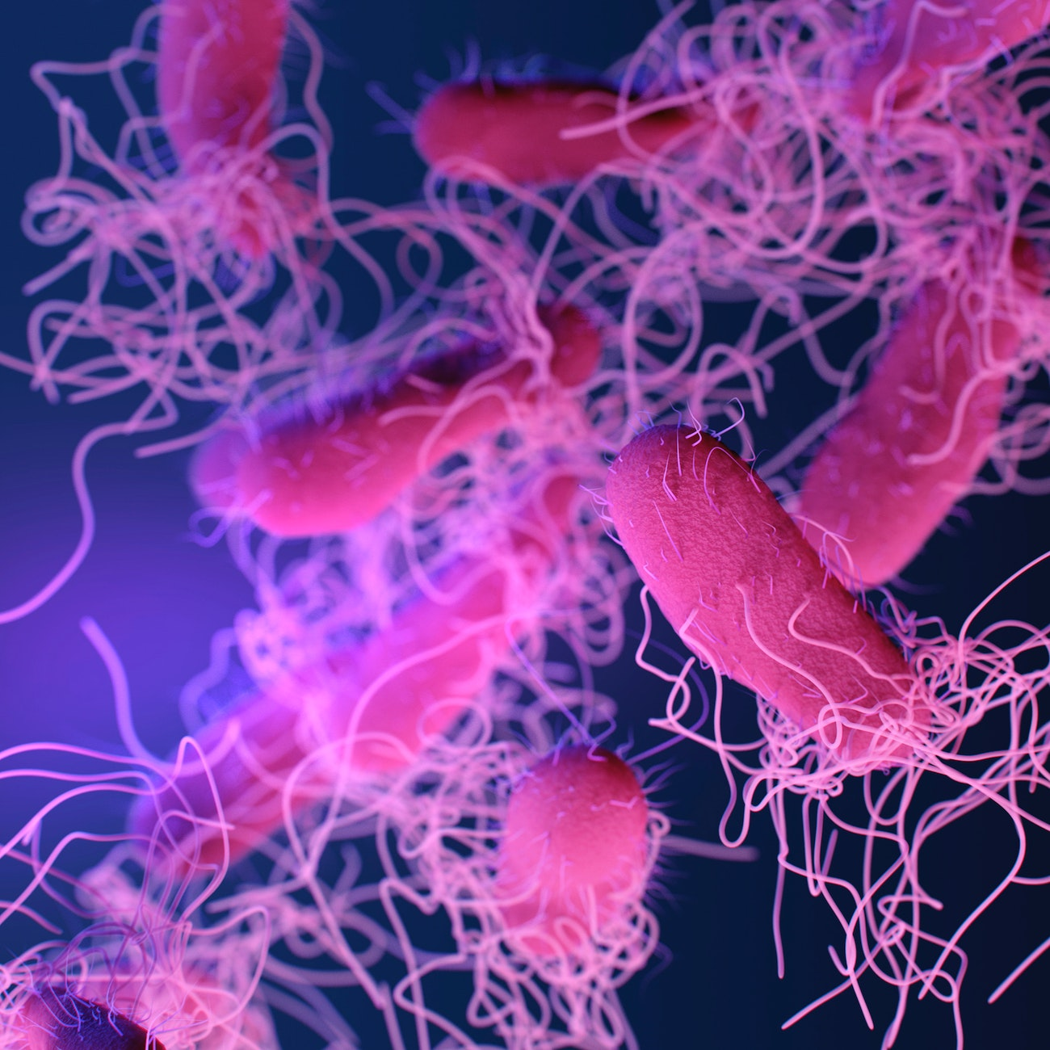
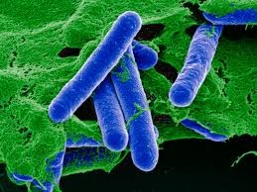
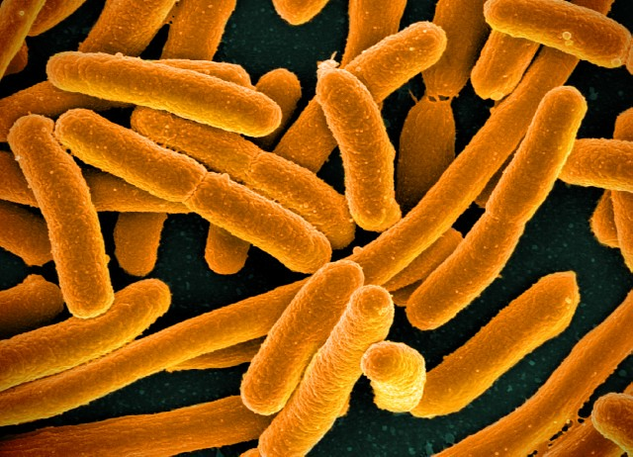
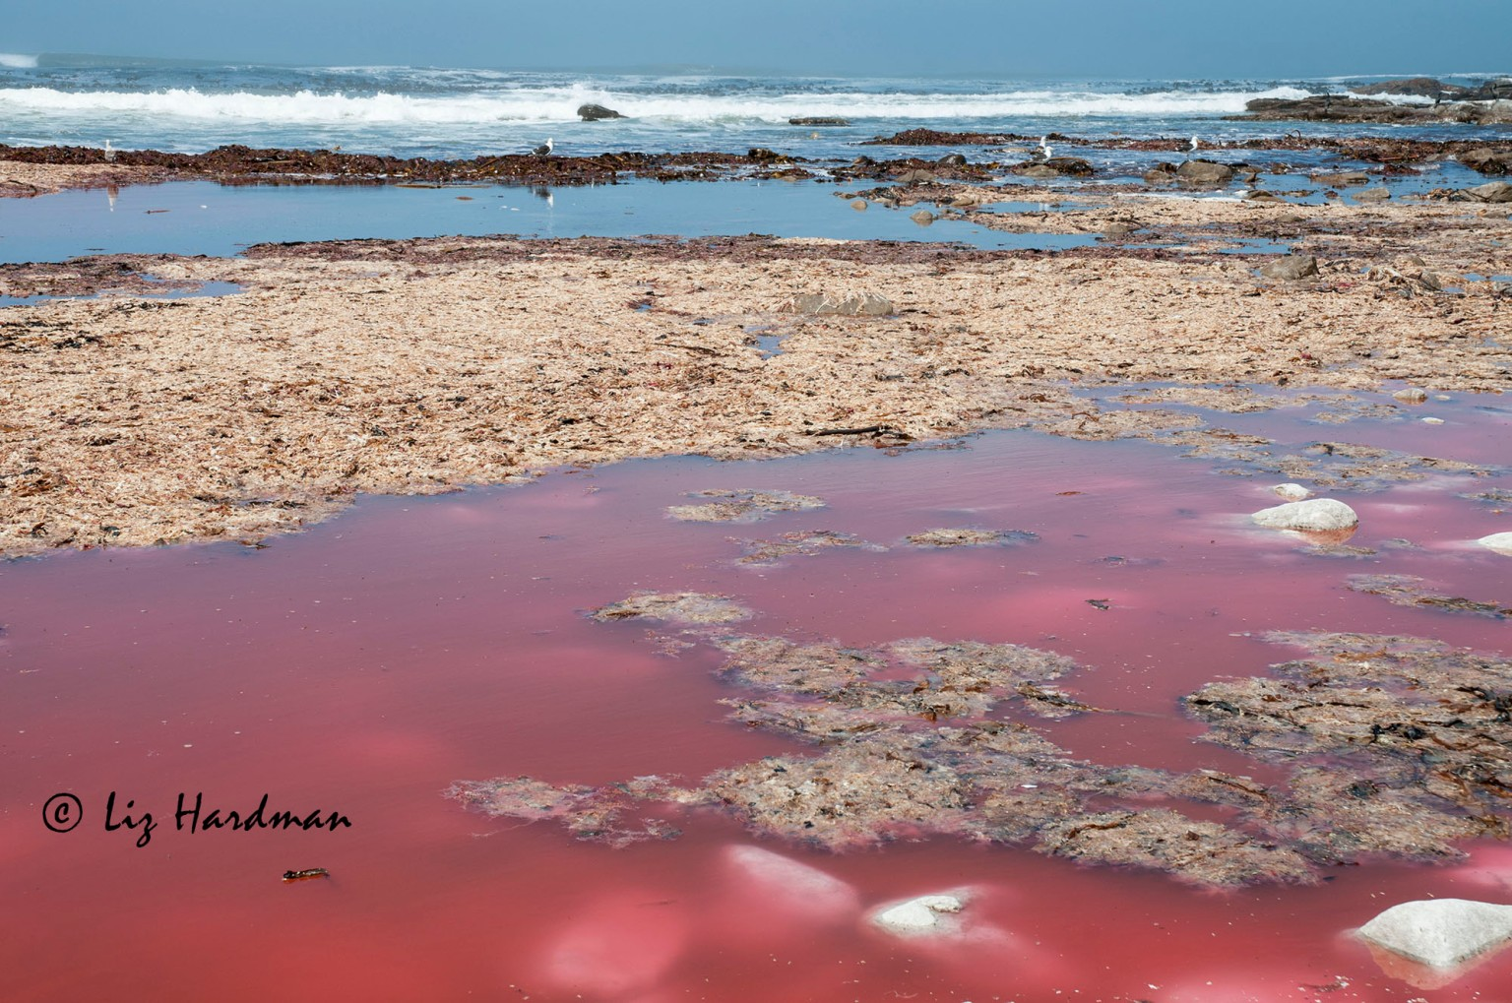
Harmful Microorganisms
Some microorganisms are harmful:
Salmonella
Clostridium botulinum (Botox)
E-Coli
Algae

Slide 12
Harmful Microorganisms
Salmonella - A common bacterial disease that affects the intestinal tract. Humans become infected most frequently through contaminated water or food.

Slide 13
Harmful Microorganisms
Clostridium botulinum (Botox) – A bacteria that under certain conditions can grow in foods and cause severe food poisoning. It is also used in very small doses by doctors to treat health conditions where weakening or paralyzing certain muscles or by blocking certain nerves is needed.

Slide 14
Harmful Microorganisms
E. Coli – A bacteria that normally live in the intestines of people and animals. Most are harmless and an important part of a healthy human intestinal tract. However, some are pathogenic meaning they can cause illness, such as diarrhea. Most people become infected from contaminated food, such as undercooked ground beef.

Slide 15
Harmful Microorganisms
Algae - Organisms that are important to the Earth because they produce the oxygen needed to sustain life. If too much algae or cyanobacteria grow at once or they make toxins, they can harm people, animals, and the environment. Algae blooms such as a red tide are examples.

Slide 16
Beneficial or Harmful?
Algae - Organisms that are important to the Earth because they produce the oxygen needed to sustain life. If too much algae or cyanobacteria grow at once or they make toxins, they can harm people, animals, and the environment. Algae blooms such as a red tide are examples.

