Slide 1
Balloon Racers

Slide 2
Standards
S8P3. Obtain, evaluate, and communicate information about cause and effect relationships between force, mass, and the motion of objects.
a. Analyze and interpret data to identify patterns in the relationships between speed and distance, and velocity and acceleration. (Clarification statement: Students should be able to analyze motion graphs, but students should not be expected to calculate velocity or acceleration.)

Slide 3
Saturn V Rocket

Slide 4
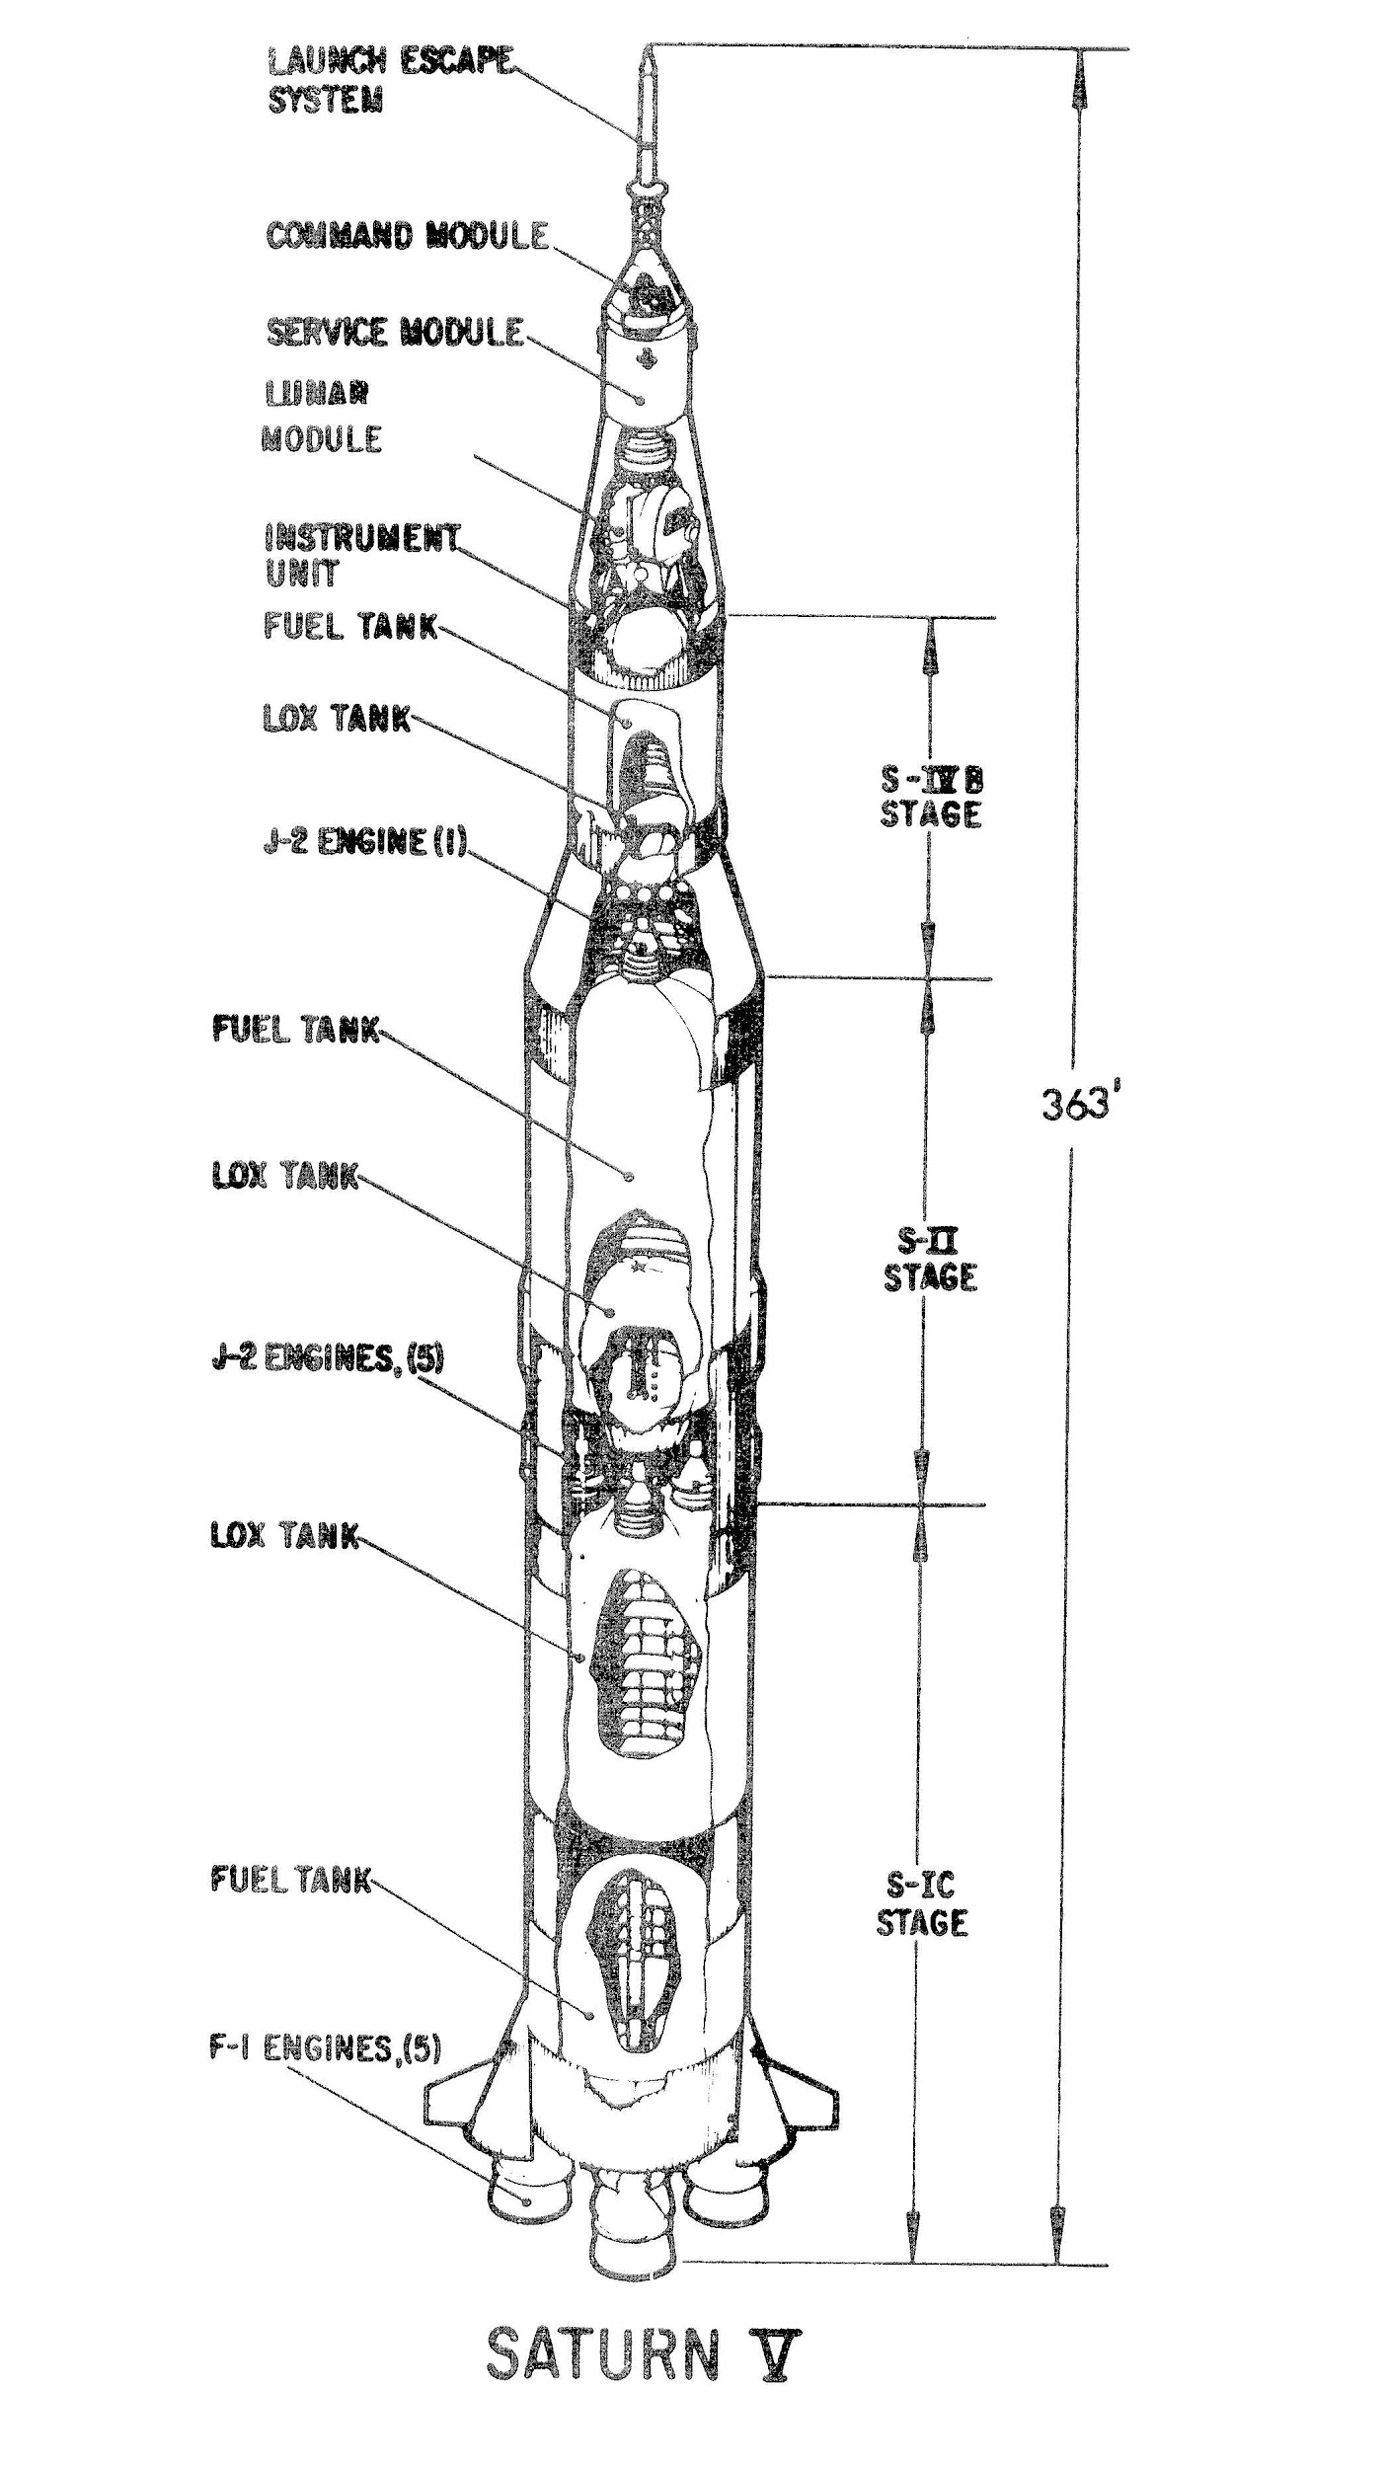
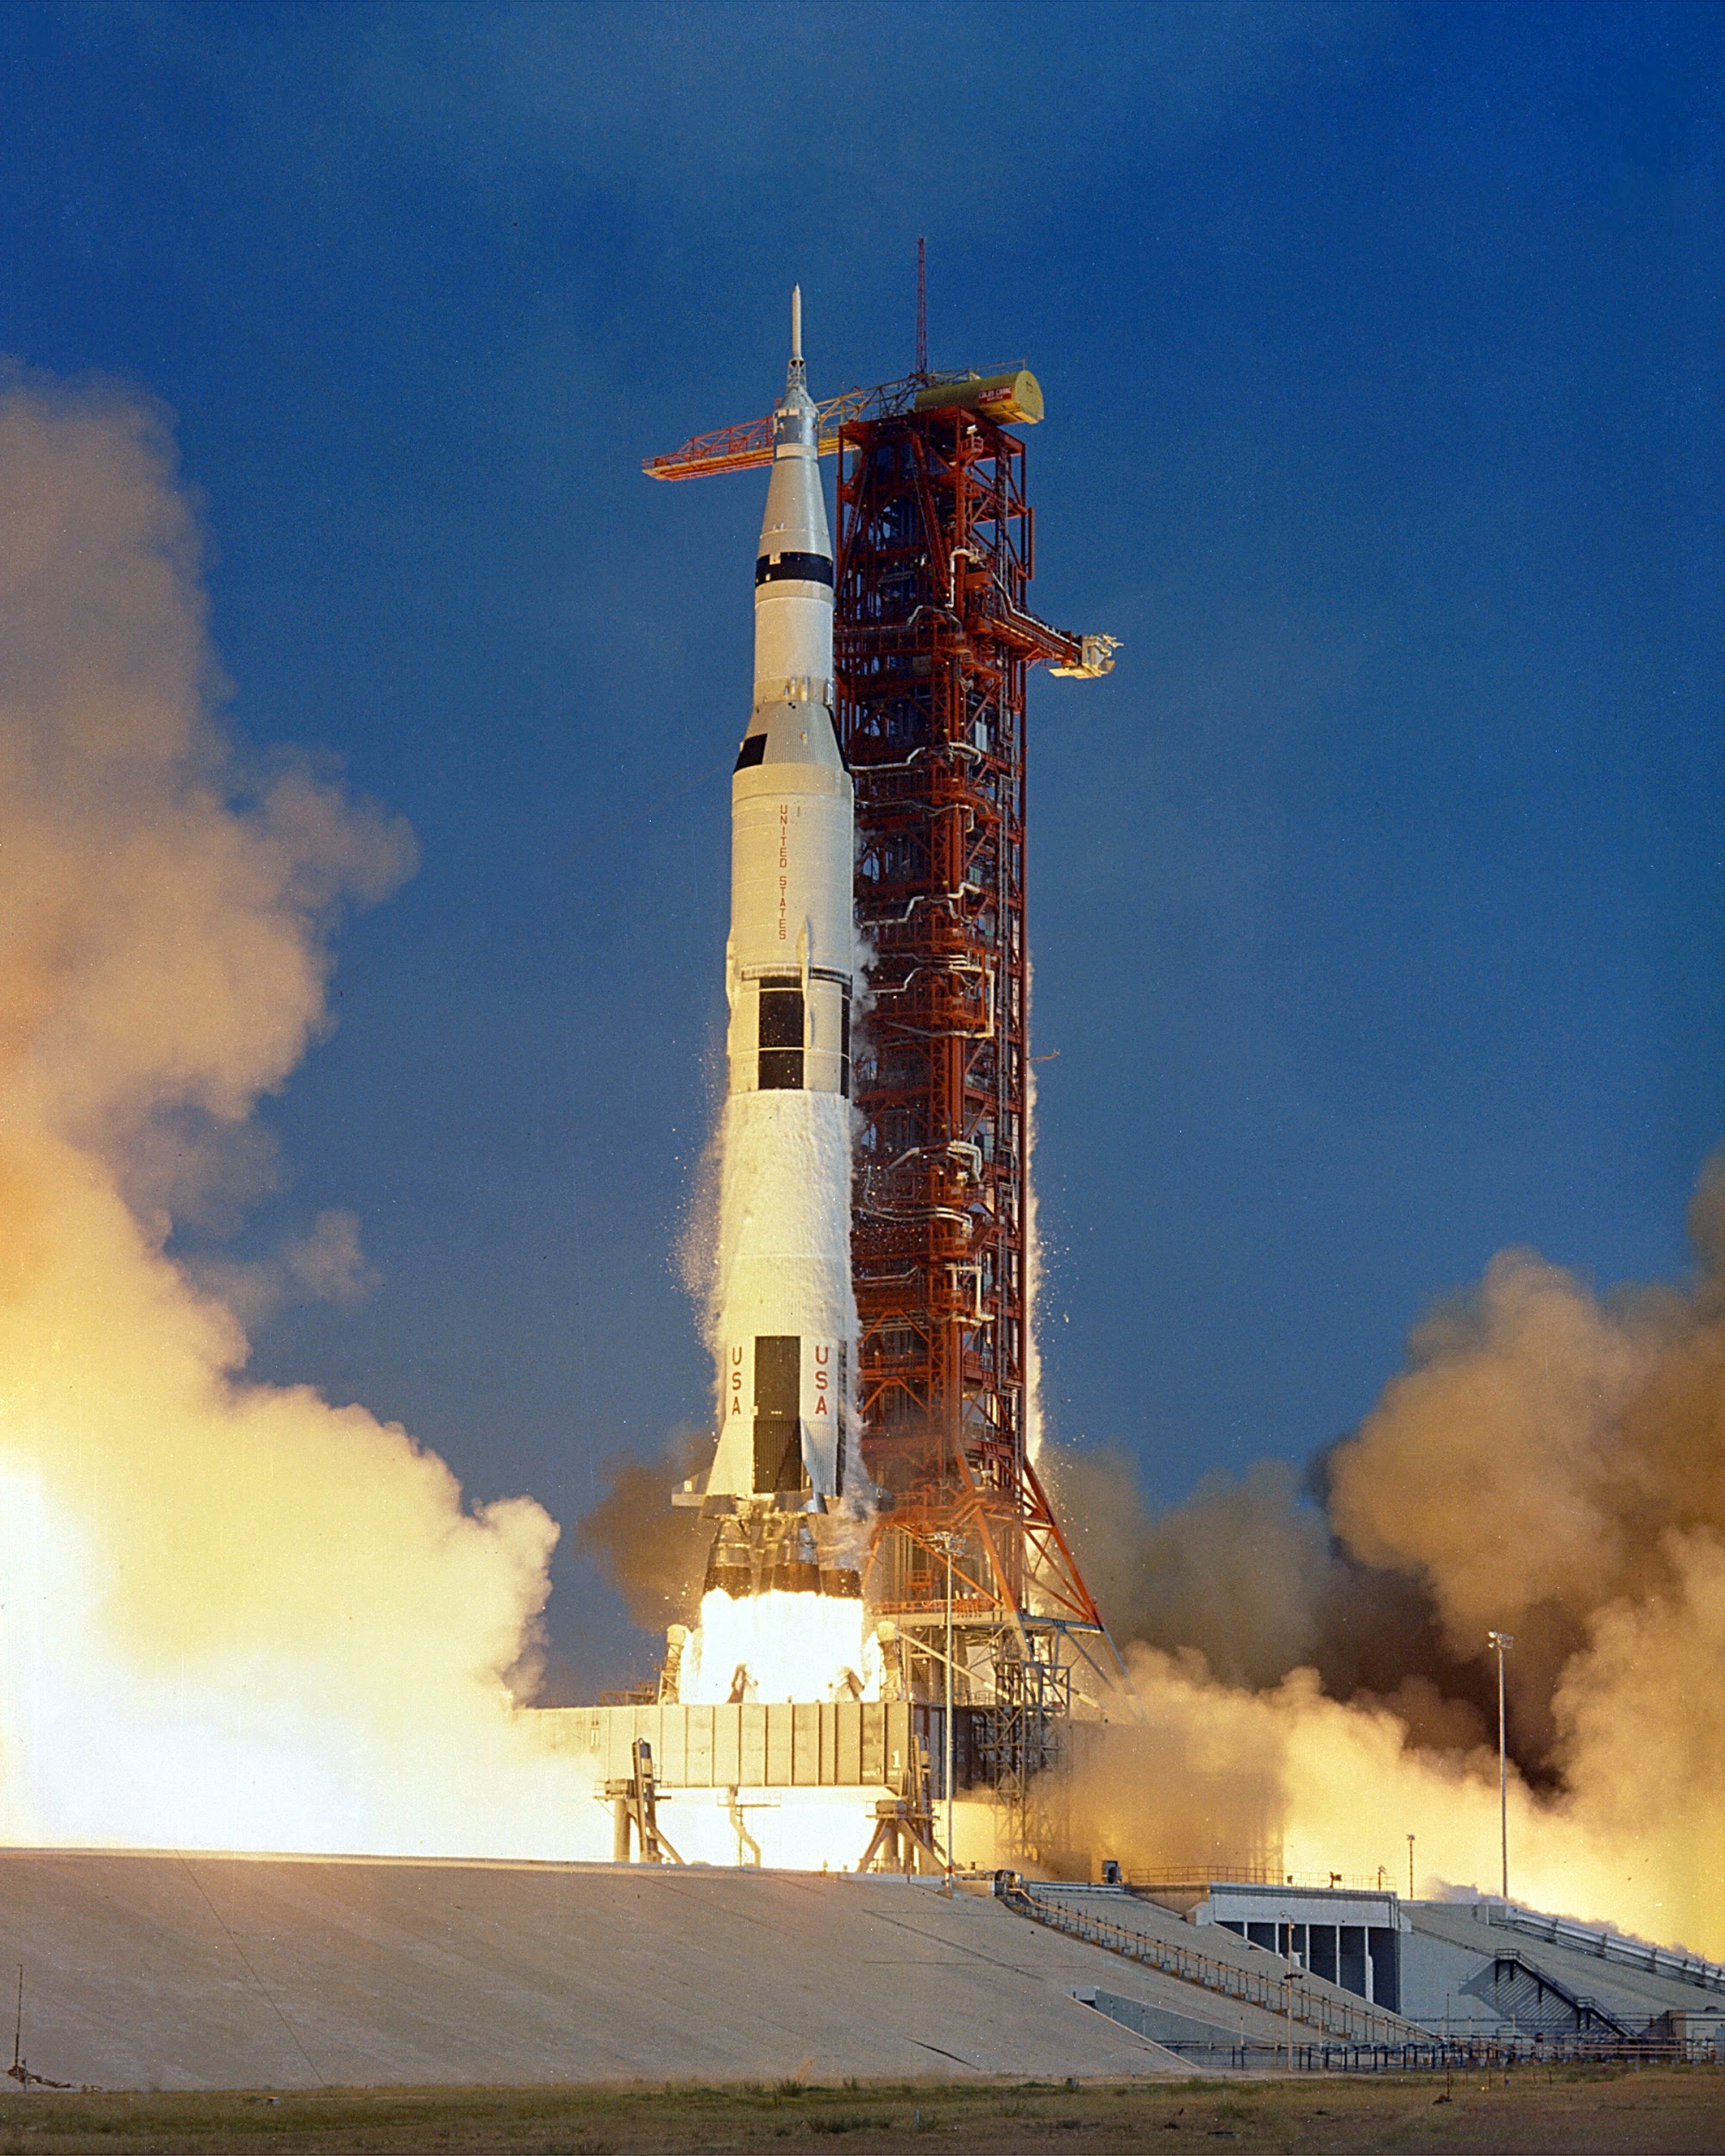
Saturn V Rocket
The Saturn V rocket, the rocket that took the Apollo 11 astronauts to the moon in 1969, was made up of over 3 million parts that each had to be rigorously tested and redesigned in order to work properly. Engineers are the people that designed and tested each of these parts, and engineers also use the same precise testing and measuring procedures to create everyday products such as cars, homes, and even toothbrushes.

Slide 5
Challenge
Imagine you and your partner are engineers who just graduated from college. A company is looking to hire two new engineers. Engineers have to be accurate in their measurements and to observe carefully as they test their designs. In addition, you have to be able to quantify your observations so that you can demonstrate the effectiveness of your designs with convincing data. After interviewing, the company narrowed the candidates down to the people in this class. To figure out whom to hire they have one final test: Your team’s balloon racer must travel the 2 to 5-meter zipline in the fastest time.

Slide 6
Materials
Balloon Racer Investigation Worksheet
4 balloons
4 straws
3 pieces of construction paper
6 meters of string
Scissors
Masking tape
Stopwatch
Measuring tool
Optional: Scales

Slide 7
Design
Sketch and label your first balloon racer design before you build.

Slide 8
Build
Build your Balloon Racer.
Test it at least three times and record the distance it traveled and the time it took to travel the distance.

Slide 9
Explain
1. What was your Balloon Racer’s fastest time completing the 2-5 meter track (or the furthest distance it could get to)?

Slide 10
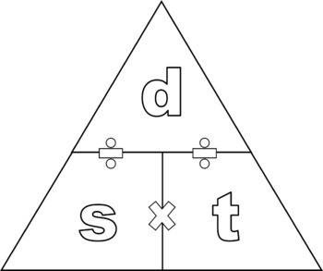
Explain
2. How might you calculate your Balloon Racer’s speed?
Distance = Speed x Time

Slide 11
Explain
Gravity
3. Your Balloon Racer was influenced by a lot of forces during its trip across the zipline. Draw a picture below and label each of these forces and draw an arrow showing the direction of the force.
Friction
Air Resistance
Thrust
Atmospheric Pressure & Elastic Pressure

Slide 12
Elaborate
What is one thing you could change about your Balloon Racer to make it travel faster down the zipline?
Make one change (independent variable) to your Balloon Racer. Then, draw and label the design in the box on your Balloon Racer Investigation Worksheet.
Retest your new balloon racer at least 3 times and calculate its top speed.

Slide 13
Evaluate
How fast did your second design travel compared to your first?
Why do you think it traveled faster/slower based on what you know about the forces acting on your Balloon Racer?
What features make a superior Balloon Racer?

Slide 14
STEM Career: Mechanical Engineer
Mechanical engineers are part of your everyday life, designing the spoon you used to eat your breakfast, your breakfast's packaging, the flip-top cap on your toothpaste tube, the zipper on your jacket, the car, bike, or bus you took to school, the chair you sat in, the door handle you grasped and the hinges it opened on, and the ballpoint pen you used to take your test. Virtually every object that you see around you has passed through the hands of a mechanical engineer.
Mechanical engineers:
- read and interpret blueprints, technical drawings, schematics, or computer-generated reports;
- research, design, evaluate, install, operate, or maintain mechanical products, equipment, systems or processes to meet requirements.
- confer with engineers or other personnel to implement operating procedures, resolve system malfunctions, or provide technical information.
You generally need at least a bachelor's degree in mechanical engineering to enter this field. It takes four or five years to earn a bachelor's degree in engineering.

