Slide 1
Bee A Pollinator

Slide 2
Standard
S2L1: Obtain, evaluate, and communicate information about the life cycles of different organisms.
c. Develop a simple model that depicts an animal’s role in dispersing seeds or in the pollination of plants.

Slide 3
Engage
https://www.youtube.com/watch?v=YZXcksB-Iks

Slide 4
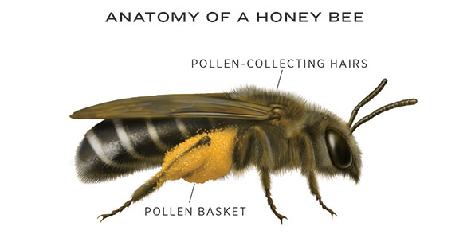
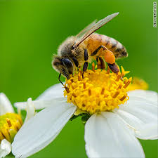
Explore: Build A Bee
Cut out your bee.
Add the three sets of legs by pushing the pipe cleaners through the paper.

Slide 5
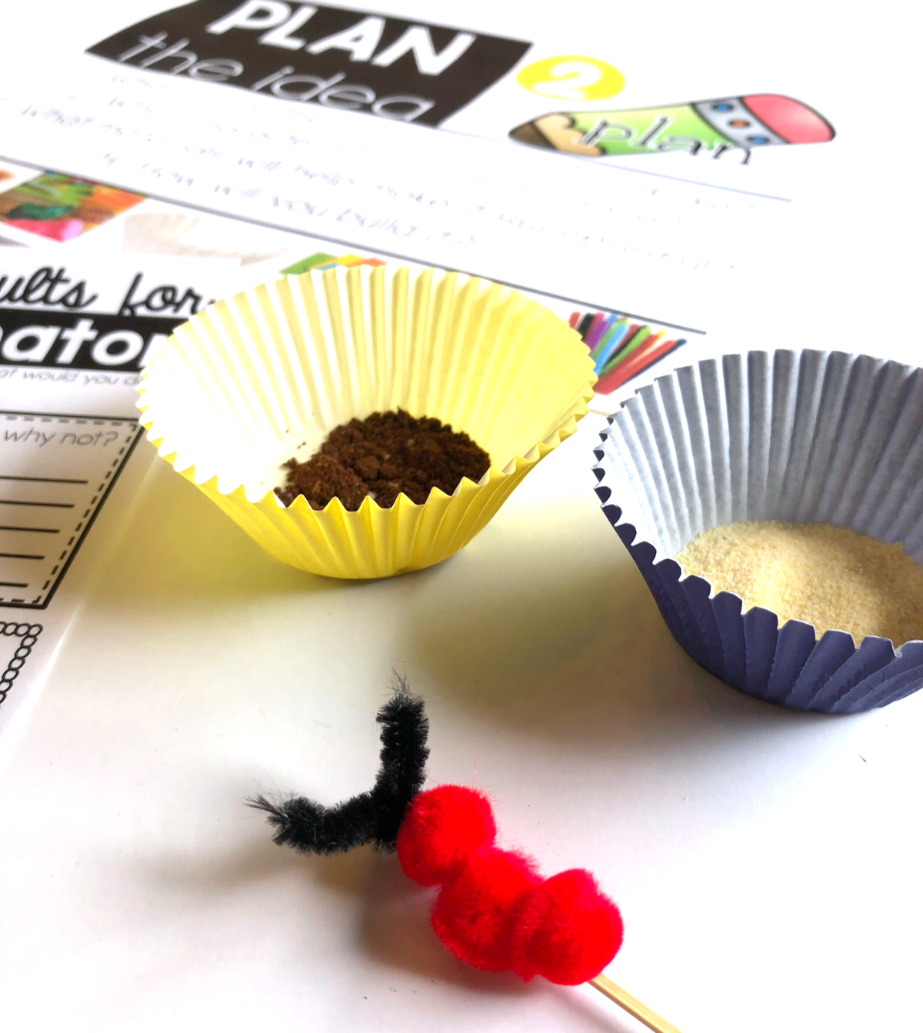
Explore: Set Up your Flowers
Spread out your two muffin cup liners. One will have powdered sugar and the other will have cocoa powder.
Let your bee visit one “flower” and then the other “flower”. Make observations.

Slide 6
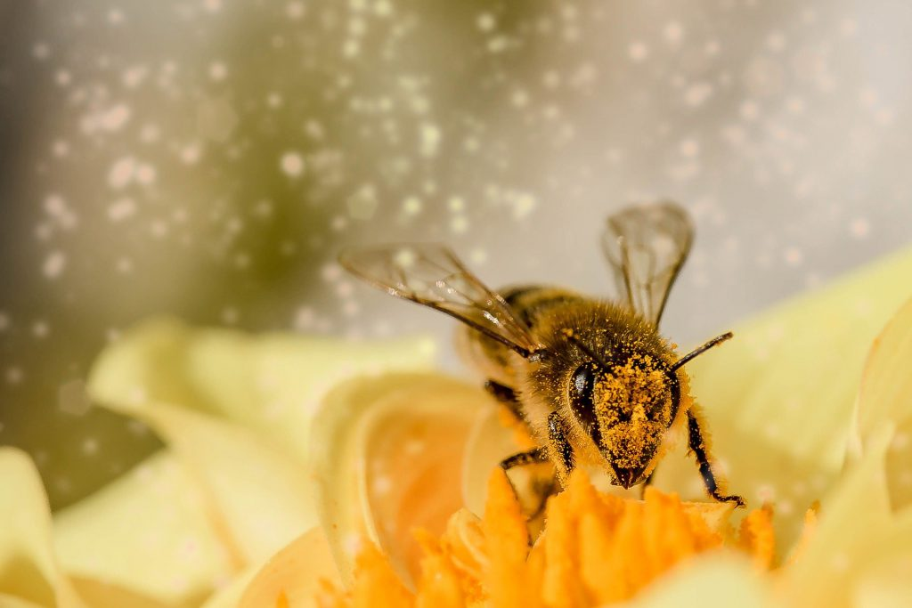
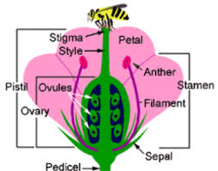
What is Pollination?
Pollination is the transfer of pollen from one flower to another (or the same flower). This allows the plant to make more plants.

Slide 7
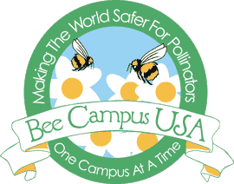
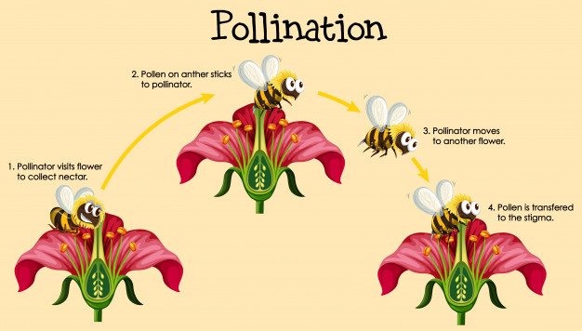
Bees Help with Pollination
Bee CAM

Slide 8
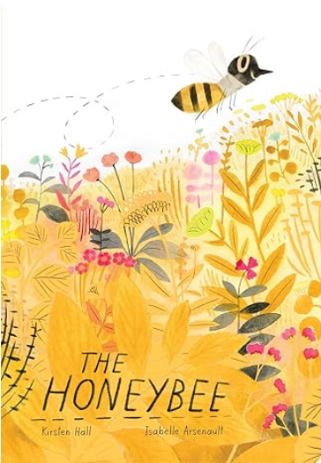
Explain: Read Aloud

Slide 9
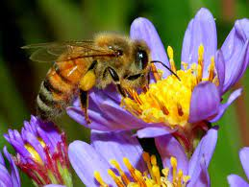
The Honeybee
All fruits and vegetables need some form of pollination to reproduce or make more.
The honeybee is one of the main pollinators in the animal kingdom.
30% of pollination is from honeybees.
However, the honeybee population has been declining by 30-50% in the US.

Slide 10
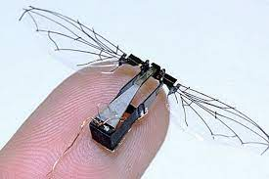
Elaborate: STEM Challenge
The Robotic Honeybee
With the decline of the honeybee population, the robotic honeybee may be a way to aid in pollination. Today, you will be an engineer and redesign you honeybee to make it a better pollinator!
https://wyss.harvard.edu/technology/robobees-autonomous-flying-microrobots/

Slide 11
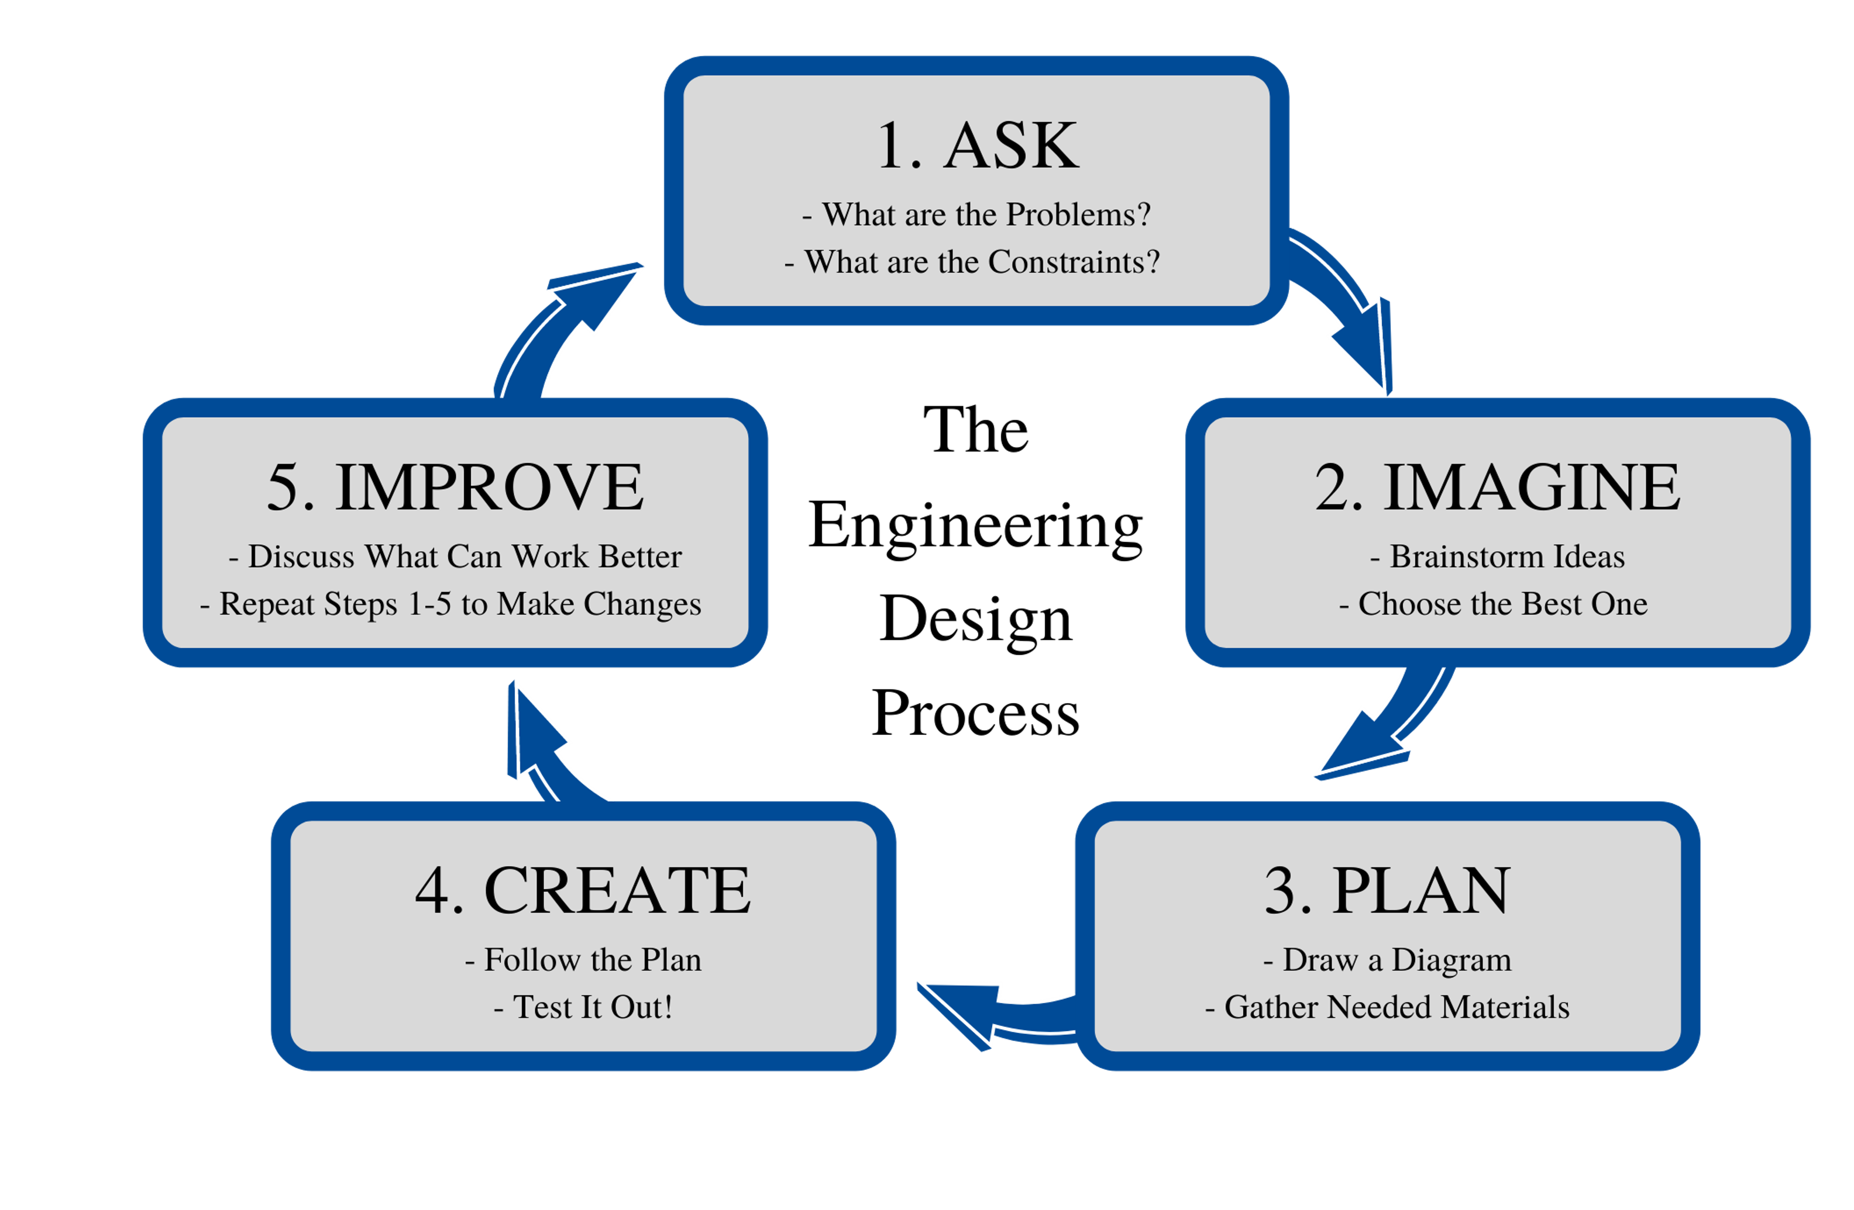
Engineering Design Process

Slide 12
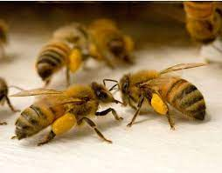
Test Your Honeybee
Did it work better?
If it didn’t work as planned, what could you do next time to make it better?

Slide 13
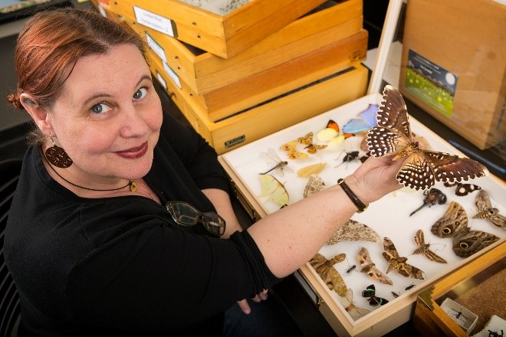
STEM Career: Entomologist
Entomologists study insects, such as ants, bees, and beetles. They also study arthropods, a related group of species that includes spiders and scorpions. Most entomologists specialize in a particular type of insect. Insects outnumber all other forms of life combined and perform functions vital to life on Earth. Consequently, entomologists make many important contributions to scientific knowledge, such as the best ways to pollinate crops, conserve insect species, and protect crops, trees, wildlife, and livestock from pests. Understanding the roles insects play in their environments can also help us restore disturbed ecosystems and clean up contaminated sites. Some entomologists study how climate change will affect insect species and their distributions.
Some entry-level positions are open to candidates with bachelor's degrees in entomology or related scientific fields, such as biology. Entomology programs usually cover insect biology and physiology, pest management, insect-borne diseases, insect taxonomy and morphology, and veterinary entomology.

