Slide 1
Cell Toy

Slide 2
Standard(s)
S7L2. Obtain, evaluate, and communicate information to describe how cell structures, cells, tissues, organs, and organ systems interact to maintain the basic needs of organisms.
Develop a model and construct an explanation of how cell structures (specifically the nucleus, cytoplasm, cell membrane, cell wall, chloroplasts, lysosome, and mitochondria) contribute to the function of the cell as a system in obtaining nutrients in order to grow, reproduce, make needed materials, and process waste.
(Clarification statement: The intent is for students to demonstrate how the component structures of the cell interact and work together to allow the cell as a whole to carry out various processes. Additional structures, beyond those listed, will be addressed in high school Biology.)

Slide 3
Think!
What do you know about cells?

Slide 4
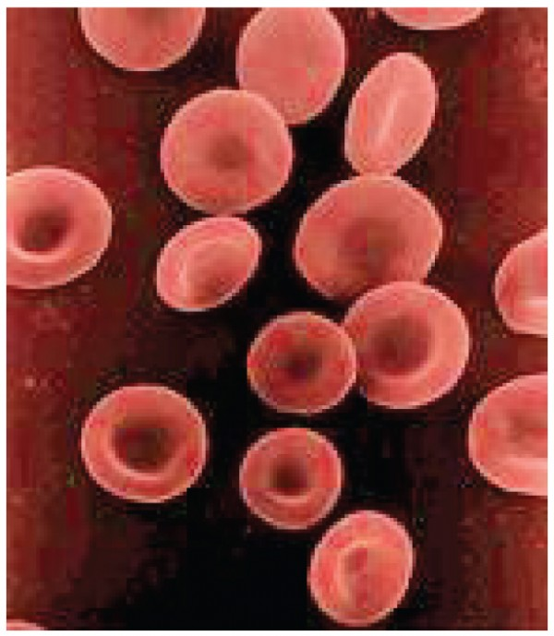
Cells
Cells are the basic units of life.
There are different types of cells:
Animal
Plant
Blood
Brain
Skin
Cancer

Slide 5
Cells
What size would a cell be?
Go to: http://learn.genetics.utah.edu/content/cells/scale/
Slide the bar back and forth to get a view of other items to compare to the actual size of a cell.
Questions to Ponder:
What did you notice about how big a skin cell is compared to a coffee bean?
What about the rhinovirus (common cold virus)?
How does the rhinovirus compare in size to the coffee bean?
How does the rhinovirus compare in size to the skin cell?

Slide 6
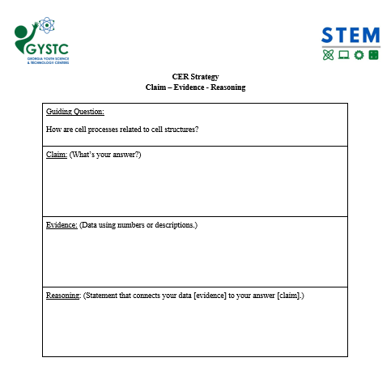
CER
Use the CER template to build your case while learning throughout this unit.

Slide 7
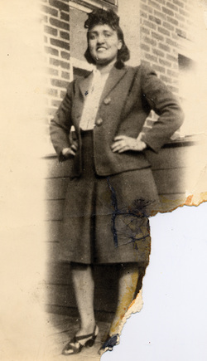
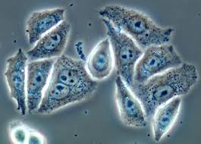
Henrietta Lacks “Immortal” Cells
Read the article, Henrietta Lacks “Immortal” Cells
Why are Ms. Lack’s Cancer cells immortal?

Slide 8
STEM Challenge: Cell Toy
ToyCo, Inc., an international supplier of gizmos, gadgets, and toys for all ages, is in need of a new product. Scientists observe and learn from the world around them. They study naturally formed structures, and then mimic these working systems to improve our daily lives. ToyCo, Inc. has contracted you as an innovative developer to study the components of a cell and design a new product that will entice a specific age group. As a team, analyze the parts that make up a cell, as well as the structure and function of each one of these parts. Then, utilize the engineering design process to generate a toy concept using the same principles that allow a cell to work through form and/or function.
What will be the purpose of your toy?
How will it work?
How will you build it?
What parts will you use and how will those parts compare to those of a cell?

Slide 9
STEM Challenge: Cell Toy Continued
ToyCo, Inc. would like to see at least eight of the most vital cellular components represented within the toy either structurally and/or functionally. Design and build a prototype of your toy. It must be mathematically scaled to size if not presented as actual size.
Finally, create a written proposal and marketing presentation for the board members of ToyCo, Inc. Make sure your presentation is clearly labeled/written, attractive, colorful, well-designed, and scientifically informative. Don’t forget to include a bibliography of your sources.
a.Why should ToyCo, Inc. choose your design?
b.What will you name your product?
c.What makes your toy innovative and unique as well as interesting to the end consumer?
d.What age group will your toy target?
e.How much will it cost the consumer and how much do you predict the company will profit from the sale of each individual unit after construction?

Slide 10
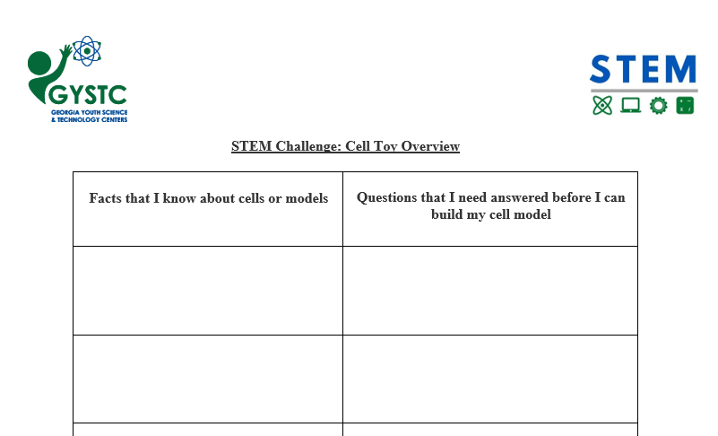
STEM Challenge: Cell Toy Box Chart

Slide 11
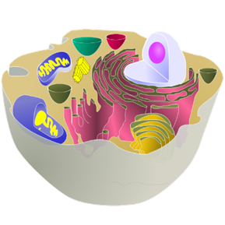
Plant & Animal Cell Organelles & Functions
Nucleus:
Controls the cell
Contains chromosomes
Found in both plant and animal cells
Where cell reproduction (mitosis) begins

Slide 12
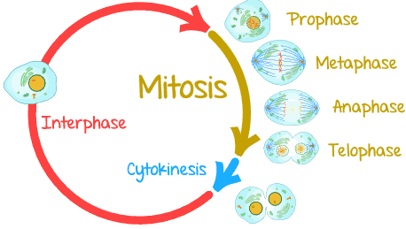
Cell Reproduction

Slide 13
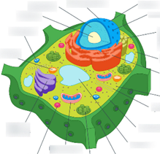
Plant & Animal Cell Organelles & Functions
Cell Wall:
Provides strong, stiff support
Found only in plant cells

Slide 14
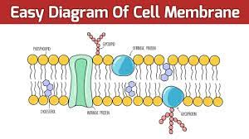
Plant & Animal Cell Organelles & Functions
Cell Membrane:
Controls what comes in and out of the cell (regulates transport)
Protects the cell
Is semipermeable
Found in both plant and animal cells

Slide 15
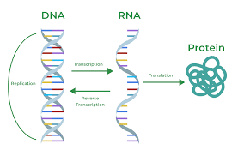
Plant & Animal Cell Organelles & Functions
Ribosomes:
Make proteins
Reads messenger RNA
Found in the cytoplasm and attached to the rough endoplasmic reticulum in plant and animal cells

Slide 16
Plant & Animal Cell Organelles & Functions
Golgi Body:
Prepares proteins and fat molecules for use in other places inside and outside the cell
Found in both plant and animal cells

Slide 17
Plant & Animal Cell Organelles & Functions
Cytoplasm:
Thick liquid that fills the cell
Enclosed by the cell membrane
Cyto = Cell
Plasm = Stuff
Cytoplasm = Cell Stuff
Found in both plant and animal cells

Slide 18
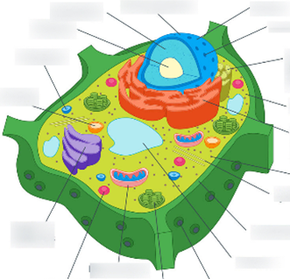
Plant & Animal Cell Organelles & Functions
Cytoskeleton:
Provides support
Tiny microtubules and filaments
Found in plant and animal cells

Slide 19
Plant & Animal Cell Organelles & Functions
Endoplasmic Reticulum:
Delivery system, like a conveyor belt
Smooth ER has no ribosomes attached; Rough ER has ribosomes attached
Found in both plant and animal cells

Slide 20
Plant & Animal Cell Organelles & Functions
Mitochondria:
Powerhouse of the cell – generates energy in the form of ATP
Found in plant and animal cells

Slide 21
Plant & Animal Cell Organelles & Functions
Chloroplasts:
Captures sunlight
Where photosynthesis takes place
Found only in plant cells

Slide 22
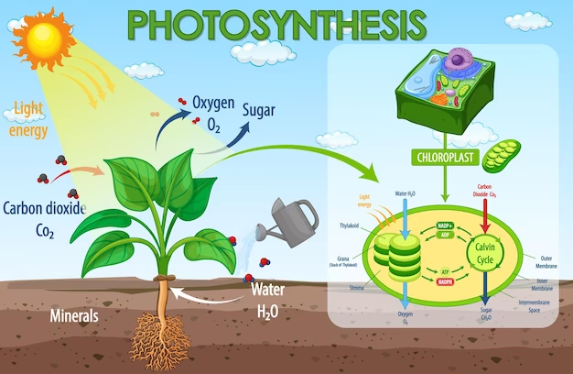
Photosynthesis

Slide 23
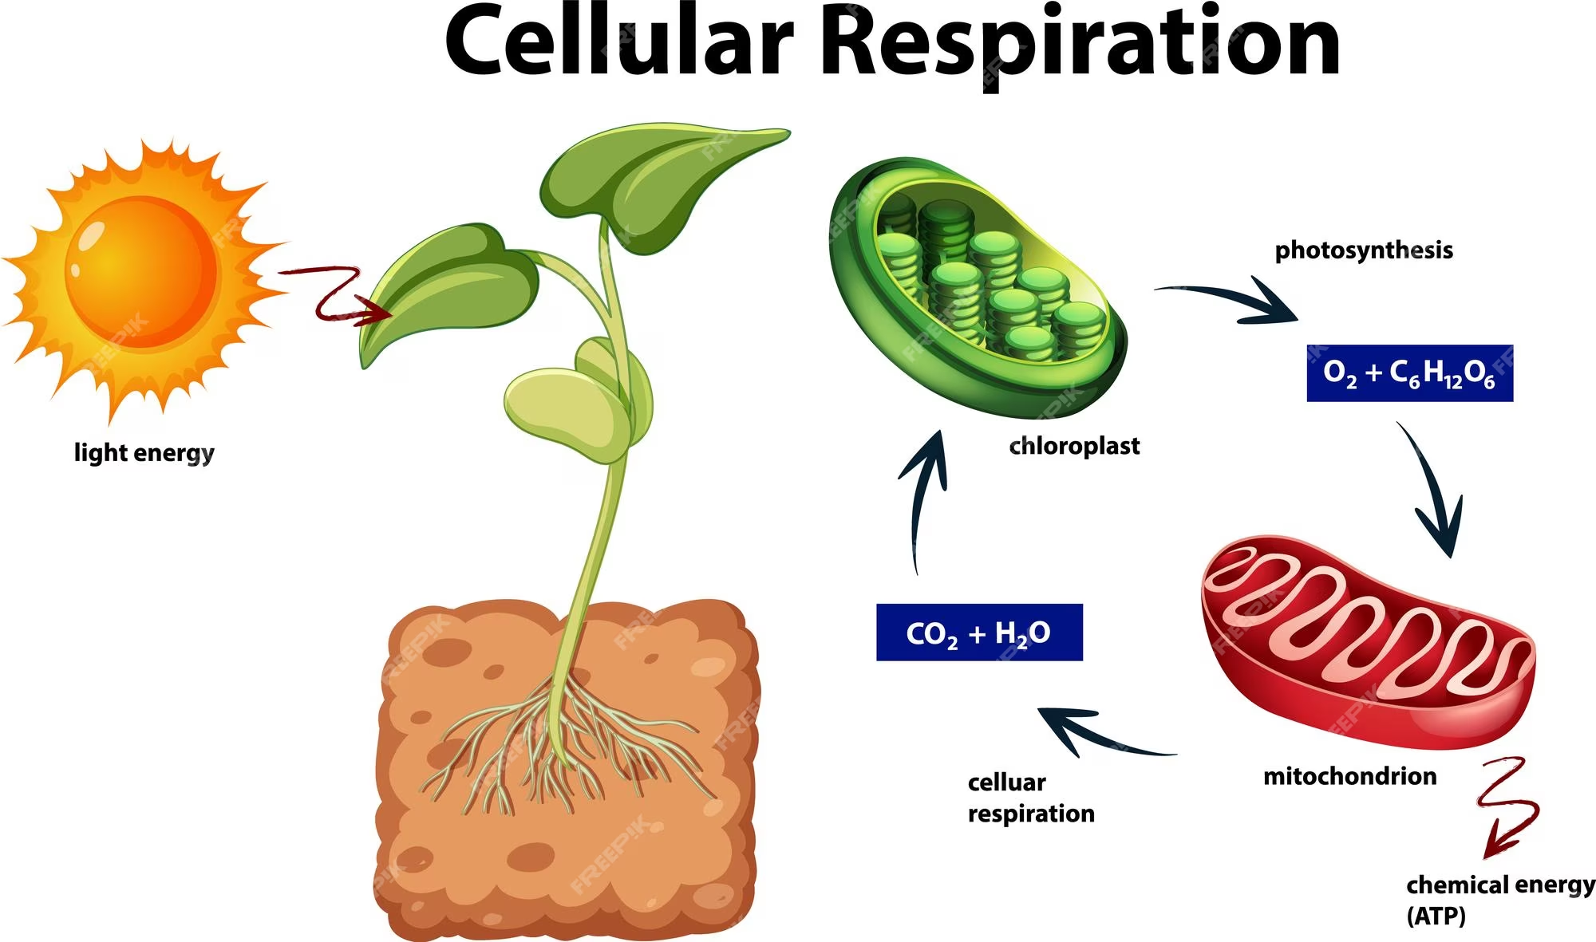
Cellular Respiration

Slide 24
Plant & Animal Cell Organelles & Functions
Vesicle:
Sack that acts as a package to transport materials
Found in both plant and animal cells

Slide 25
Plant & Animal Cell Organelles & Functions
Vacuole:
Stores food and water
Found in both plant and animal cells (larger in plant cells)

Slide 26
Plant & Animal Cell Organelles & Functions
Lysosomes:
Breaks down worn out organelles
Gets rid of waste
Found only in animal cells

Slide 27
Sketch a Plant Cell & Animal Cell
Using the Eukaryotic Cells Organelle Chart, sketch an animal cell and label the organelles.
Next sketch a plant cell and label the organelles.
Highlight the organelles that are found in a plant cell.
List a function for each organelle.

Slide 28
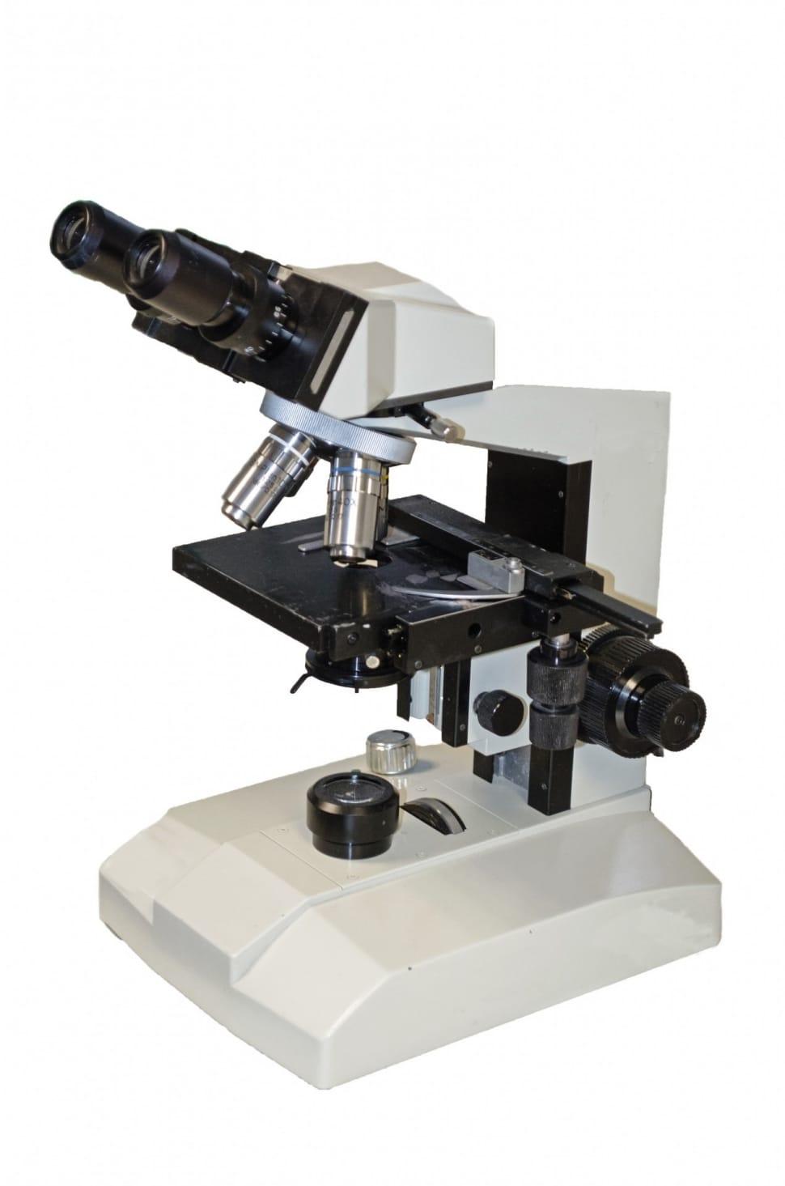
Microscope Lab
Using your microscope, observe the plant and animal cells.
Compare and contrast your drawings.

Slide 29
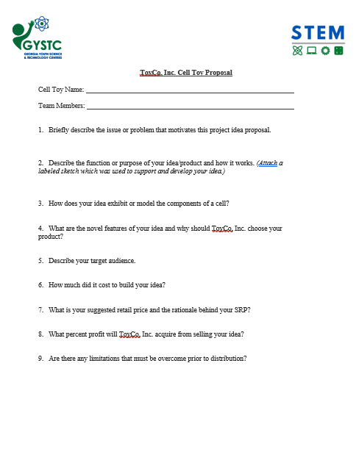
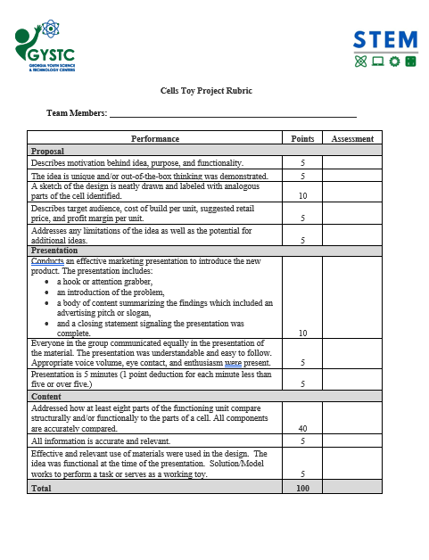
STEM Challenge: Cell Toy
Refer back to the STEM Challenge: Cell Toy Overview.
Use the Cell Toy Proposal, the Cell Toy Project Rubric, and the Engineering Design Process to develop a toy that represents a cell.

Slide 30
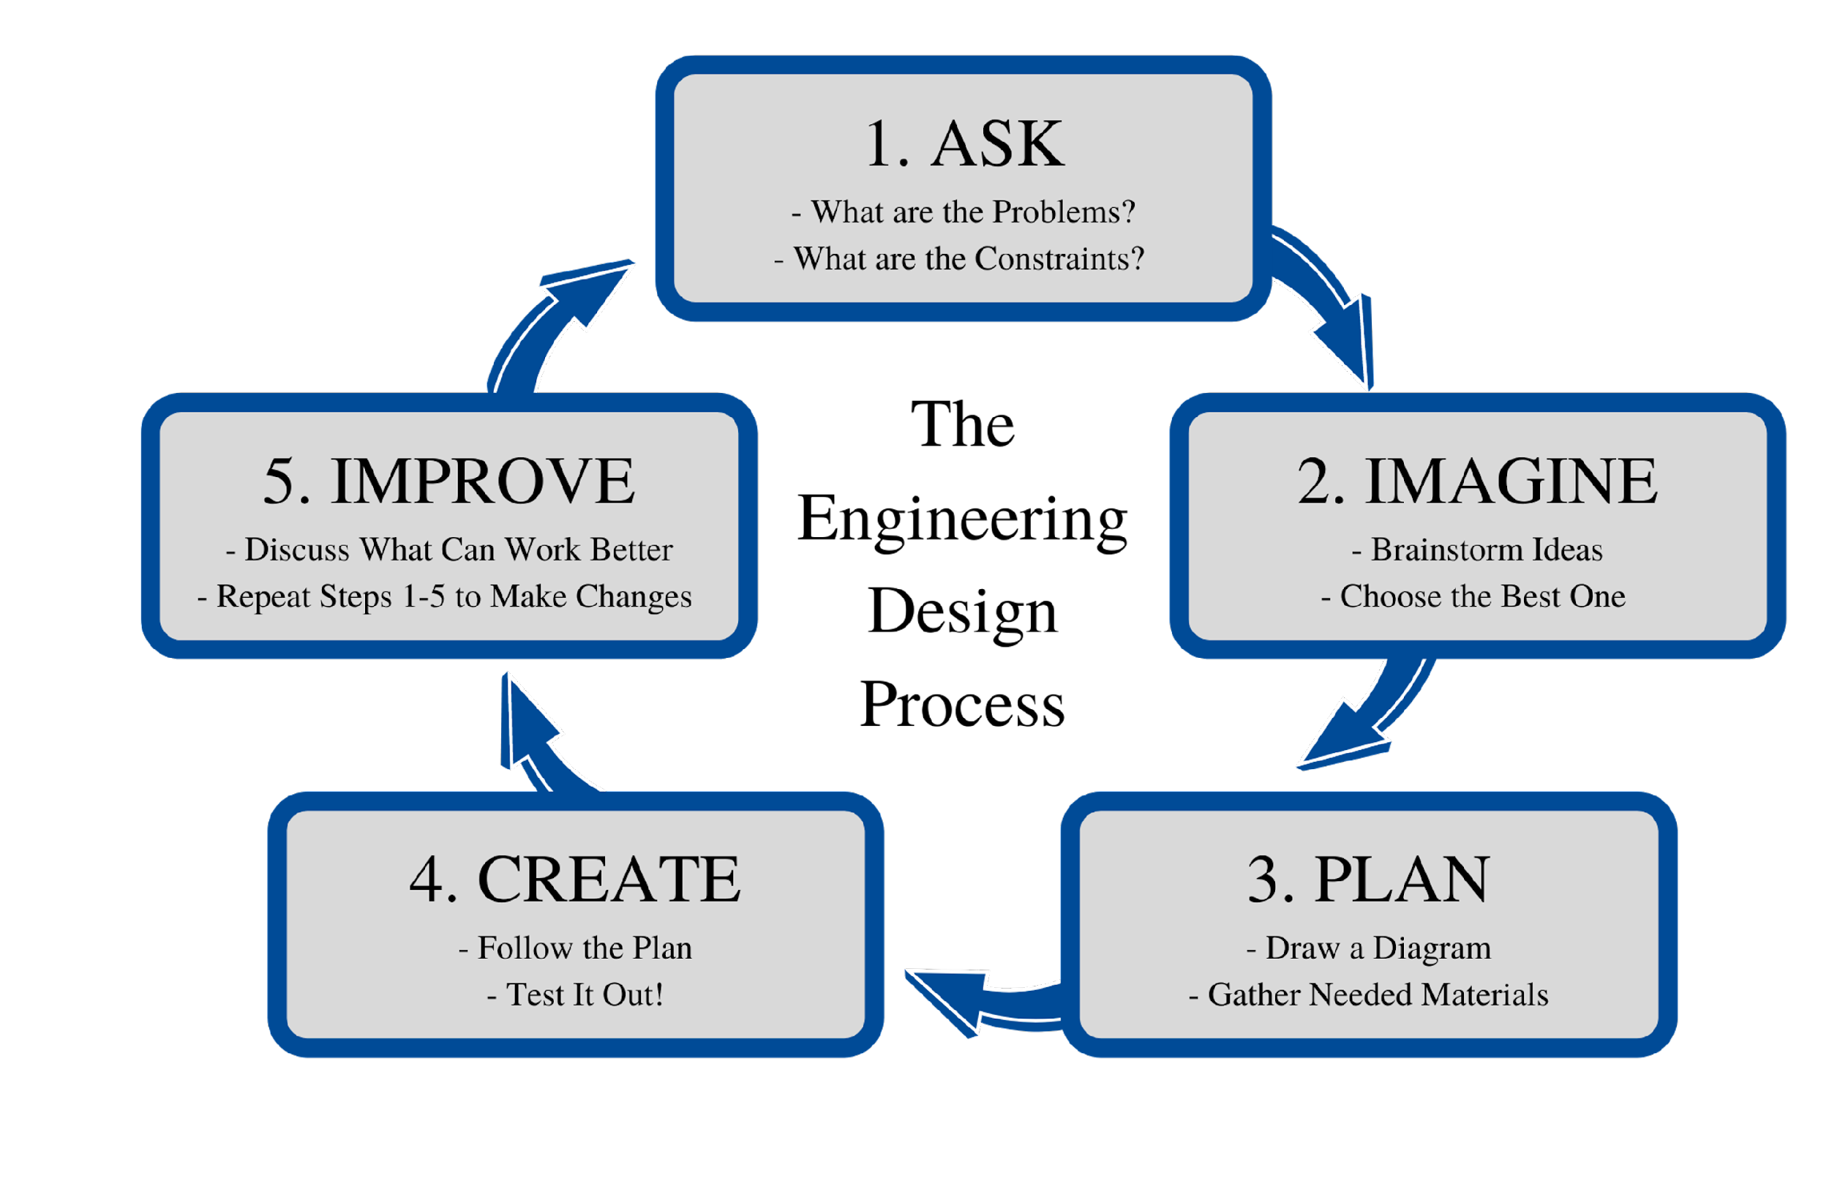
Engineering Design Process
Ask: What is the problem we are trying to solve?
Imagine: Brainstorm ideas.
Plan: On a piece of paper, draw a picture of your idea.
Create: Build your toy!
Improve: Is there anything that you could do to make your toy even better?

Slide 31
STEM Career: Medical Doctor
Medical doctors work to ease physical and mental suffering due to injury and disease. They diagnose medical conditions and then prescribe or administer appropriate treatments. Medical doctors also seek to prevent medical problems in their patients by advising preventative care. Ultimately, medical doctors try to help people live and feel better at every age.
Formal education and training requirements for medical doctors are among the most demanding of any occupation—4 years of undergraduate school, 4 years of medical school, and 3-8 years of internship and residency, depending on the specialty selected. A few medical schools offer combined undergraduate and medical school programs that last 6 years, rather than the customary 8 years.
Premedical students must complete undergraduate work in physics, biology, mathematics, English, and inorganic and organic chemistry. Students also take courses in the humanities and the social sciences. Some students volunteer at local hospitals or clinics to gain practical experience in the health professions.

