Slide 1
Classifying Pollinators

Slide 2
Standard(s)
S7L1. Obtain, evaluate, and communicate information to investigate the diversity of living organisms and how they can be compared scientifically.
a. Develop and defend a model that categorizes organisms based on common characteristics.

Slide 3
What’s All the Buzz?
https://www.ega.edu/about/sustainability/bee-campus/bee-cam.html

Slide 4
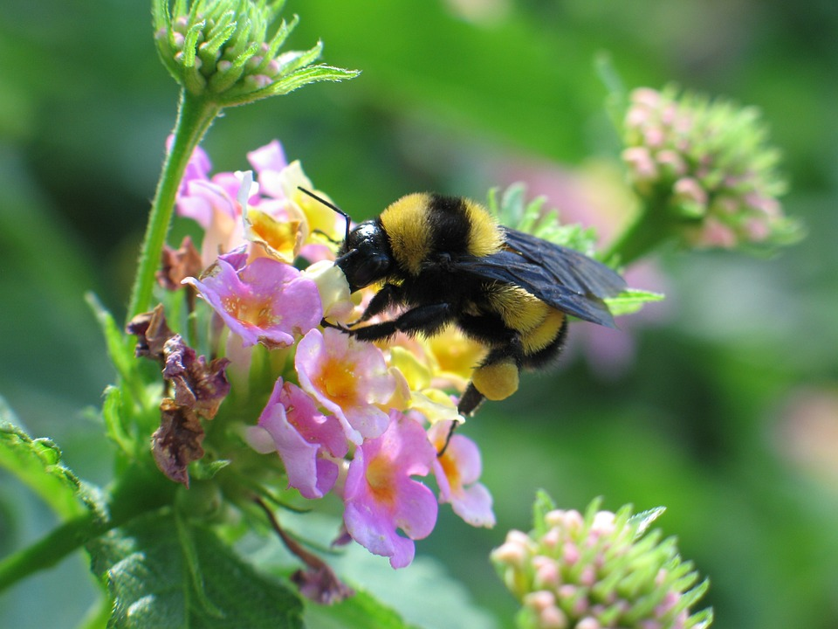
Bees
How many different types of bees are there?

Slide 5
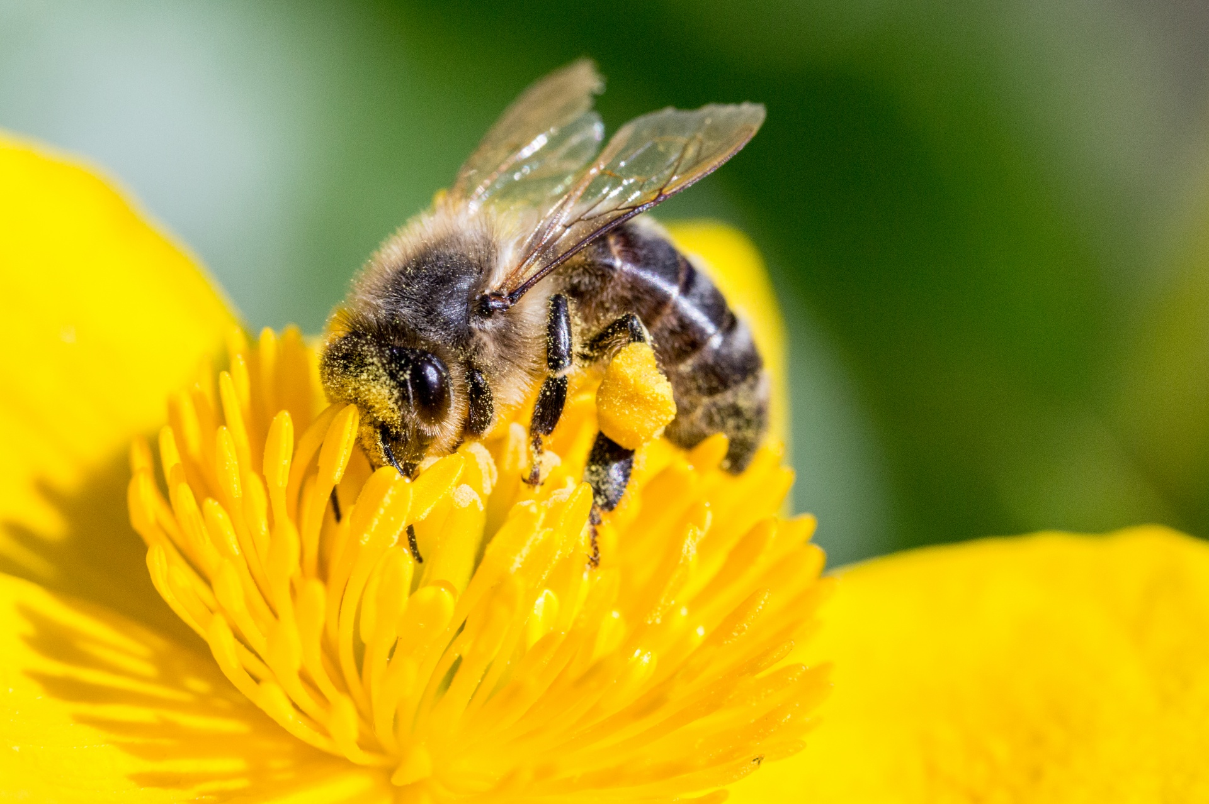
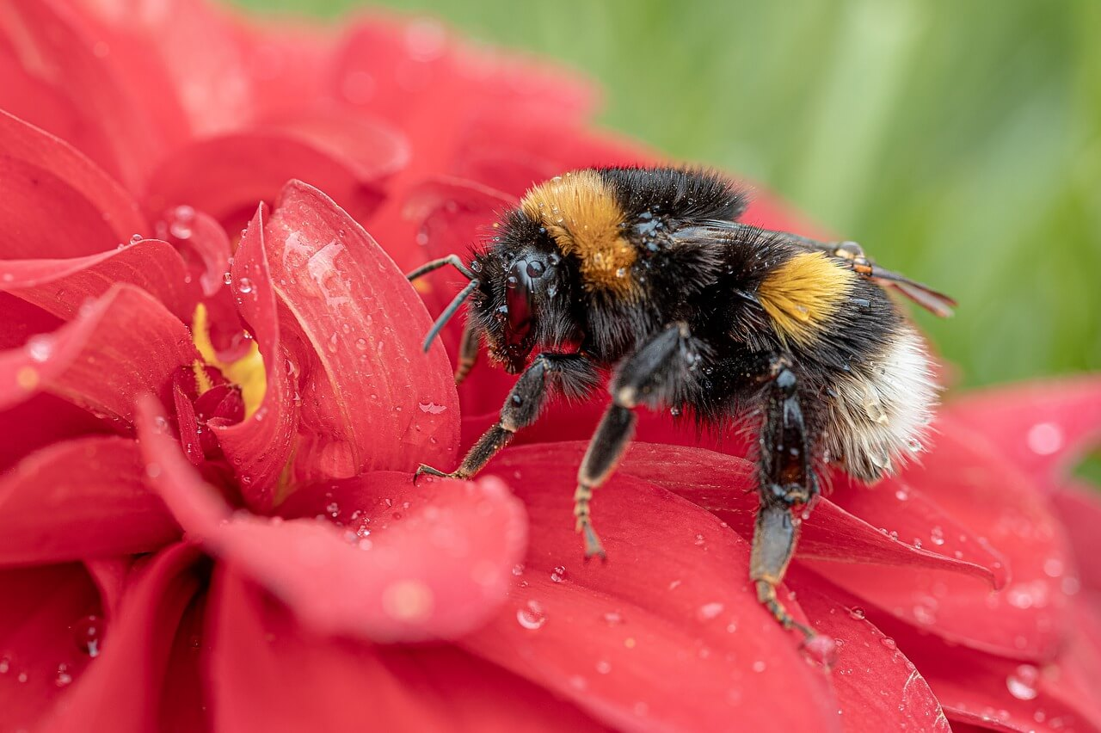
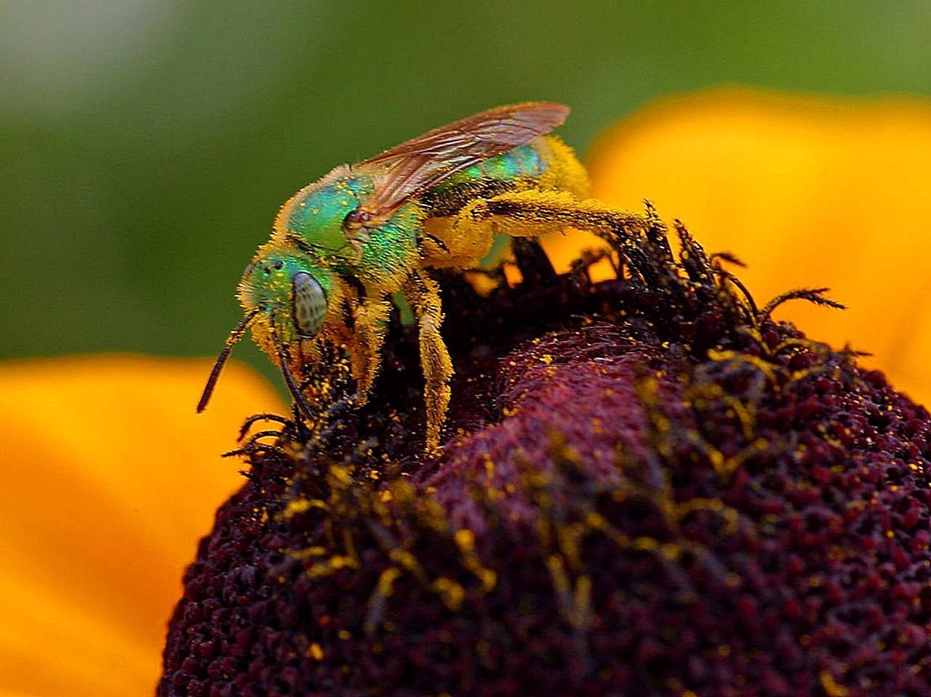
Bees
There are over 20,000 bee species worldwide. In North America, there are 4,000 species that live in a wide range of ecosystems from forests to deserts to grasslands.
Think:
How do scientists compare the different types of bees?
How do scientists organize all the information about bees?

Slide 6
Biological Diversity
Earth has an astounding amount of biological diversity. Over the course of history, humans have come up with various ways to organize or classify it. Living organisms can be classified by overall similarities, color, function, etc. The most useful way that scientists have grouped organisms is through shared evolutionary history. In this way, groups are not only organized but also convey information about the groups’ evolutionary history.

Slide 7
Bees
Kingdom
Animalia
Phylum
Arthropoda
Class
Insects
Order
Hymenoptera
Family
Andrenidae, Apidae, Colletidae, Hailctidae, Megachilidae, Melittidae, & Stenotritidae (only in Australia)
The Apidae family is the largest family of bees with over 6,000 species including the honeybee and 300 types of bumblebees. Scientists can document that this family began between 115 and 95 million years ago, thanks to the fossil record.

Slide 8
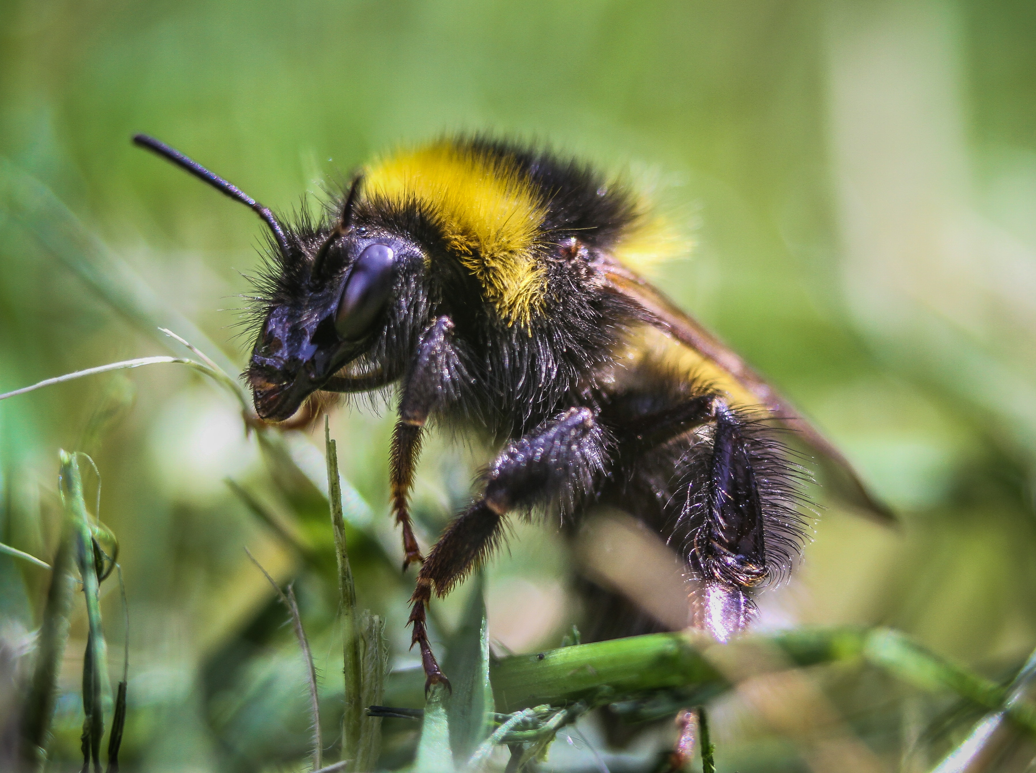
Objective
Today, you are going to look at some pictures of different bee species and classify them using a dichotomous key.

Slide 9
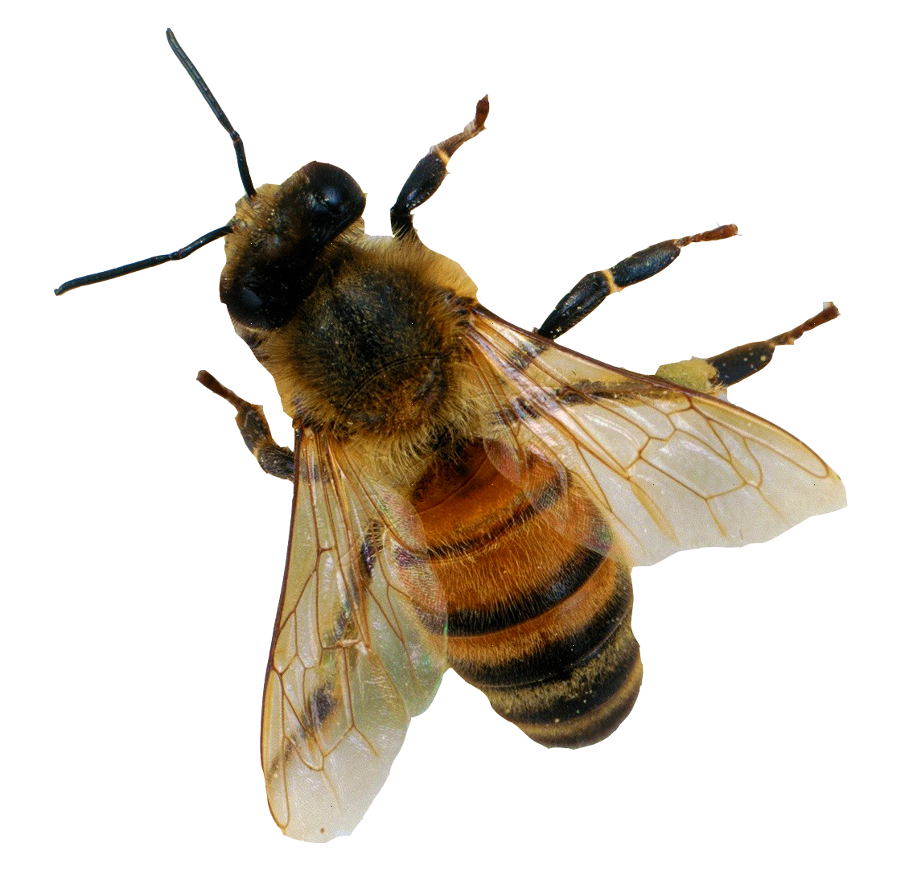
Activity
Procedure:
You will need a set of bee photographs, a Bee Dichotomous Key, a Classifying Pollinators Recording Sheet, a ruler, and a magnifying glass.
Using the Bee Dichotomous Key try to identify the species of bee in the picture.
Identify the species and your justification for the bee identification.

Slide 10
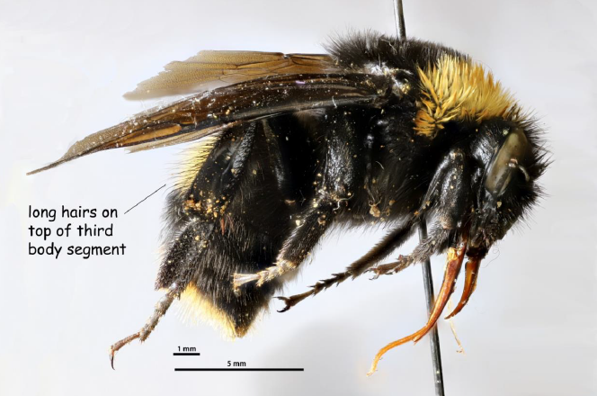
Bee #1
Bombus sp. (bumblebee)
Bumblebees (genus Bombus) are the most easily seen bees after European honeybees, mostly due to their larger size.
There are over 250 known species worldwide that can mostly be identified by the black hair with different patterns of yellow, orange, or white stripes.
Most bumblebees are social insects that form small colonies with a single queen.
[image: Bombus crotchii, UCSB-IZC00033148]

Slide 11
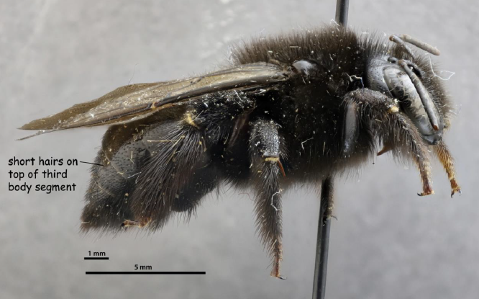
Bee #2
Xylocopa sp. (carpenter bee)
Carpenter bees (genus Xylocopa) get their name from their behavior of burrowing into hard plant material, such as wooden planks or bamboo.
Carpenter bees are mostly solitary bees, but some species live in simple nests with their daughters and sisters.
[image: Xylocopa tabaniformis orpifex, UCSB-IZC00012184]

Slide 12
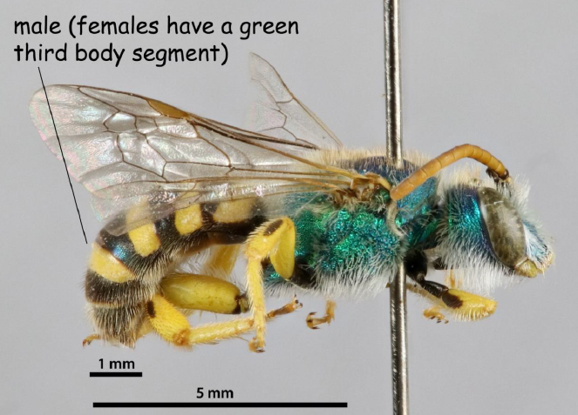
Bee #3
Agapostemon texanus (ultra-green sweat bee)
Sweat bees (family Halictidae) get their name from coming to and drinking human sweat to get salt for nutrition.
The ultra-green sweat bee (Agapostemon texanus) is the most common species of Western Hemisphere sweat bees.
Ultra-green sweat bees nest in the ground, sometimes in groups, but without division of labor such as single queens and workers.
[image: UCSB-IZC00028349]

Slide 13
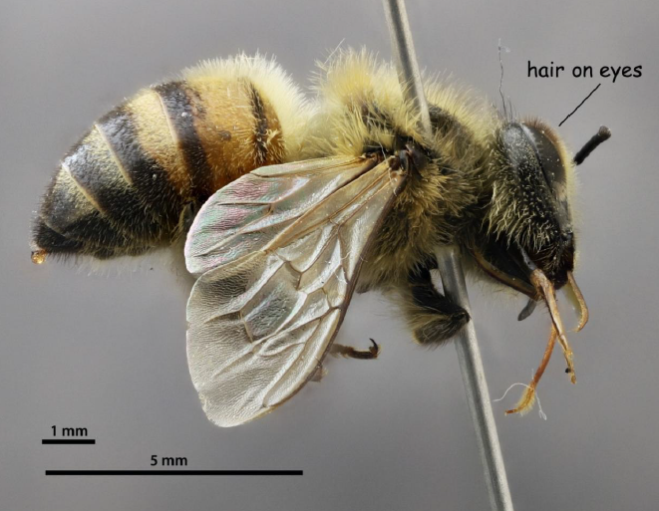
Bee #4
Apis mellifera (European honeybee)
European honeybees (Apis mellifera), also known as western honeybees or just as honeybees, are the most well-known bee species around the world. They are native to the Eastern Hemisphere but were domesticated and brought all over the world by people to be used in pollinating farmers’ crops.
The Africanized honeybee is a more aggressive hybrid of multiple subspecies of the European honeybee.
Honeybees have the most recognizable social insect system, with a single queen commanding up to thousands of her daughters as workers in the colony.
[image: UCSB-IZC00009350]

Slide 14
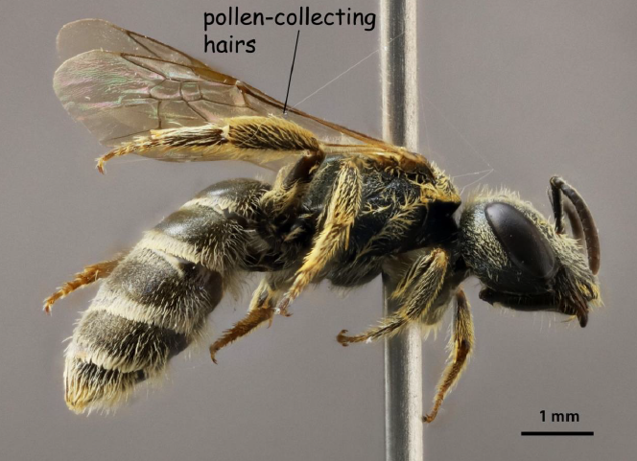
Bee #5
Halictus sp. (furrow bee)
Furrow bees (genus Halictus) are a genus in the family of sweat bees (family Halictidae). They do not produce honey, but they are important pollinators.
There are over 200 species of furrow bees worldwide.
Many furrow bees are social insects, with colony sizes from two to two hundred individuals.
[image: Halictus tripartitus, UCSB-IZC00037432]

Slide 15
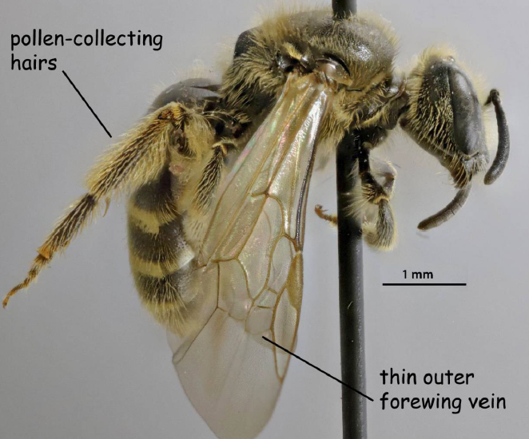
Bee #6
Lasioglossum sp. (metallic-sweat bee)
Small sweat bees of the genus Lasioglossum are important and diverse native pollinators.
The genus Lasioglossum is the largest bee genus with over 1,700 species worldwide.
Sweat bees of this genus can be solitary or social depending on the species. The largest colonies have hundreds of workers.
[image: Lasioglossum (Evylaeus), UCSB-IZC00035588]

Slide 16
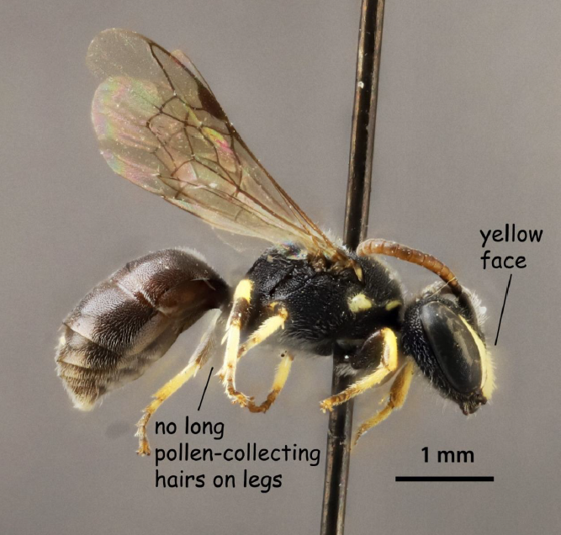
Bee #7
Hylaeus sp. (yellow-faced bee)
The yellow-faced bees (genus Hylaeus) are very small wasp-like bees. They still gather pollen from plants, but they store it inside their body in a crop instead of on their legs or third body segment like other bees.
There are more than 500 species of yellow-faced bees worldwide.
Yellow-faced bees are solitary insects that nest in twigs, hollow grass stems, and other natural cavities.
[image: Hylaeus polifolii, UCSB-IZC00035468]

Slide 17
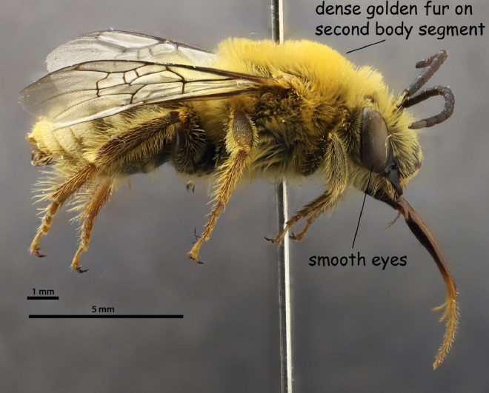
Bee #8
Peponapis pruinosa (pruinose squash bee)
The pruinose squash bee (Peponapis pruinosa) are efficient and important pollinators of squash plants, especially in the plant genus Cucurbita which includes pumpkins.
This species of squash bee has spread throughout North America as humans grow more squash for food.
Pruinose squash bees are solitary bees that nest in the ground. Males wait inside squash flowers to mate with the females that visit.
[image: UCSB-IZC0008718]

Slide 18
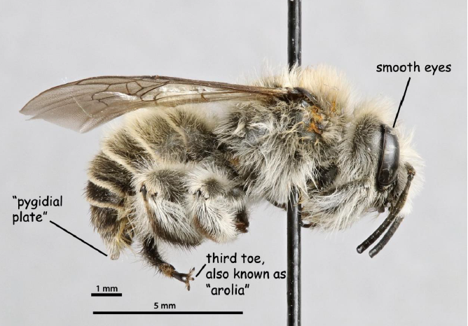
Bee #9
Diadasia bituberculata (chimney bee)
Chimney bees (tribe Emphorini) are named for the turret-shaped nests that some species make in the ground. Many species are pollen specialists.
The chimney bee species specializes in pollinating the trumpet-shaped flowers of bindweed and morning glory plants.
The chimney bees nest in groups, with many entrance holes in clusters on the ground.
[image: UCSB-IZC00034398]

Slide 19
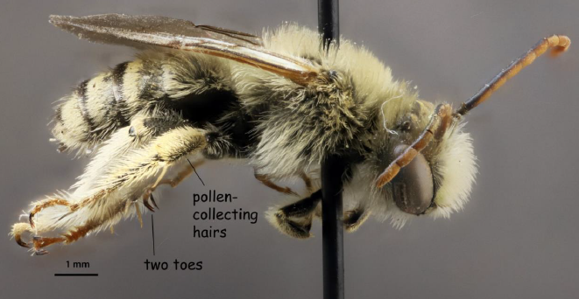
Bee #10
Melissodes tepida timberlakei (long-horned bee)
Long-horned bees of the genus Melissodes get their name from the males having long antennae.
There are at least 140 species worldwide in the genus Melissodes.
Long-horned bees are solitary bees. The females nest in the ground and the males sleep in or on flowers at night.
[image: UCSB-IZC00034457]

Slide 20
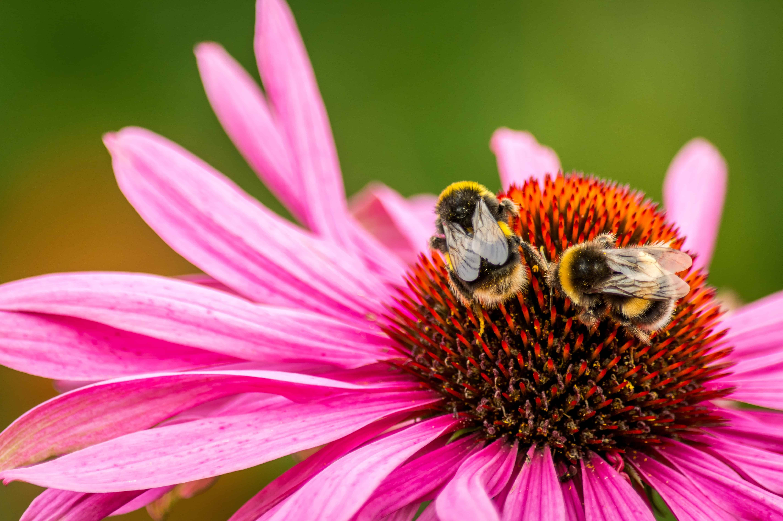
The Big Idea
In order to understand bees today, we have to learn about their origins and how they’ve changed over time. Scientists examine bee anatomy, behavior, genetic data, and explore the fossil record to do just that.
Today, we have seven species of bee families that share traits and evolutionary history. From the seven families, they are further divided into 28 subfamilies. These subfamilies are unique in anatomy and biology ich set them apart from each other. Scientists use classification to help them organize and communicate this information.
Currently, there are 542 species listed in Georgia.

Slide 21
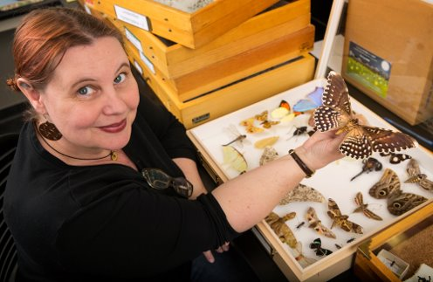
STEM Career: Entomologist
Entomologists study insects, such as ants, bees, and beetles. They also study arthropods, a related group of species that includes spiders and scorpions. Most entomologists specialize in a particular type of insect. Insects outnumber all other forms of life combined and perform functions vital to life on Earth. Consequently, entomologists make many important contributions to scientific knowledge, such as the best ways to pollinate crops, conserve insect species, and protect crops, trees, wildlife, and livestock from pests. Understanding the roles insects play in their environments can also help us restore disturbed ecosystems and clean up contaminated sites. Some entomologists study how climate change will affect insect species and their distributions.

Slide 22
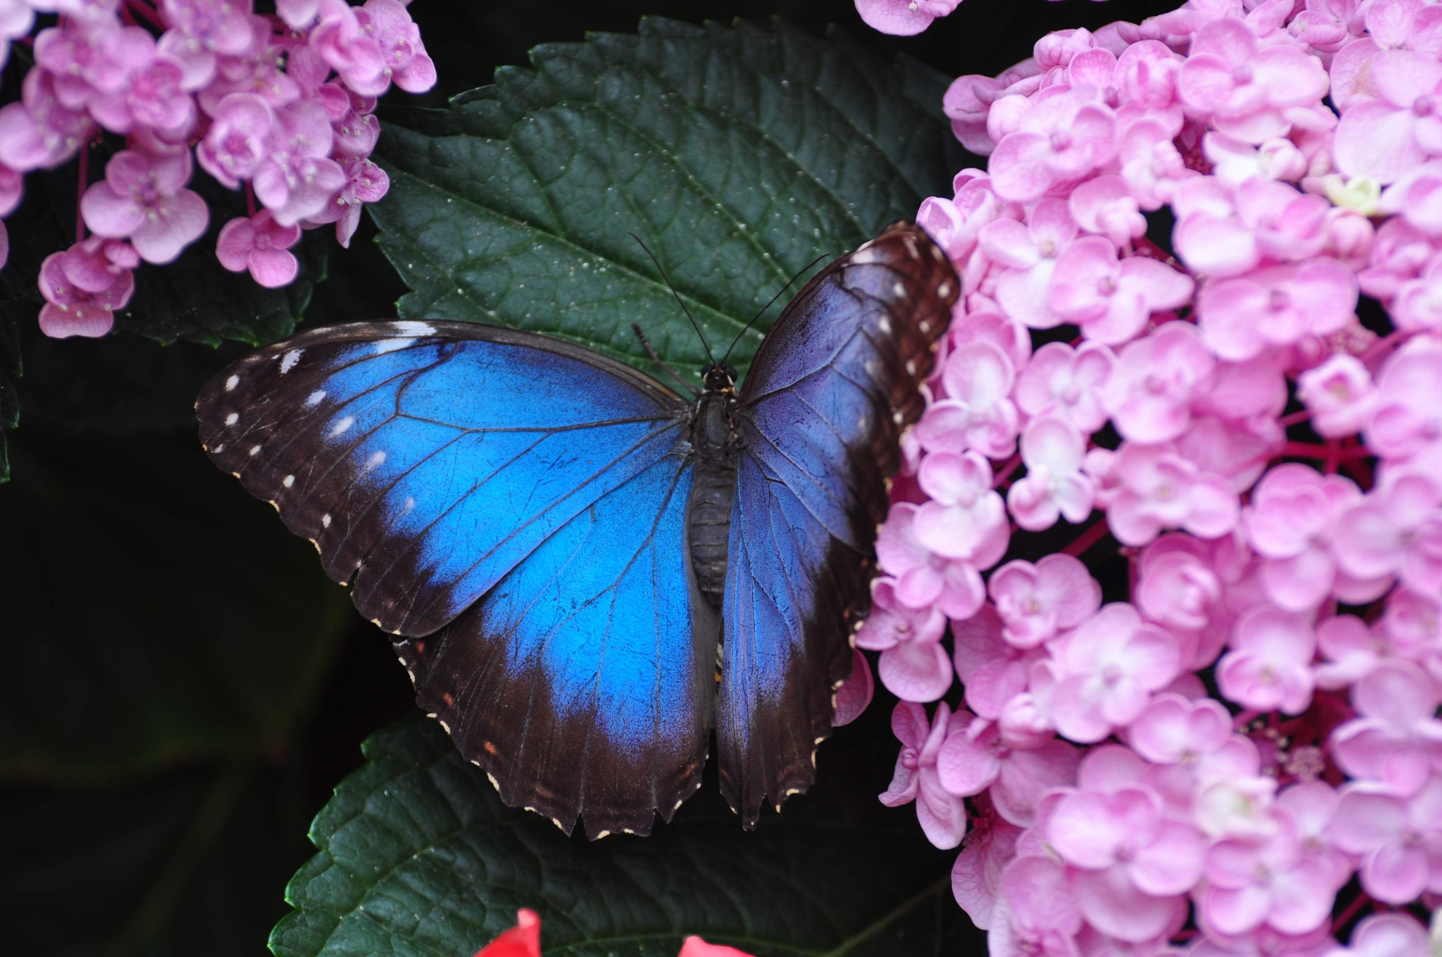
Elaboration
Bees are not the only types of pollinators we have. Research another type of pollinator in Georgia, like butterflies, and see how many different species you can identify.

