Slide 1
Electromagnets

Slide 2
Standard(s)
S8P5. Obtain, evaluate, and communicate information about gravity, electricity, and magnetism as major forces acting in nature.
c. Plan and carry out investigations to identify the factors (e.g., distance between objects, magnetic force produced by an electromagnet with varying number of wire turns, varying number or size of dry cells, and varying size of iron core) that affect the strength of electric and magnetic forces. (Clarification statement: Including, but not limited to, generators or motors.)

Slide 3
Watch This!

Slide 4
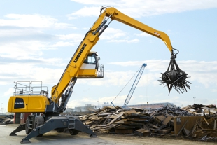
Think!
What did you see happening?
How do you think that works?

Slide 5
Let’s review!

Slide 6
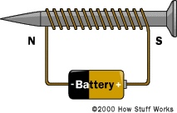
What is an electromagnet?
A temporary magnet that has coils of current carrying wire around a metal core.
A magnet that runs on electricity

Slide 7
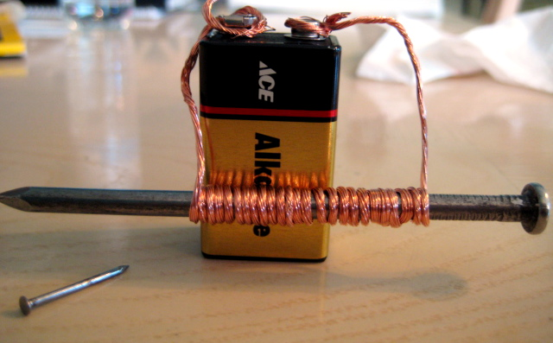
Hypothesize:
How will changing these components affect the strength of your electromagnetic:
the core material
the number of coils
the number of batteries
On your Electromagnet Data Sheet, predict how these changes will affect the strength of the electromagnet.

Slide 8
Investigate
In your groups of 3-4, collect the materials for the investigation.
For the first trial, construct an electromagnet with one 1.5-volt battery and 5 coils of wire wrapped tightly around a bolt core. Record the strength of the electromagnet by writing down the number of large paper clips picked up on the Electromagnet Data Sheet.
Repeat the investigation with the air core (straw) and wood core (dowel). Record the results.
For the second and third trials, increase the number of coils by 10 each time. Record the results.
Repeat the investigation with an additional battery and record the results.

Slide 9
Discuss
Was your hypothesis supported by your observations during your investigation?

Slide 10
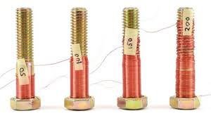
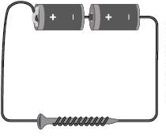
Electromagnets
An electromagnet is a temporary magnet — the magnetic field only exists when the electric current flows.
You can determine the strength of the magnetic force by adjusting the current flowing through the electromagnet by increasing the number of coils around the core or increasing the power source.

Slide 11
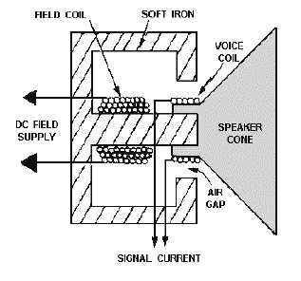
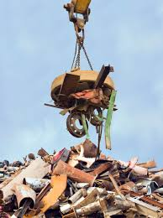
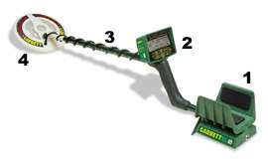
Electromagnets at Work
We can find electromagnets in:
cranes
doorbells
metal detectors
motors
MRI machines
phones
speakers
trains

Slide 12
STEM Career: MRI Technician
Electromagnets are used in magnetic resonance imaging (MRI) machines to create a magnetic field around a patient and look inside a patient’s body. Magnetic forces send radio waves throughout a patient’s body and create pictures of the tissues. MRI technicians are responsible for preparing and executing an MRI procedure. Not only do they explain the procedure to the patient, but they also help move the patient onto the MRI platform. Once the MRI procedure is complete, technicians develop the images and pass them on to physicians.

Slide 13
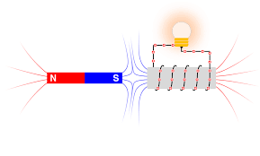
Extension
Java Lab Simulations

Slide 14
Evaluation
Using the C-E-R Model (Claim, Evidence, Reasoning), answer the following question using evidence from your investigation:
Three students build electromagnets using three 1.5-volt batteries and 25 coils of wire wrapped tightly around a core. Student A uses an air core, Student B uses a bolt core, and Student C uses a wood core. Which electromagnet will be the strongest and why?

