Slide 1
Glo Germs

Slide 2
Standards
S5L4. Obtain, evaluate, and communicate information about how microorganisms benefit or harm larger organisms. (Clarification statement: Possible microorganisms could include Tardigrades, Lactobacillus, Probiotics, Rotifers, Salmonella, Clostridium botulinum (Botox), E-coli, Algae, etc. Students are not expected to know these specific microorganisms. The list is provided to give teachers examples.) ​
a. Construct an argument using scientific evidence to support a claim that some microorganisms are beneficial. ​
b. Construct an argument using scientific evidence to support a claim that some microorganisms are harmful.

Slide 3
Watch This!
https://www.facebook.com/ChathamCounty/videos/slow-motion-sneeze/556767678313367/

Slide 4
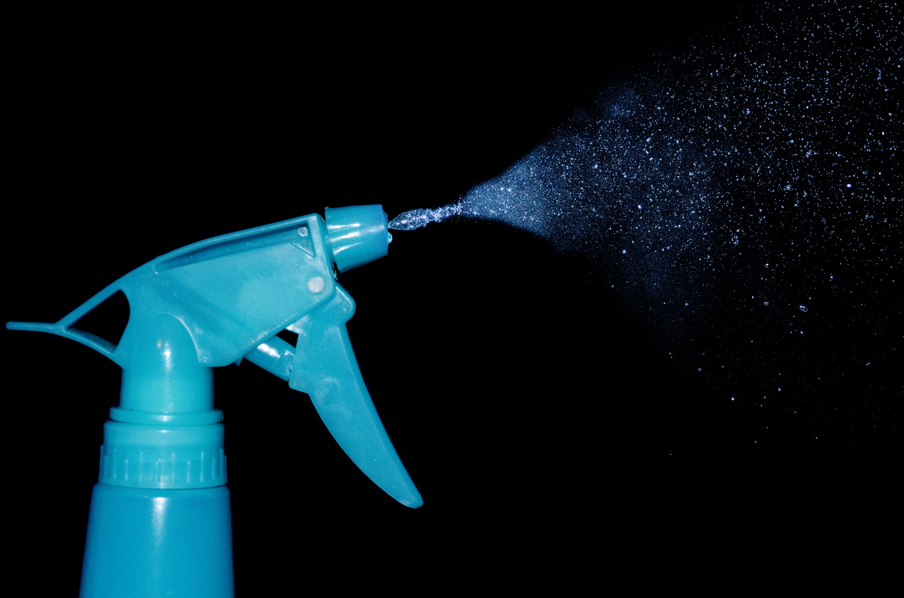
Let’s Try It
Raise your hand if you felt water land on you.
How far did our “sneeze” travel?

Slide 5
How Do Germs Spread?

Slide 6
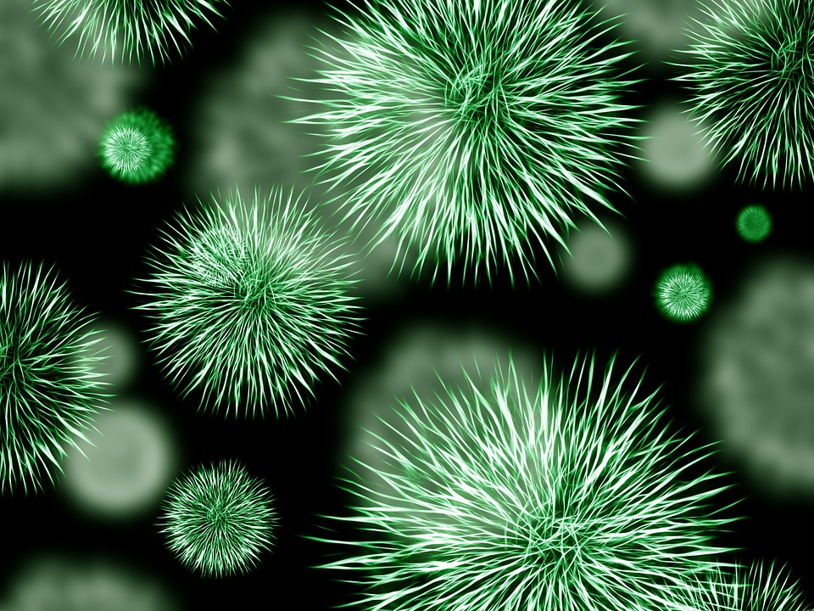
Investigate
You will be put into one of four groups:
Do Nothing
Wash Hands with Water
Wash Hands with Water & Soap
Use Hand Sanitizer
Rub some Glo-Germ into your hands. Then, follow the directions for your group.
Let’s look for germs!

Slide 7
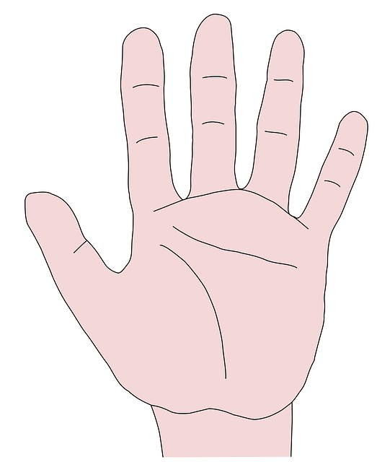
Follow-Up
Which method worked best for preventing the spread of germs?
Where were most of the germs found?

Slide 8
What do you think microorganisms are?

Slide 9
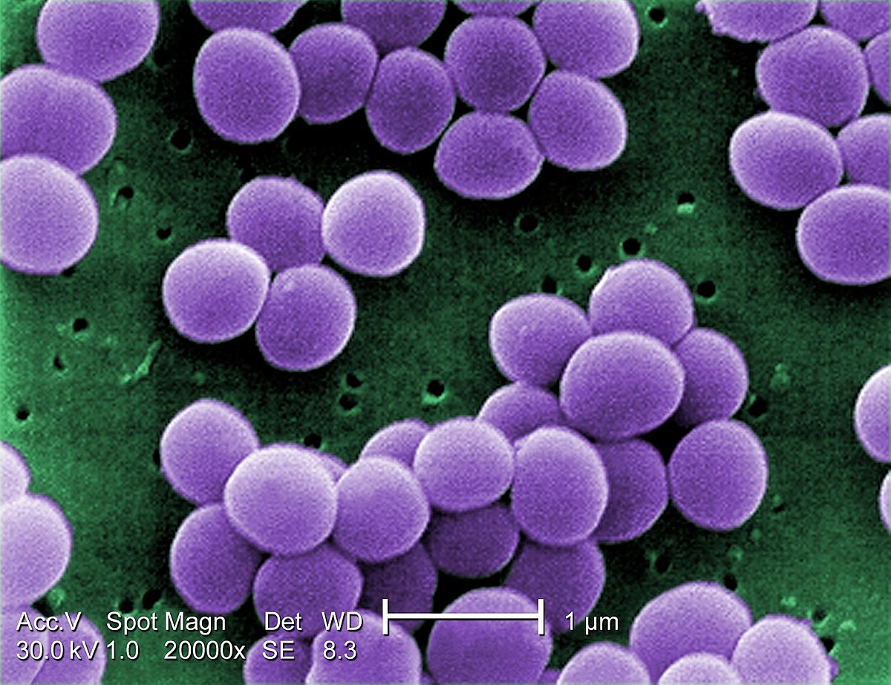
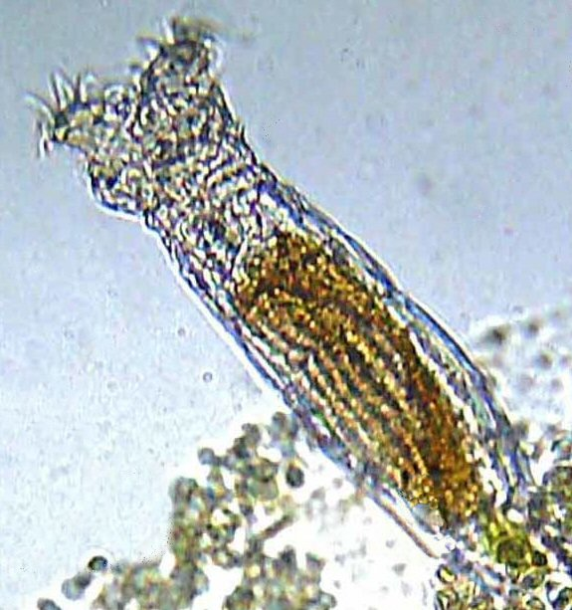
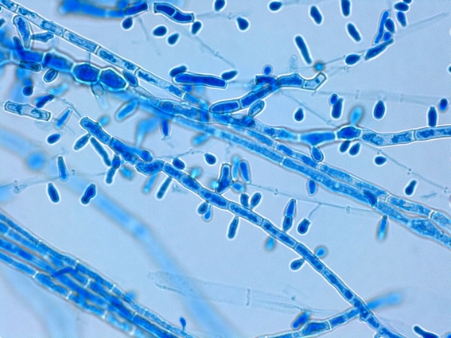
Microorganisms
A microorganism is a living organism that is so small that it is invisible to the naked eye - they can only be seen with a microscope that magnifies the image of the organism!
Microorganisms include bacteria, fungi, viruses, and protozoa.
While most microorganisms are single-celled, some are multicellular.
The study of microorganisms is called microbiology.

Slide 10
Where might we find microorganisms?

Slide 11
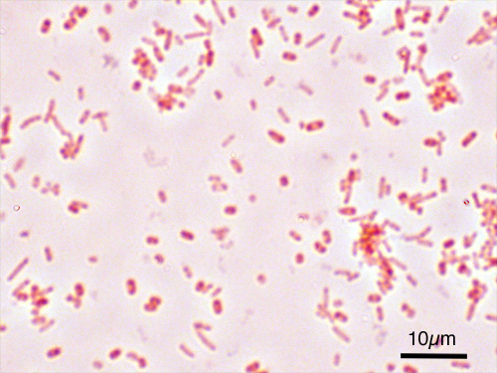
Microorganisms: Where to Find
Microorganisms are found almost everywhere.
Most of them are beneficial but some are harmful and can cause disease and even death.
Harmful microbes, called pathogens or germs, can infect living things, and cause a variety of sicknesses and diseases. For example, salmonella is a group of bacteria that causes typhoid fever, food poisoning, and other illnesses.

Slide 12
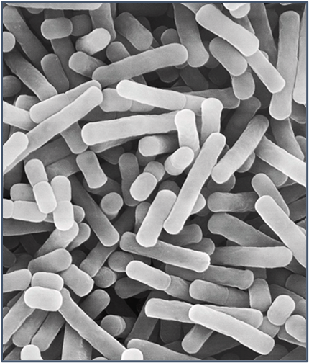
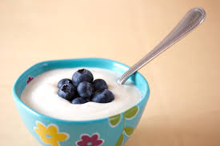
Common Beneficial Microorganisms
Lactobacillus bulgaricus is a bacteria that is used to make pickles, kimchi, and yogurt.

Slide 13
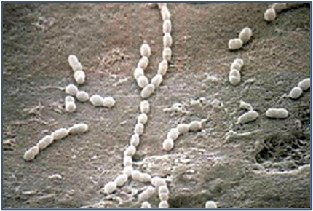
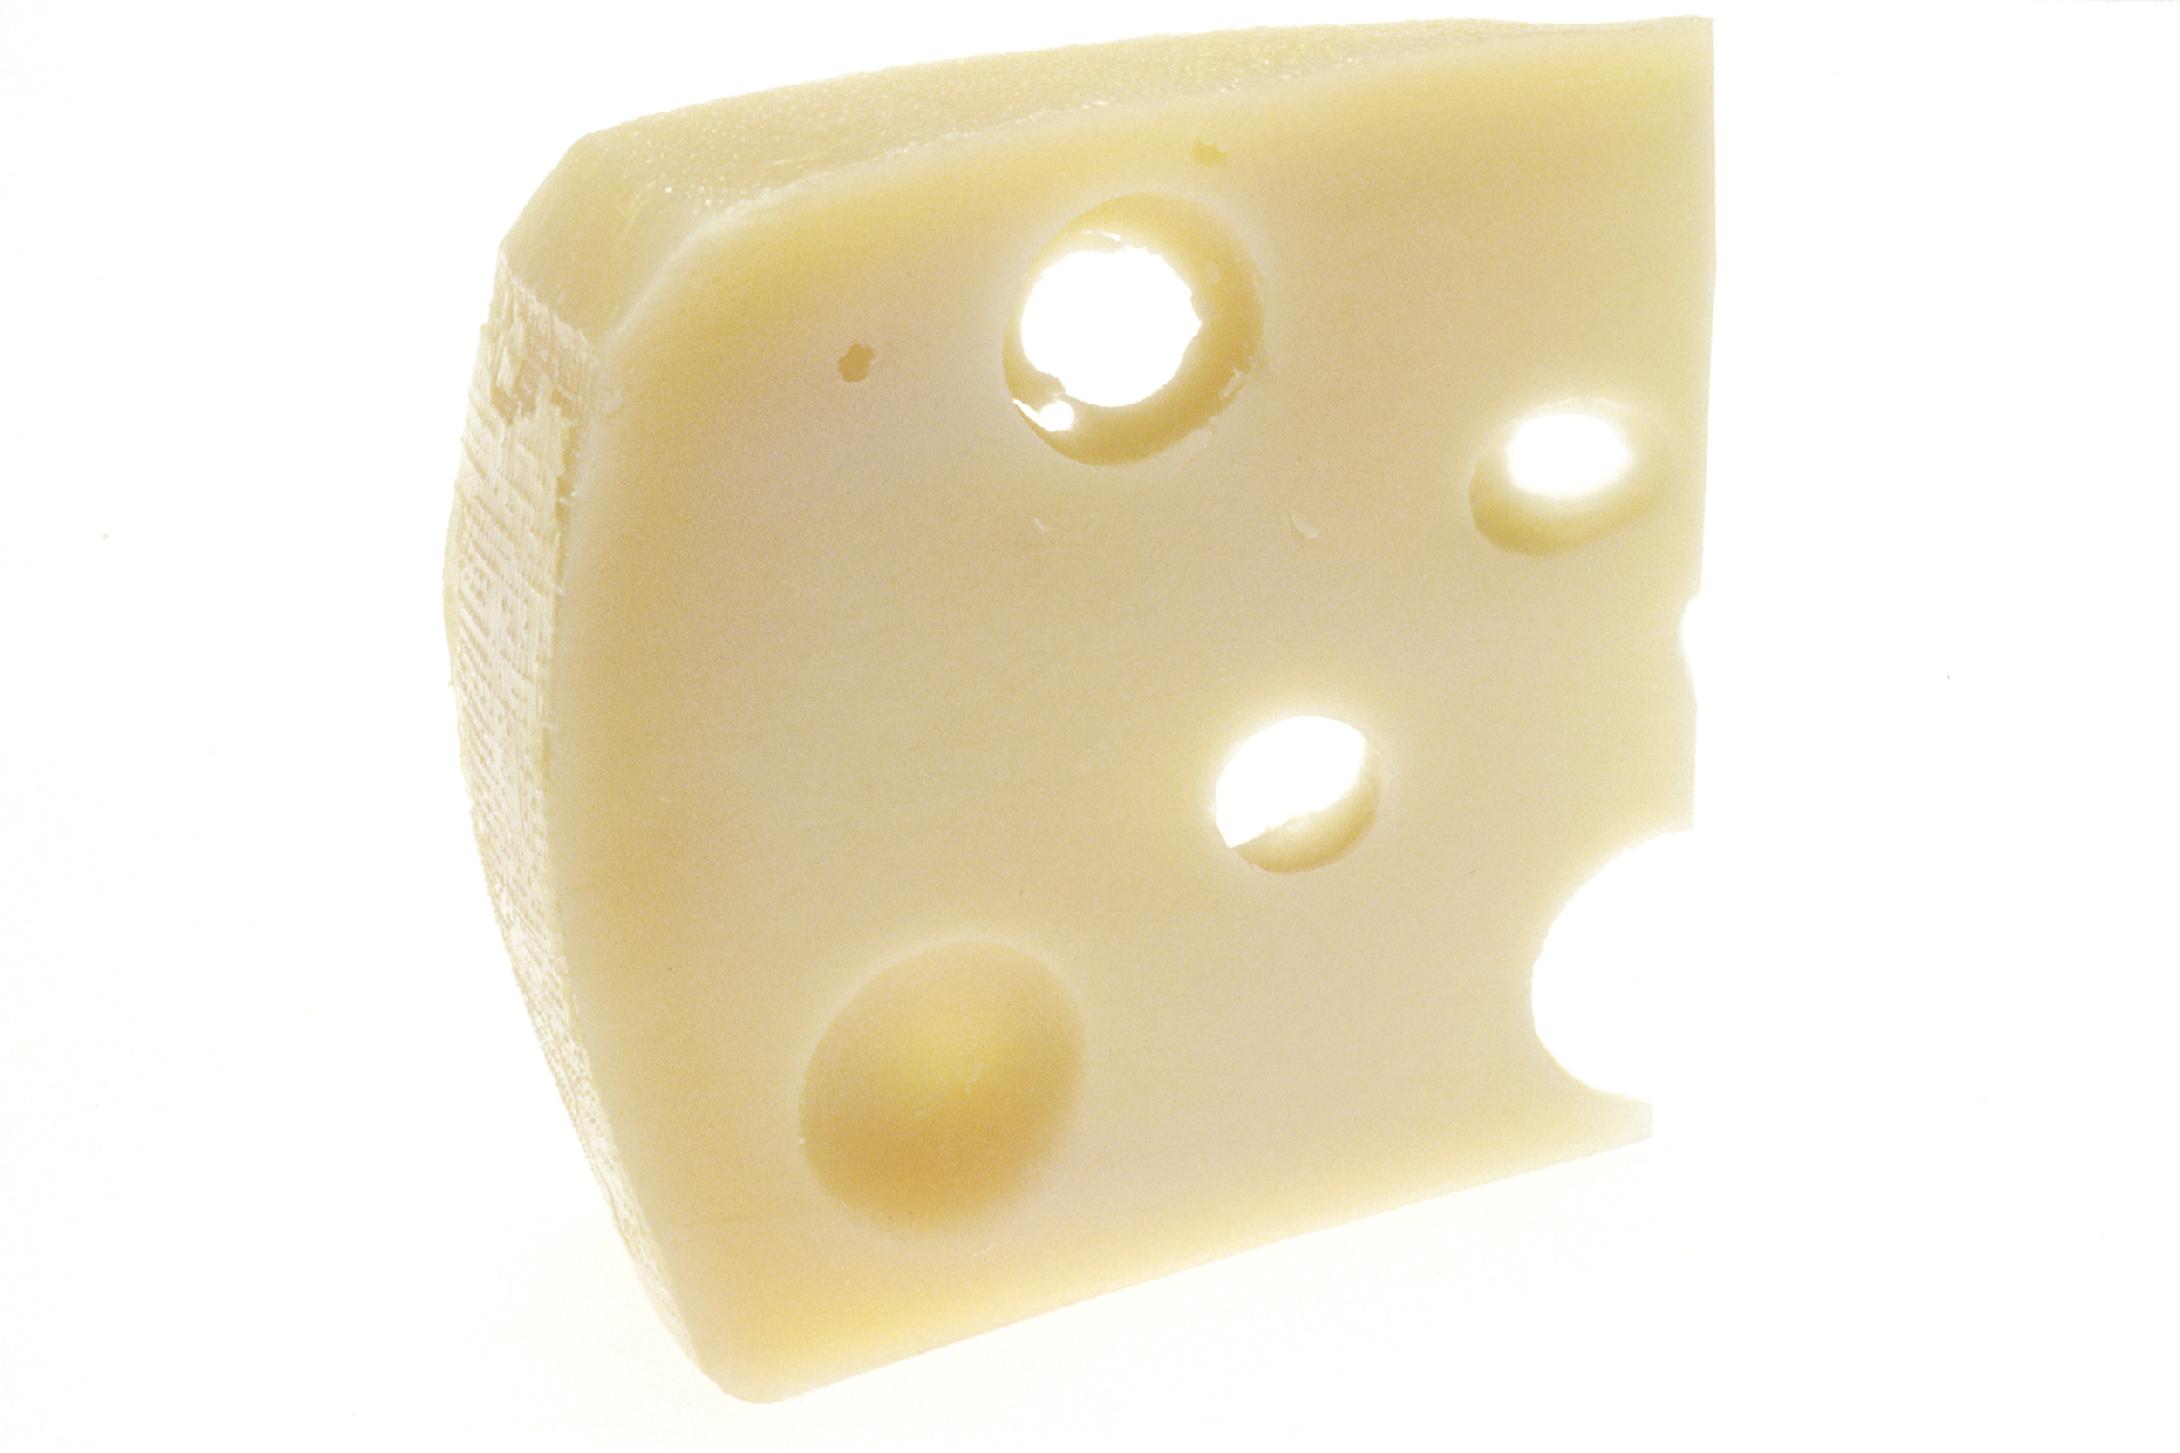
Common Beneficial Microorganisms
Streptococcus thermophilus is a bacteria that is used to make cheese and yogurt.

Slide 14
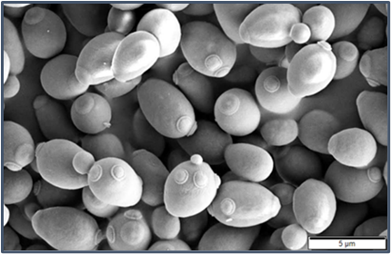
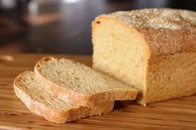
Common Beneficial Microorganisms
Saccharomyces cerevisiae (Baker’s Yeast) is used to make bread and fermented drinks such as kombucha.

Slide 15
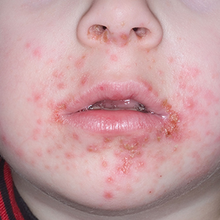
Common Harmful Microorganisms
Staphylococcus aureus is a bacteria that lives on our skin. The bacteria can cause “staph infections.”

Slide 16
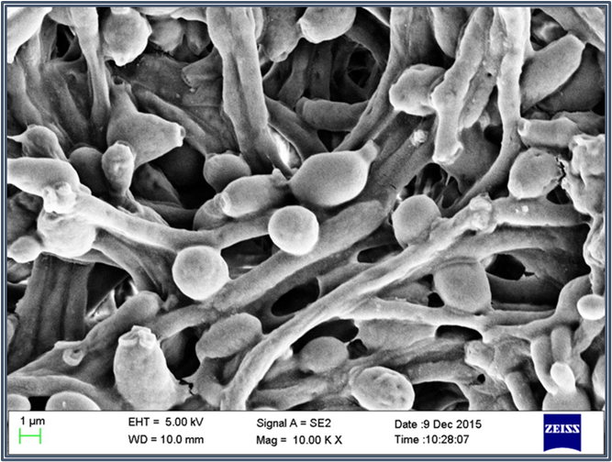
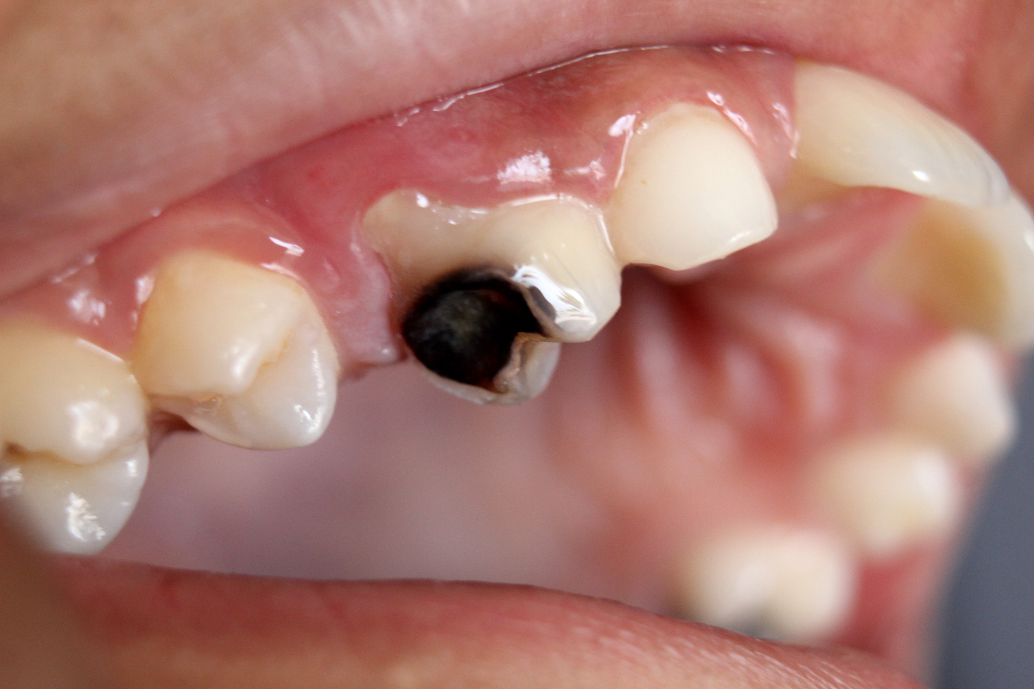
Common Harmful Microorganisms
Candida Albicans is a bacteria that lives in our mouth. The bacteria can cause tooth decay.

Slide 17
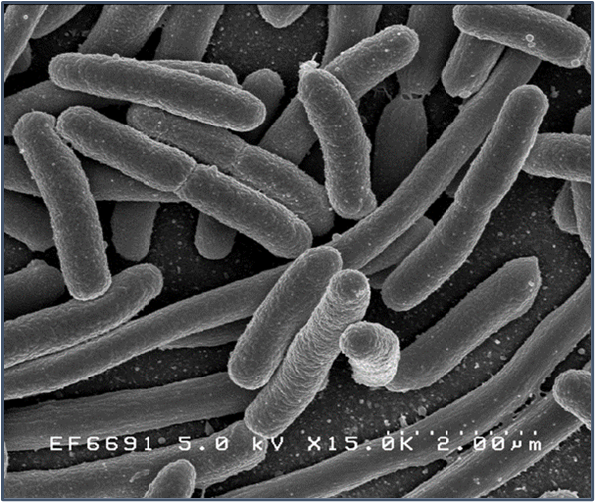
Common Harmful Microorganisms
Escherichia Coli is a bacteria that can be found in uncooked food. It can cause severe stomach pain, vomiting, diarrhea, and fever.

Slide 18
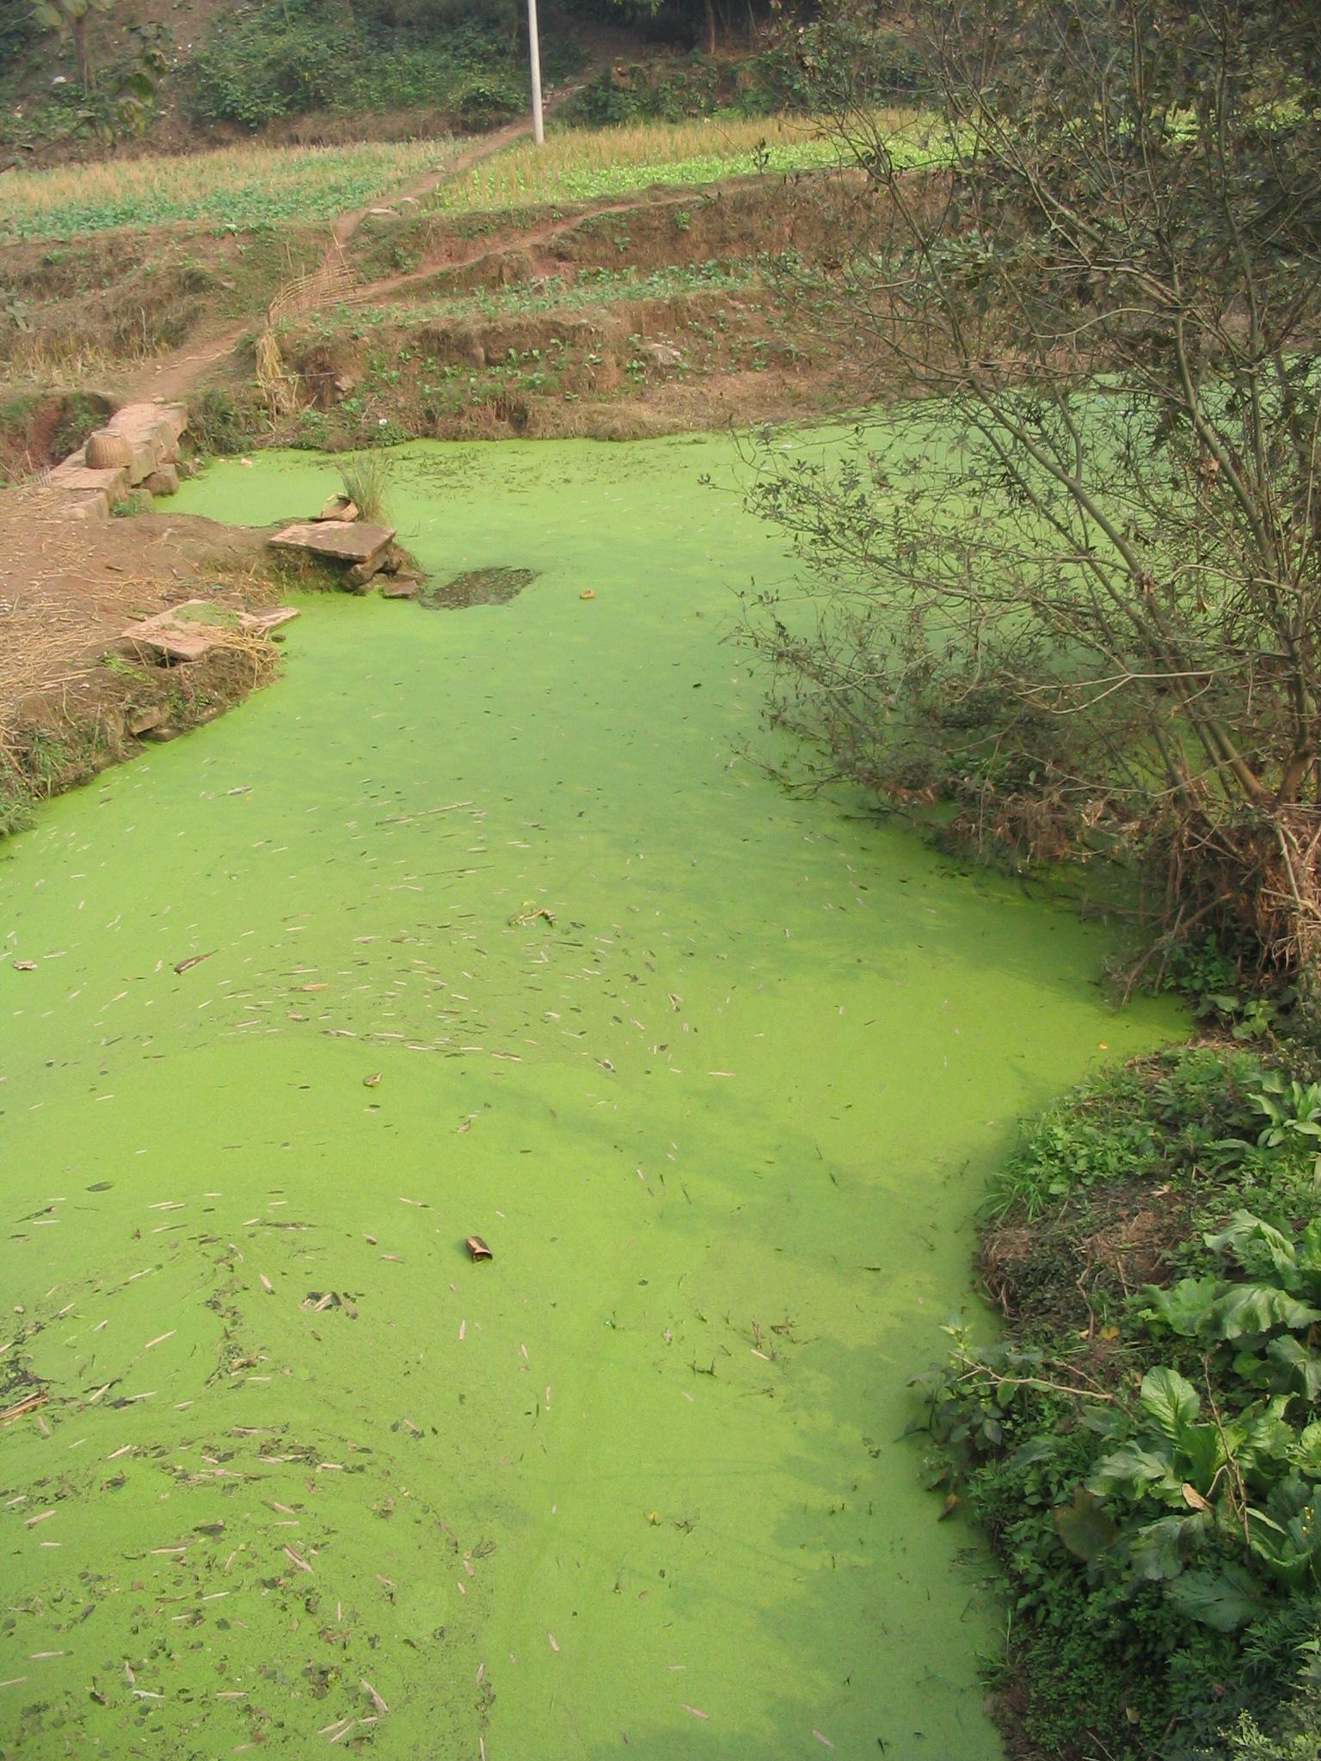
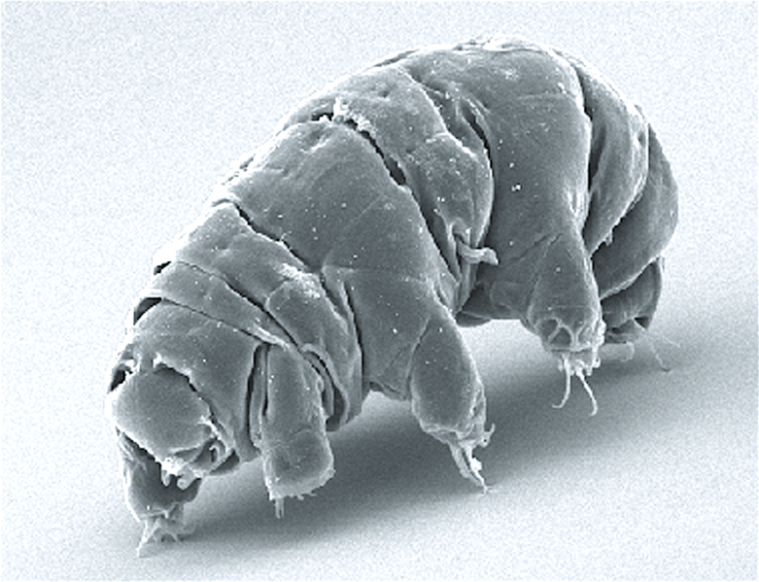
Common Microorganisms
Algae is a protist that can grow out of control and kill fish but can also be used in health supplements and toothpaste.
Rotifers and tardigrades are protists that help to break down organic matter in soil, but if accidentally consumed by humans have no ill effect.

Slide 19
Why do you think washing your hands often is so important?

Slide 20
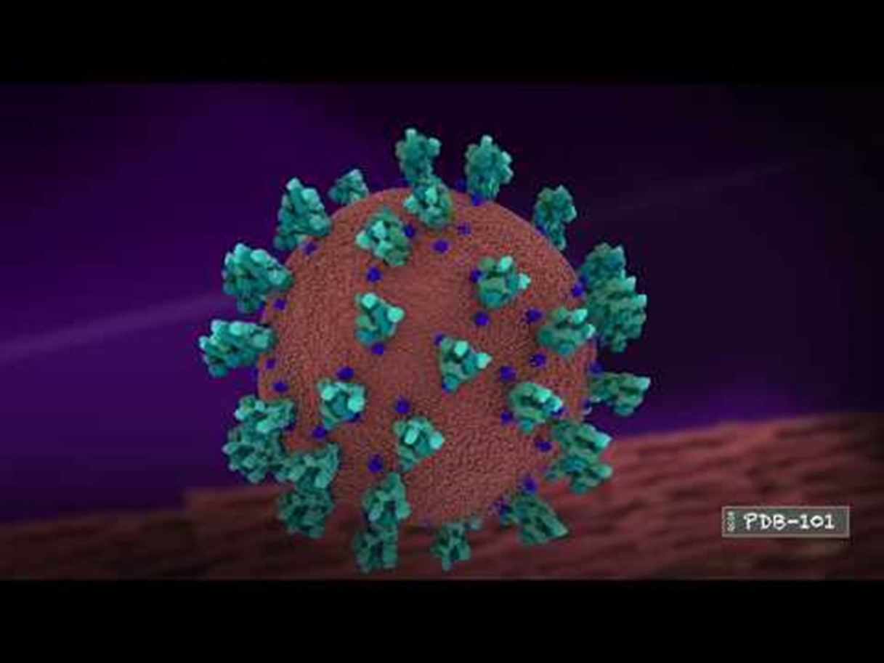
Handwashing
Keeping our hands clean through improved handwashing is one of the most important steps we can take to avoid getting sick and spreading germs (pathogens) to others.
Many diseases and conditions are spread by not washing hands with soap and clean, running water.
Hand sanitizer doesn't replace soap and water if your hands are dirty, but along with regular hand washing, it helps fight many important germs.

Slide 21
How are microorganisms beneficial and harmful to humans?

Slide 22
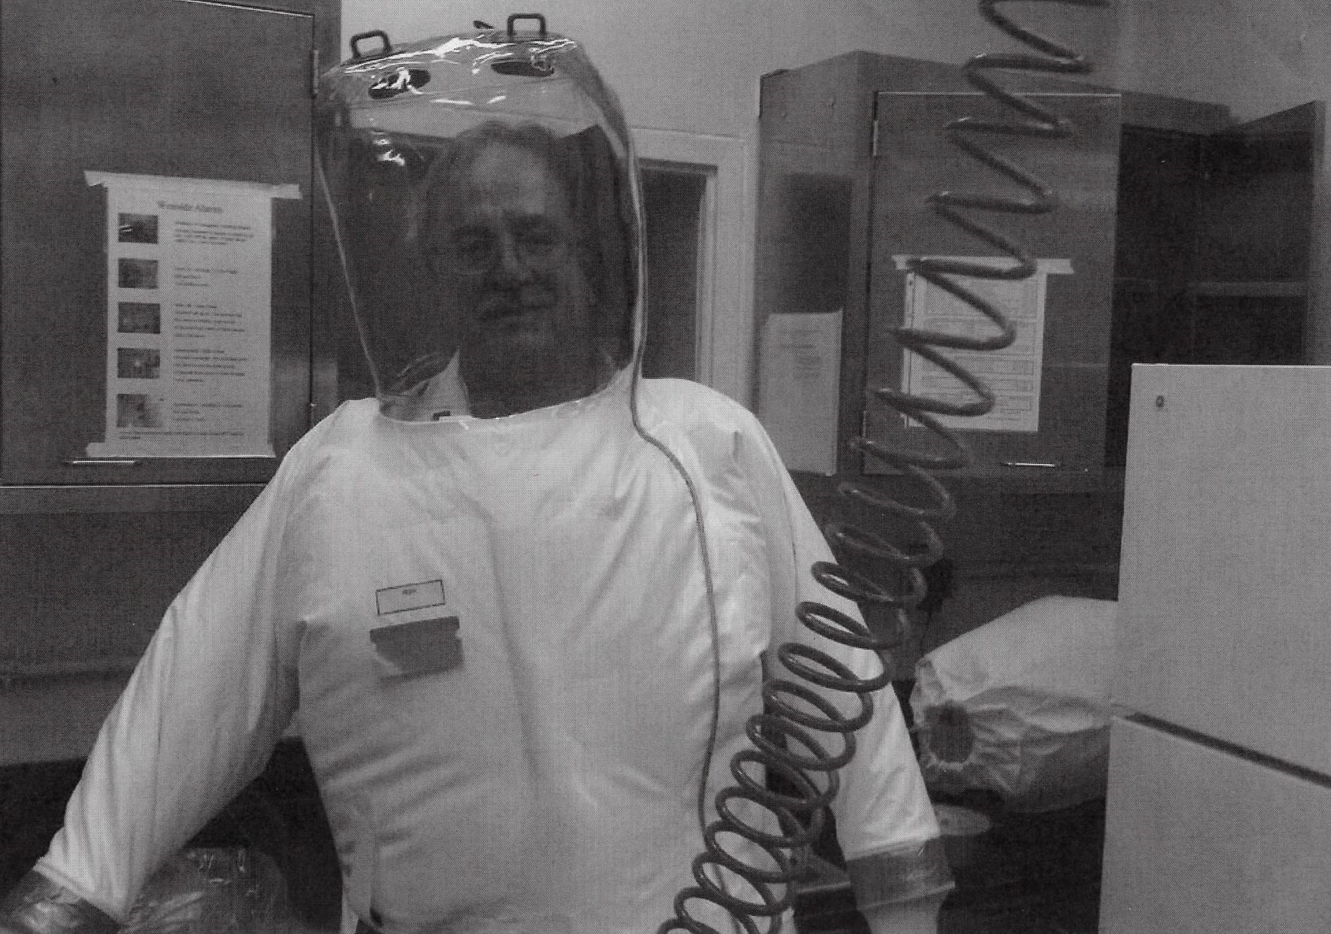
STEM Career: Microbiologist
Microbiologists study the growth, structure, development, and general characteristics of microorganisms to promote health, industry, and a basic understanding of cellular functions. They can figure out how to prevent food from molding quickly, develop an acne medication that kills pimple-causing bacteria, and identify the virus responsible for a pandemic.
A bachelor's degree is adequate for some non-research microbiology-related jobs, such as serving as a technician or an inspector in the food industry. However, the majority of microbiology jobs require at least a master's degree. A master's degree is sufficient for many jobs in applied research or product development, as well as for jobs in management, inspection, sales, and service. To conduct independent research, in either industry or in academia, or for advancement to administrative positions, a PhD is usually necessary.

