Slide 1
Gravity Railroad

Slide 2
Standards
S4P3. Obtain, evaluate, and communicate information about the relationship between balanced and unbalanced forces.
Plan and carry out an investigation on the effects of balanced and unbalanced forces on an object and communicate the results.
Construct an argument to support the claim that gravitational force affects the motion of an object.

Slide 3
Check it Out!

Slide 4
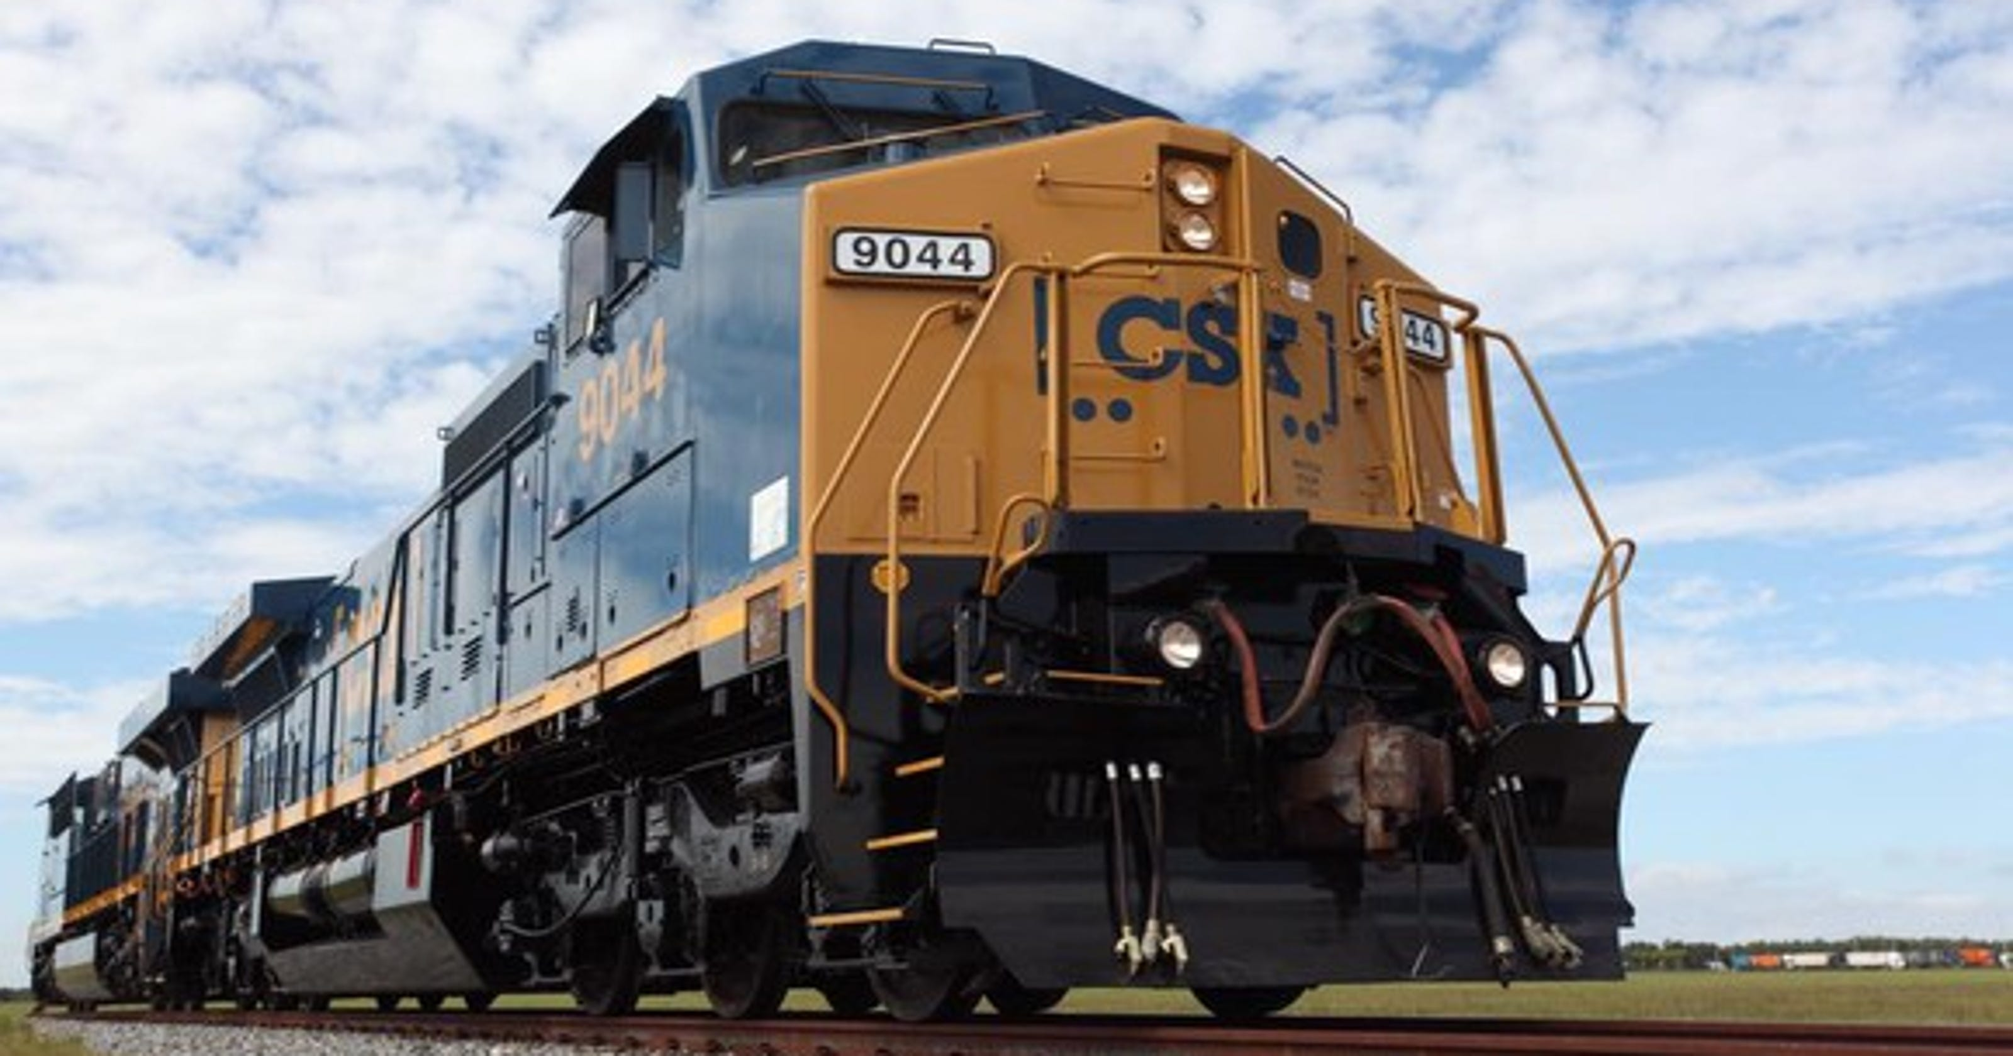
Think!
What do you observe about the train in that video?
How is the train able to move so fast with those heavy cars?

Slide 5
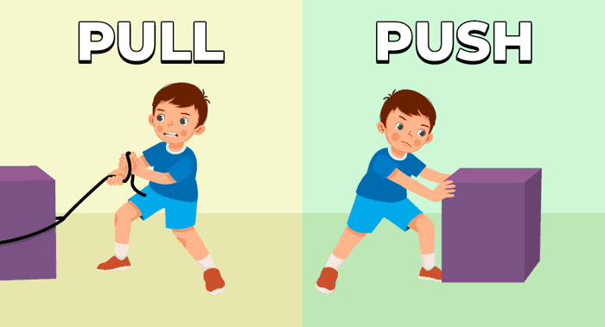
Force & Motion
A force is a push or pull on an object.
When the forces acting on an object are balanced, the object is at rest.
When the forces acting on an object are unbalanced, the object moves.

Slide 6
Force & Motion
For Example:
When you arm wrestle with someone, if you both are exerting the same amount of force, your arms don’t move. When someone exerts more force, the stronger arm will overtake the weaker arm and push it down.

Slide 7
STEM Challenge
Today, you are going to observe the effects of balanced and unbalanced forces on an object.

Slide 8
Materials
For each group:
A toy train (must have moving wheels)
A flat piece of cardboard
3 stackable items of the same size (i.e., blocks, books, etc.)
Meter stick
Masking tape
Recording sheet

Slide 9
Investigate Part 1
Set the toy train on the ground.
Why isn’t the train moving?
How could we make the train move?”

Slide 10
Investigate Part 2
Using a piece of masking tape, mark a starting point for the train.
Place the train on the starting point and give it a gentle push.
Measure how far the train traveled. Record your data and explain why you think this happened (be sure to use vocabulary).

Slide 11
Investigate Part 3
Build a ramp one object tall (make sure the top of the ramp is at the starting point).
Place the train at the top of the ramp and let go.
Measure how far the train traveled. Record your data and explain why you think this happened (be sure to use vocabulary).

Slide 12
Investigate Part 4
Explore and observe with a ramp two and three objects tall.
Measure how far the train traveled each time. Record your data and explain why you think this happened (be sure to use vocabulary).

Slide 13
Investigate Debrief
Which ramp made the train go the furthest distance?
Which ramp created the most unbalanced force?

Slide 14
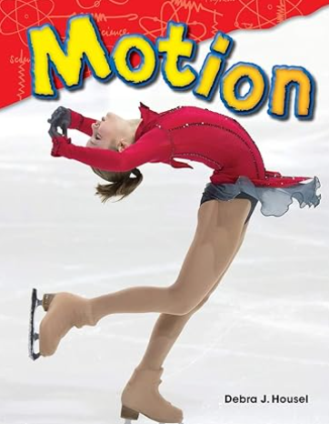
Read Aloud

Slide 15
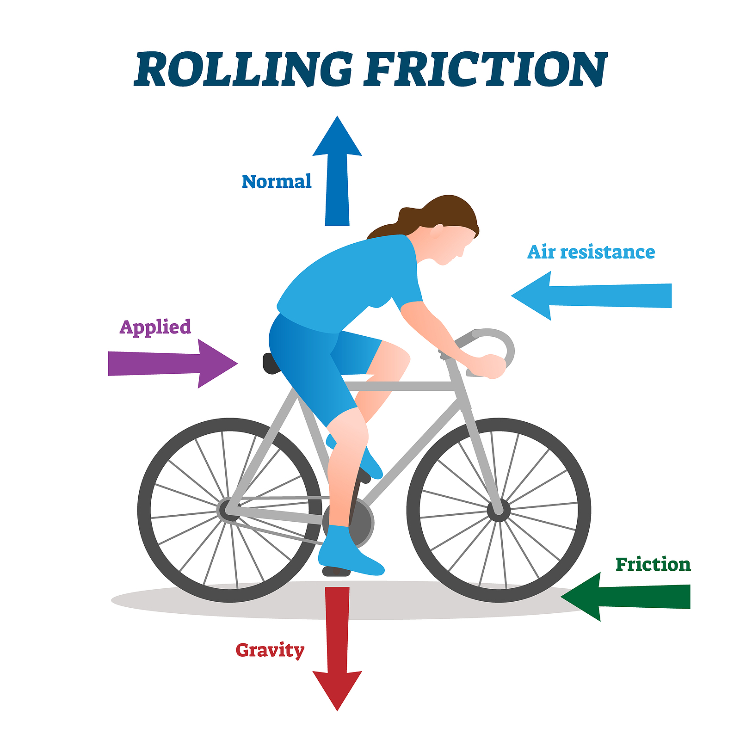
Explain
Motion is movement and can be slowed or stopped through friction and drag.
Friction is a force that slows or stops motion.
Drag is friction through a fluid (water or air), also known as air resistance.
An unbalanced in forces causes motion.
Gravity is an unseen force that pulls us towards the Earth.

Slide 16
STEM Career: Systems Management Analyst

