Slide 1
It’s Electric!

Slide 2
Standards
S5P2. Obtain, evaluate, and communicate information to investigate electricity.
a. Obtain and combine information from multiple sources to explain the difference between naturally occurring electricity (static) and human-harnessed electricity.
b. Design a complete, simple electric circuit, and explain all necessary components.
c. Plan and carry out investigations on common materials to determine if they are insulators or conductors of electricity.

Slide 3
Think!
Have you ever dragged your shoes across a carpet? What happened?

Slide 4
Watch This!
Why is his/her hair following the balloon?

Slide 5
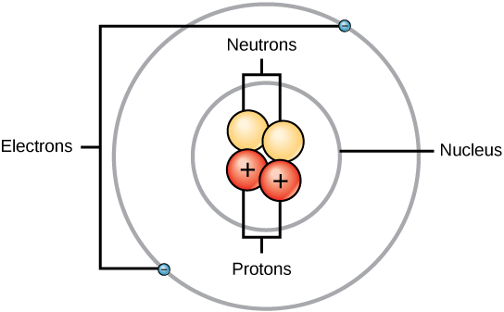
Atoms
All physical objects are made up of atoms.
Atoms have protons, electrons, and neutrons.
Protons are positively charged (+).
Electrons are negatively charged (-).
Neutrons are neutral.

Slide 6
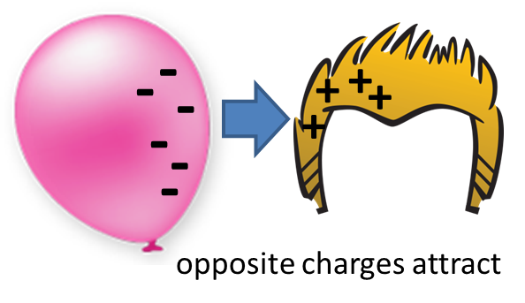
Charges
All things are made up of charges.
Opposite charges attract each other, while like charges repel each other.
Most of the time, the positive and negative charges balance which makes an object neutral.

Slide 7
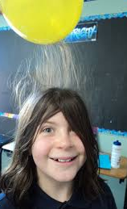
Static Electricity
Static electricity is the result of an imbalance between negative and positive charges in an object.
These charges can build up on the surface of an object until they find a way to be released or discharged. This happens when you rub certain materials together which transfers electrons.
These charges can be discharged through a circuit.

Slide 8
Imagine…
You are hiking with a friend in the mountains. You stumble and fall. Your flashlight falls out of your backpack. It rolls down the hill and out of sight. It is getting dark and you need another light source. What should you do to create another light source?

Slide 9
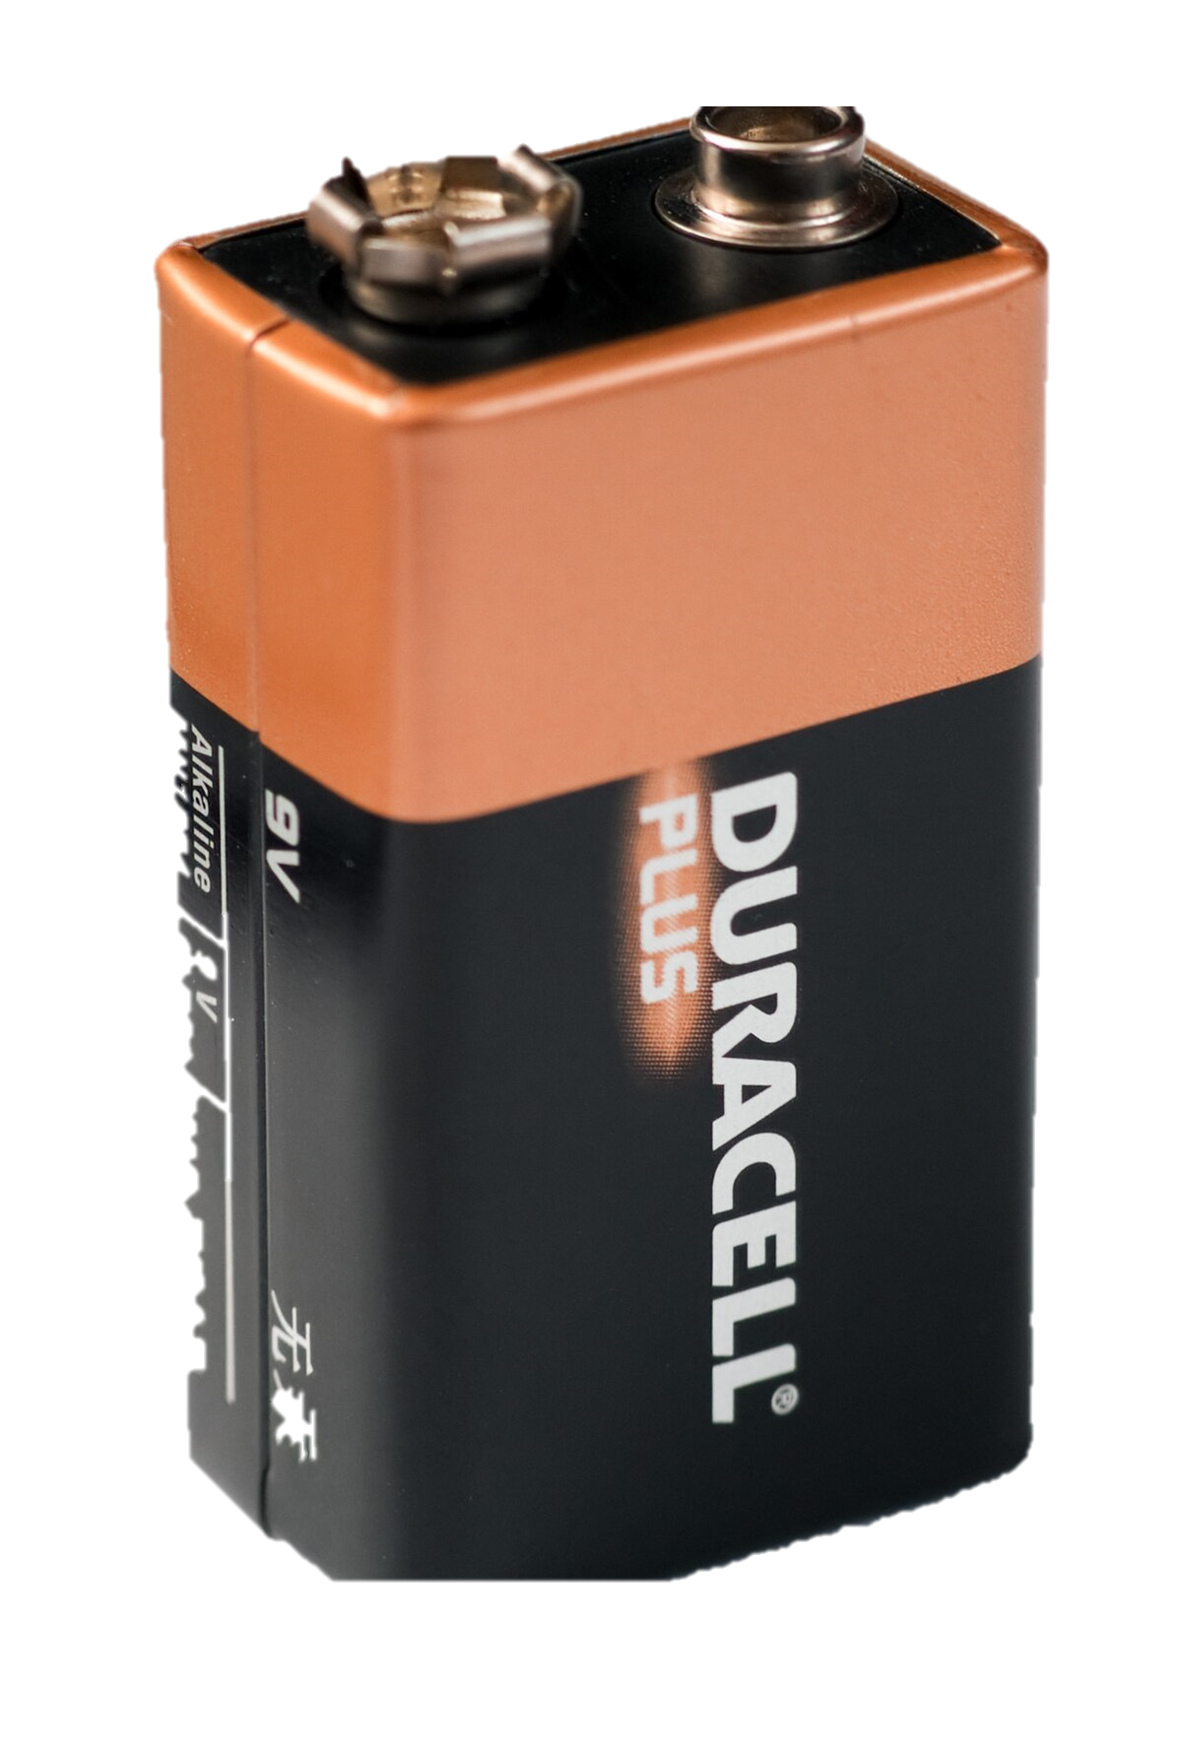
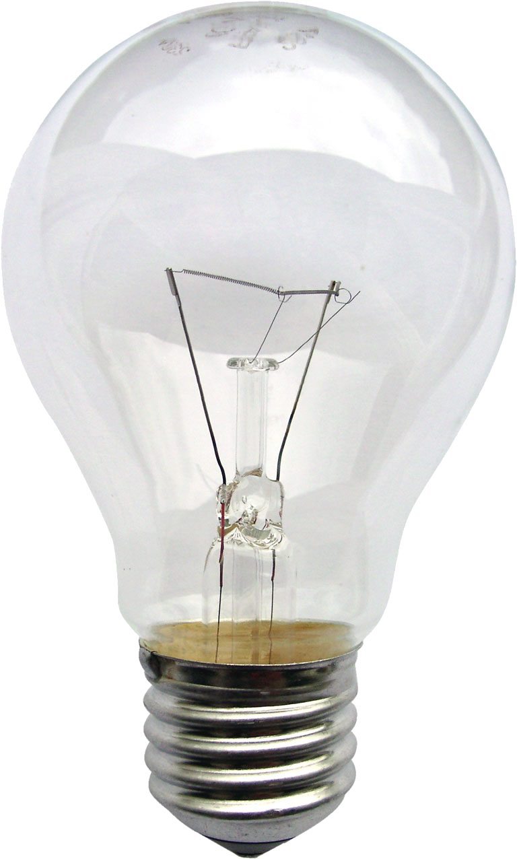
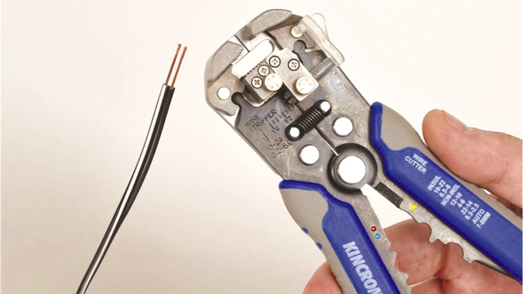
STEM Challenge
How can we use these materials to light the bulb?
Is there more than one way?

Slide 10
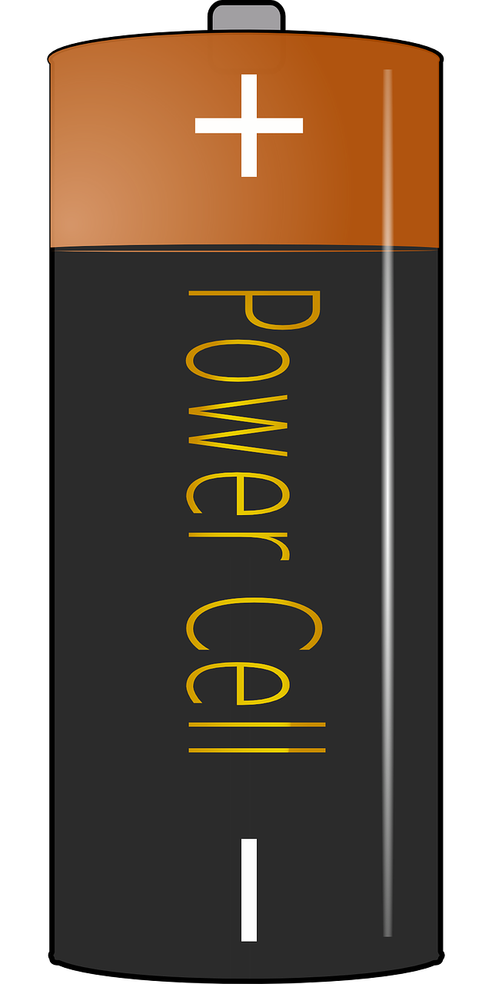
Simple Circuit
6. The electrons have now travelled a complete circuit. Without a complete circuit the electrons cannot flow.
5. Then, the electrons continue to the positive side of the battery.
4. The electrons flow across the filament and some of the electrical energy changes to heat and light energy.
2. The electrons move from the negative side of the battery towards the base of the bulb.
3. The electrons continue up a small wire inside the bulb and to the conductive side of the bulb.
1. A circuit is a route in which electrical current can flow.

Slide 11
Series Circuit
In a series circuit, the current flows from one component to the next.
When you add in more bulbs, they will become equally dim. More resistance has been added to the circuit, which decreases the flow of current, as the battery has more work to do.
If a bulb is removed the circuit will be broken, as the electrons stop flowing.

Slide 12
What do all of the completed circuits have in common?
A path for the flow of electrons.

Slide 13
Conductors vs. Insulators
Conductor: A material through which electricity can flow through.
Insulator – A material through which electricity cannot flow through.

Slide 14
STEM Career: Electrical Engineer
Electrical and electronics engineers gather and shape electricity and use it to make products that transmit power or transmit information. Electrical and electronics engineers may specialize in one of the millions of products that make or use electricity, like cell phones, electric motors, microwaves, medical instruments, airline navigation system, or handheld games.
Most electrical and electronics engineers have a bachelor’s or master’s degree in engineering in areas that include electronics, electrical engineering, or computer engineering. Job responsibilities include specification, design, development, and implementation of products or systems, as well as research to create new ideas. This role provides a number of challenges ranging from problem identification and the selection of appropriate technical solutions, materials, test equipment, and procedures, to the manufacture and production of safe, economical, high-performance products and services.

