Slide 1
Pollution Solution

Slide 2
Standard
S3L2. Obtain, evaluate, and communicate information about the effects of pollution (air, land, and water) and humans on the environment.
a. Ask questions to collect information and create records of sources and effects of pollution on the plants and animals.
b. Explore, research, and communicate solutions, such as conservation of resources and recycling of materials, to protect plants and animals.

Slide 3
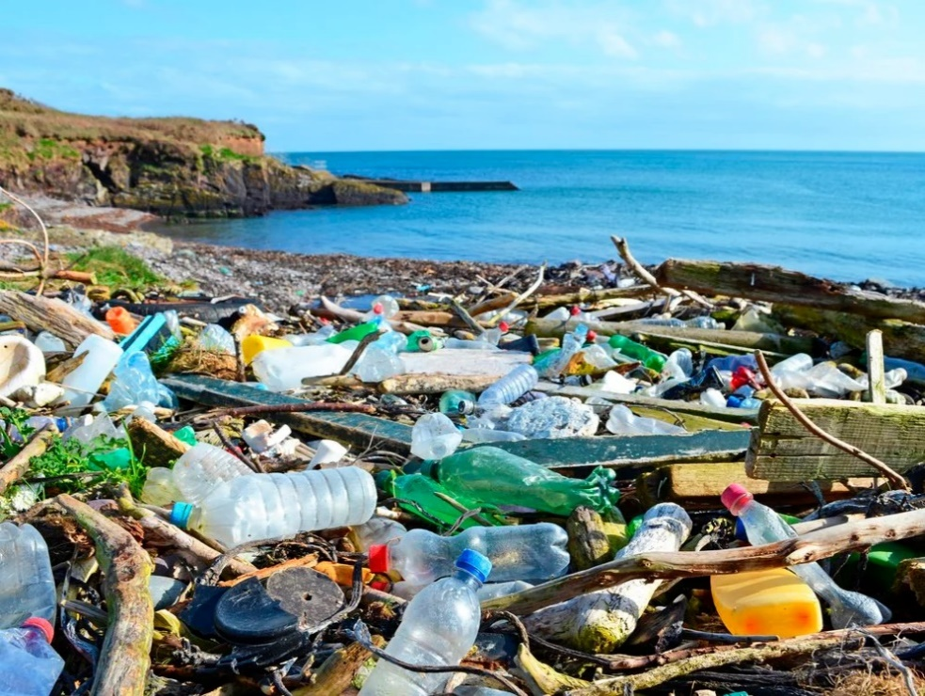
Engage
What do you notice?
What do you wonder?
How does this make you feel?

Slide 4
Engage

Slide 5
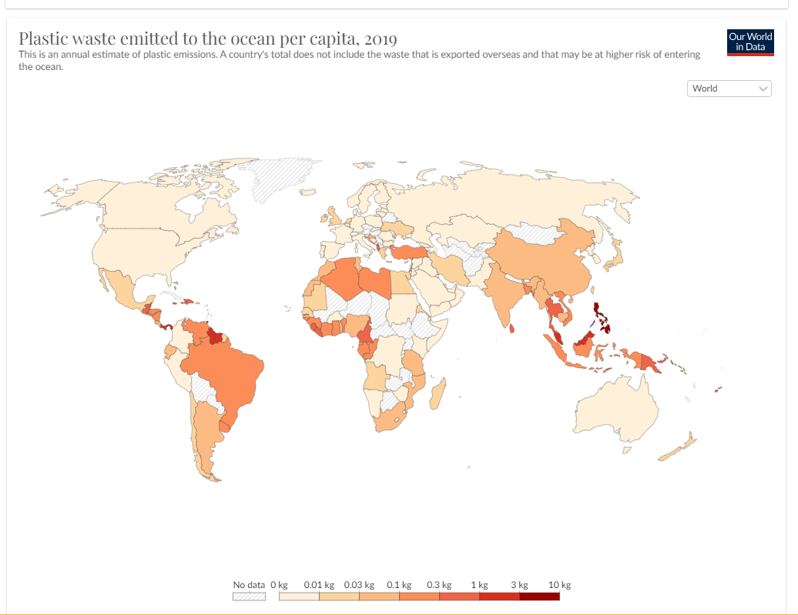
Explore
Our World in Data:
https://ourworldindata.org/plastic-pollution

Slide 6
Explain
Every year, millions of tons of plastic enter the oceans, primarily from rivers. And the plastic that is afloat within the oceans isn’t going away by itself. Pollution is a change in the environment that can affect the health, survival, or activities of a living thing. Water, air, and land pollution affect all the plants and animals in that area either directly or indirectly. People can make everyday choices that directly help or harm the environment. Conservation and recycling can reduce the negative effects of pollution.

Slide 7
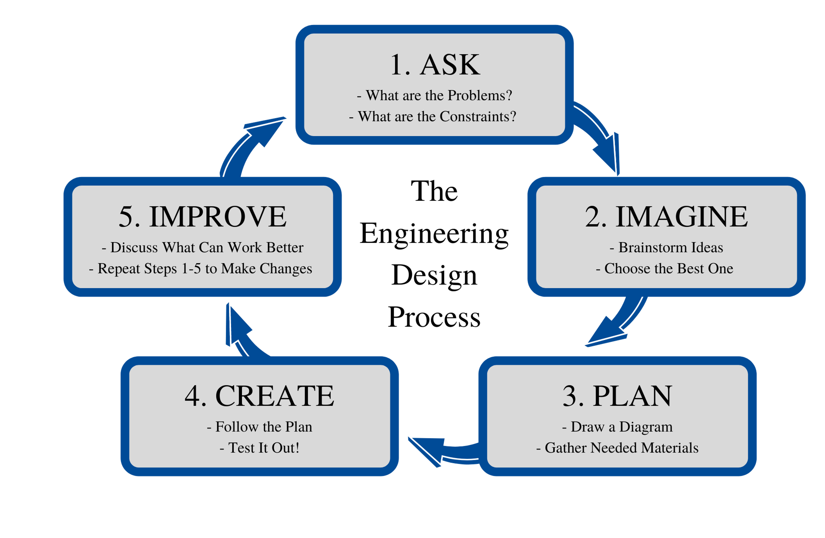
Elaborate
STEM Challenge:
Using recycled materials, design and build a solution to the ocean pollution that you have been learning about.

Slide 8
Share Your Ideas!
How does your design work?
What materials did you use?
How can you make it better or improve your design?

Slide 9
STEM Career: Environmental Engineer
Environmental engineers plan projects around their city or state—like municipal water systems, landfills, recycling centers, or sanitation facilities—that are essential to the health of the people who live there. Environmental engineers also work to minimize the impact of human developments, like new roads or dams, on environments and habitats, and they strive to improve the quality of our air, land, and water.
Environmental engineering requires a B.S. degree in engineering, typically civil, chemical, mechanical, or environmental. You must do your best in the math, science, and engineering courses that comprise any engineering degree. Through both your formal training and your activities during your college career, you need to work on developing your writing and speaking skills. Environmental engineers must be able to communicate effectively with people of all types if they are to succeed in solving problems.

