Slide 1
Renew-A-Bead

Slide 2
Standards
S6E6. Obtain, evaluate, and communicate information about the uses and conservation of various natural resources and how they impact the Earth.
Ask questions to determine the differences between renewable/sustainable energy resources (examples: hydro, solar, wind, geothermal, tidal, biomass) and nonrenewable energy resources (examples: nuclear: uranium, fossil fuels: oil, coal, and natural gas), and how they are used in our everyday lives.
Design and evaluate solutions for sustaining the quality and supply of natural resources such as water, soil, and air.
Construct an argument evaluating contributions to the rise in global temperatures over the past century. (Clarification statement: Tables, graphs, and maps of global and regional temperatures, and atmospheric levels of greenhouse gases such as carbon dioxide and methane, should be used as sources of evidence.)

Slide 3
Think!
Where does the energy we use come from?

Slide 4
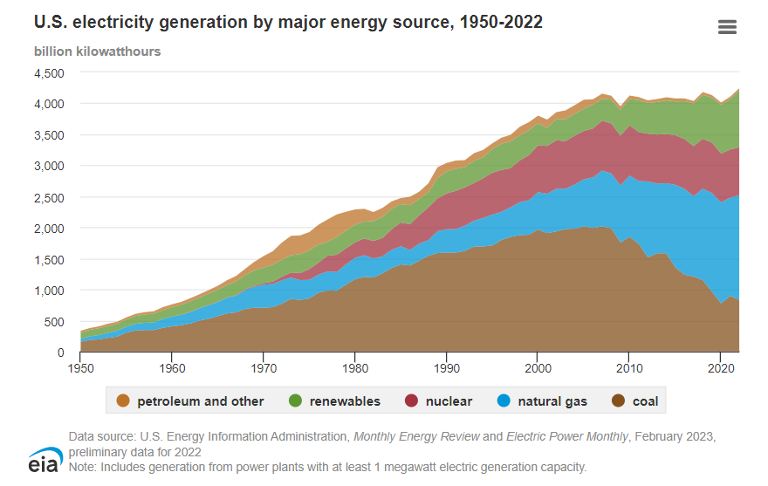
Energy
The United States uses many different energy sources and technologies to generate electricity. The sources and technologies have changed over time, and some are used more than others.

Slide 5
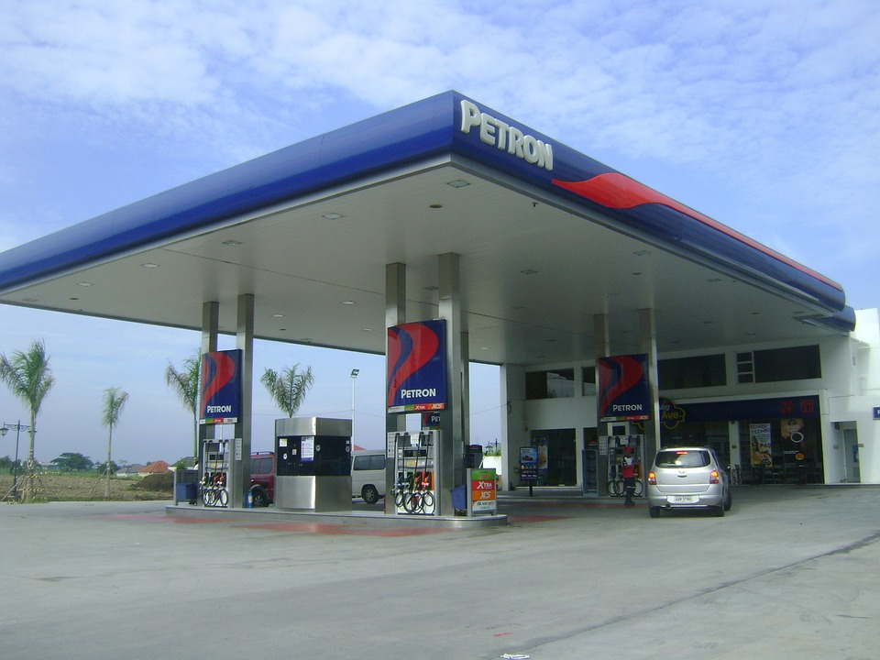
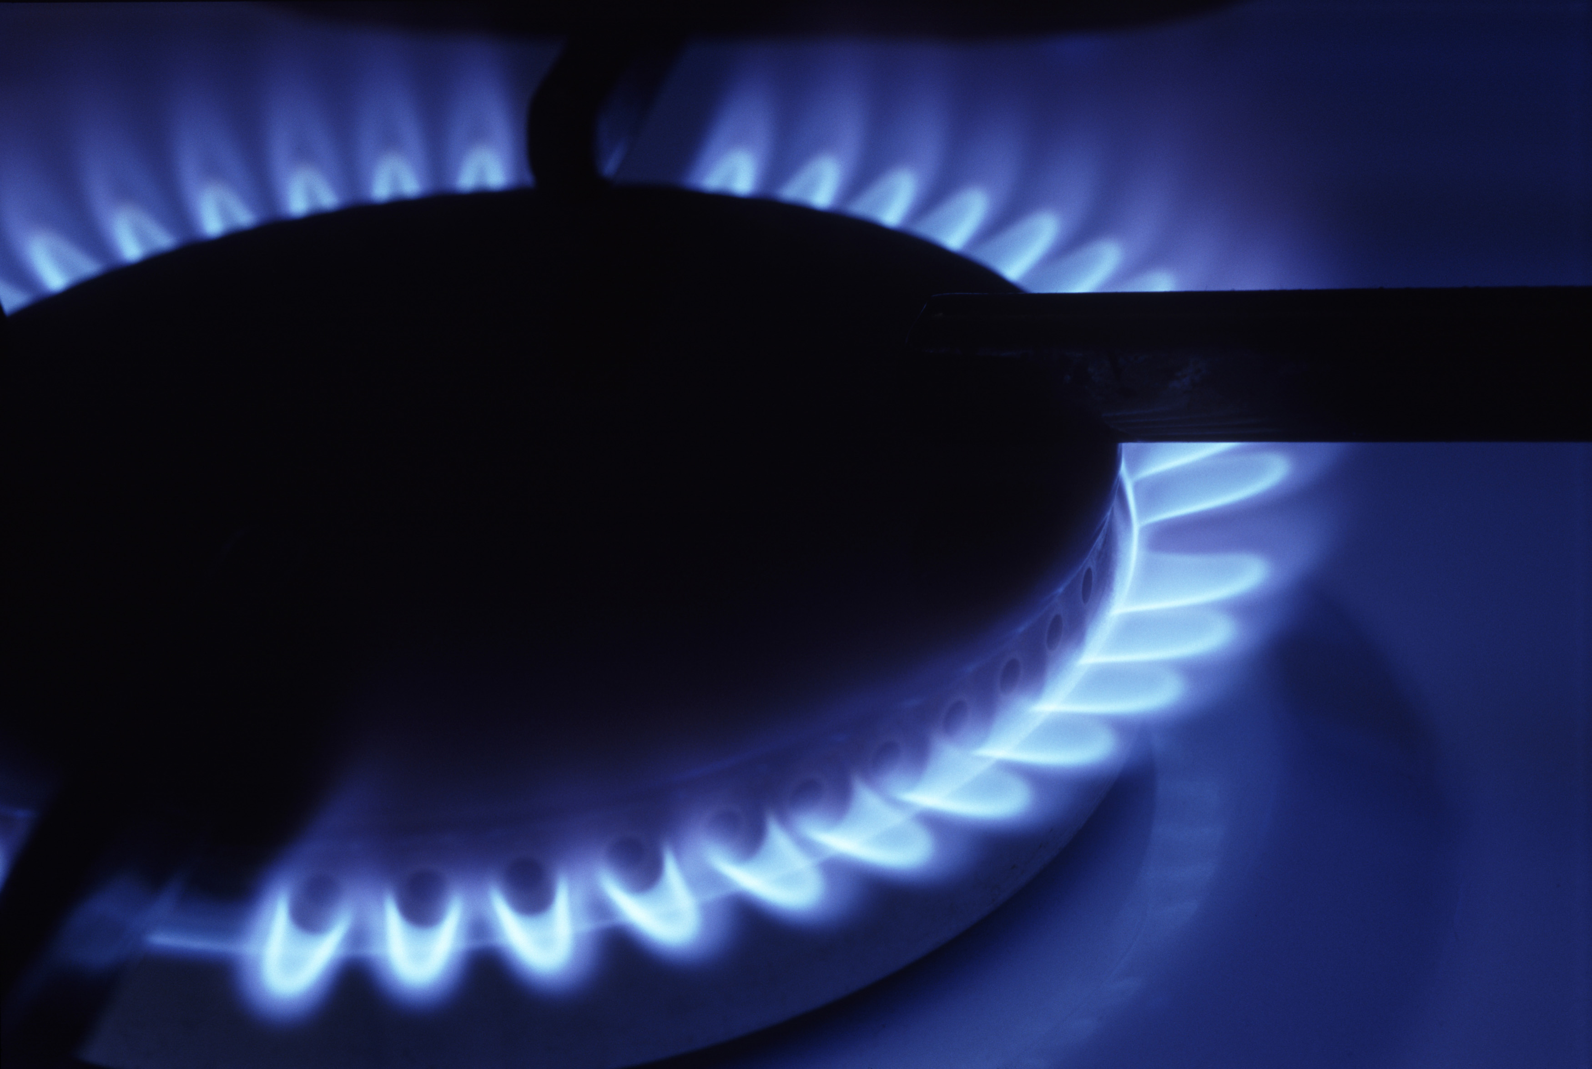
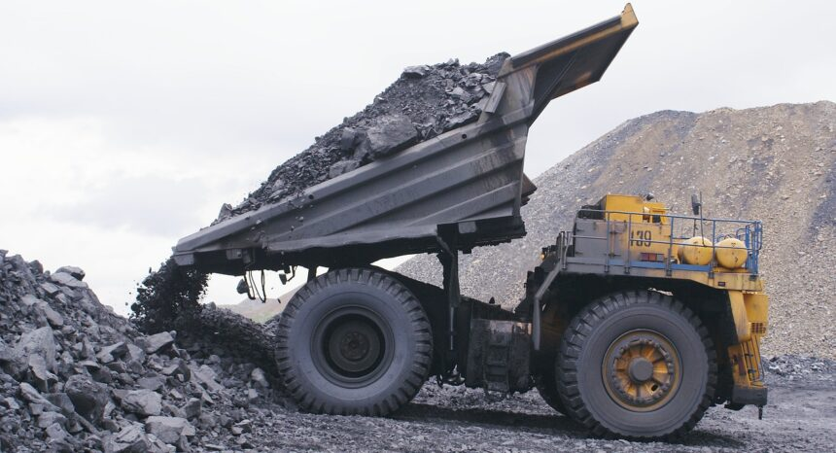
Sources of Energy
Fossil Fuels
Coal
Natural Gas
Petroleum

Slide 6
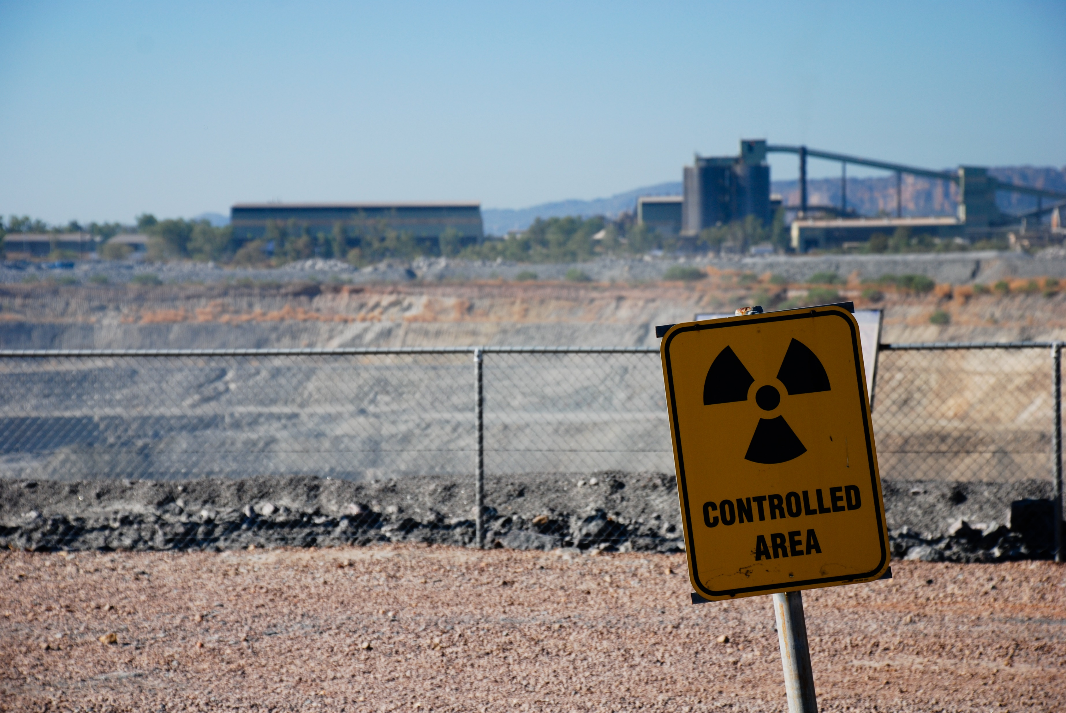
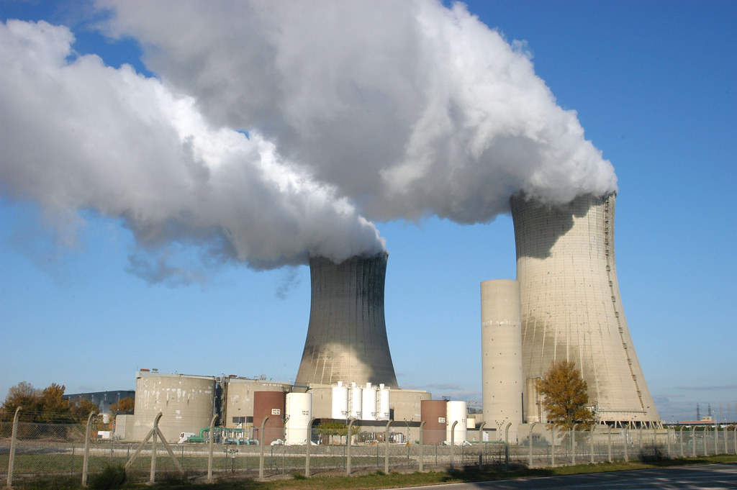
Sources of Energy
Nuclear
Uranium
This Photo by Unknown Author is licensed under CC BY-SA

Slide 7
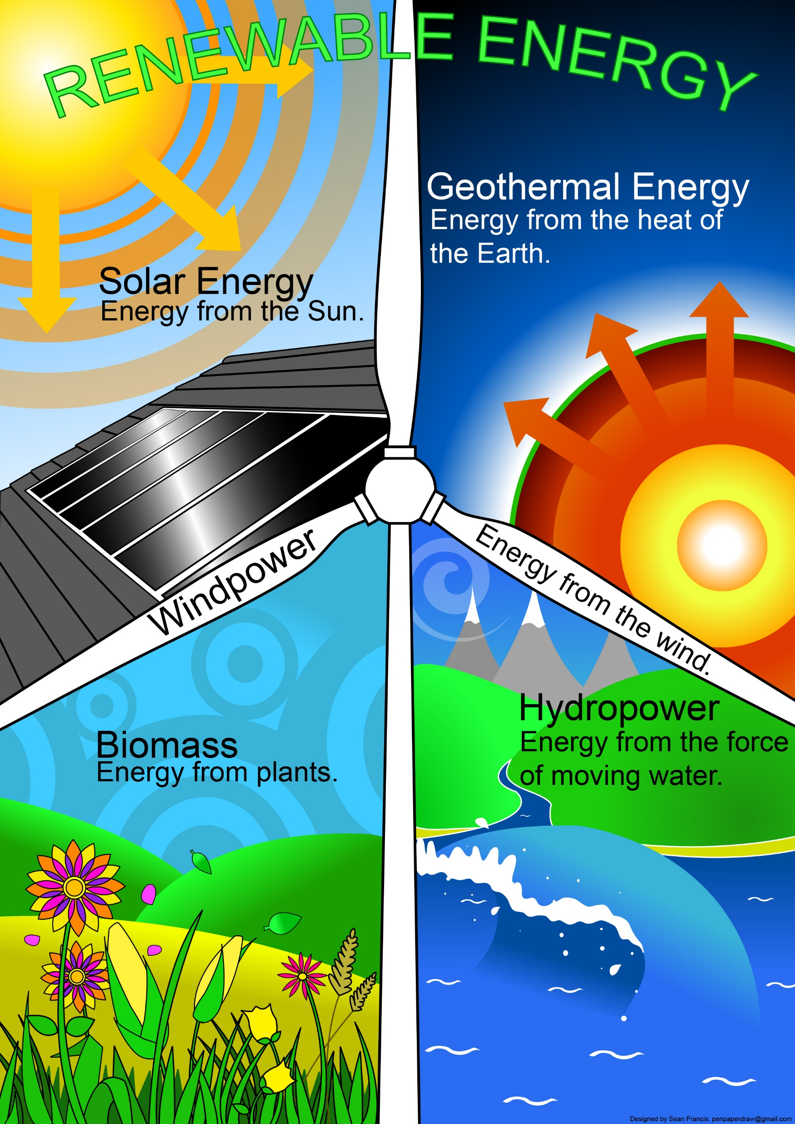
Sources of Energy
Renewable
Biomass
Geothermal
Hydropower
Wind
Solar

Slide 8
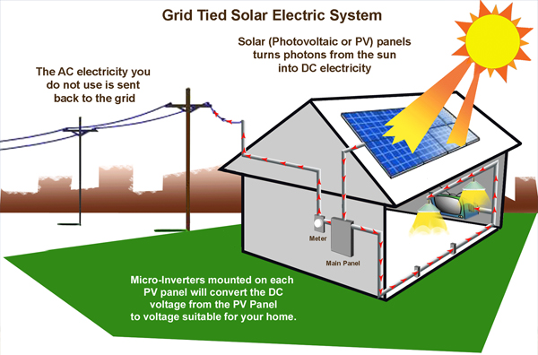
Think!
Can sunlight be directly used to power a radio?
No, a solar photovoltaic panel must be used for energy conversion. An energy system is a set of conversion technologies that convert energy resources, such as energy from the sun, into forms that we can utilize for human needs.

Slide 9
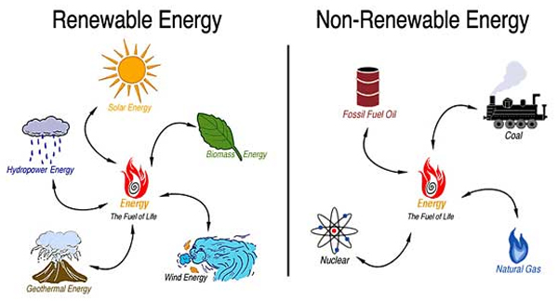
Renewable vs. Nonrenewable
Renewable
Nonrenewable
Energy resources that are replenished at the same rate that we use them are defined as renewable energy resources.
Energy sources that are being used at a much faster rate than they are being regenerated are defined as nonrenewable resources.

Slide 10
Renew-A-Bead Game
The goal of today’s game is to use a model of an energy system to see how important renewable resources are so that our country (represented by the paper bag) does not run out of energy (represented by the beads).
Follow the directions on your Renew-A-Bead Game Handout.

Slide 11
Renew-A-Bead Game: Recap
What happened to the black beads?
What advice would you give to a country that is making plans so it has enough future energy resources?
What is a model? What was the model in today's game? What do the game components represent?

Slide 12
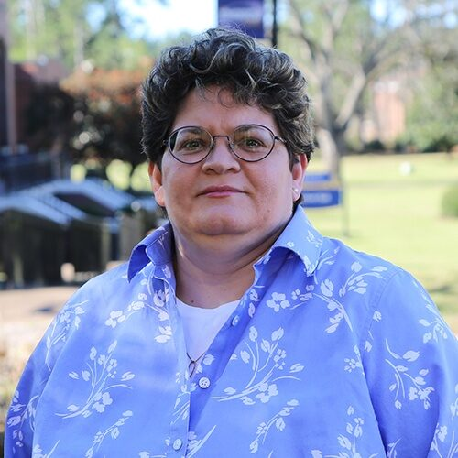
STEM Career: Environmental Engineer
Environmental engineers plan projects around their city or state—like municipal water systems, landfills, recycling centers, or sanitation facilities—that are essential to the health of the people who live there. Environmental engineers also work to minimize the impact of human developments, like new roads or dams, on environments and habitats, and they strive to improve the quality of our air, land, and water.
Environmental engineering requires a B.S. degree in engineering, typically civil, chemical, mechanical, or environmental. You should also consider getting a Masters degree in environmental engineering (more and more employers are giving preference to those who have a Masters degree). You must do your best in the math, science, and engineering courses that comprise any engineering degree. Equally important, you need to focus on the humanities. Since environmental engineering is so intertwined with people, it is necessary that you understand how people and societies function. Through both your formal training and your activities during your college career, you need to work on developing your writing and speaking skills. Environmental engineers must be able to communicate effectively with people of all types if they are to succeed in solving problems. These skills can only be learned by doing --- the more you do, the better you will become.

Slide 13
Elaborate
Energy Sources Research
Although most of the energy consumed in the United States comes from fossil fuel sources, there are many other potential sources of energy available. In all cases, there are pros and cons to our use of these sources. Some of the energy sources are limited by their availability or environmental impact; others need technological improvements before they can become widely used. For scientists and engineers, research is the best way to learn about unknown topics.
Today you will examine information about energy sources and how those sources are used to produce electrical energy. We can use this information to help us understand the various pros and cons that affect our use of different energy sources.

