Slide 1
Ripples of Awareness:
Navigating Earth’s Water Sources

Slide 2
Standards
S6E3. Obtain, evaluate, and communicate information to recognize the significant role of water in Earth processes. ​
a. Ask questions to determine where water is located on Earth’s surface (oceans, rivers, lakes, swamps, groundwater, aquifers, and ice) and communicate the relative proportion of water at each location.

Slide 3
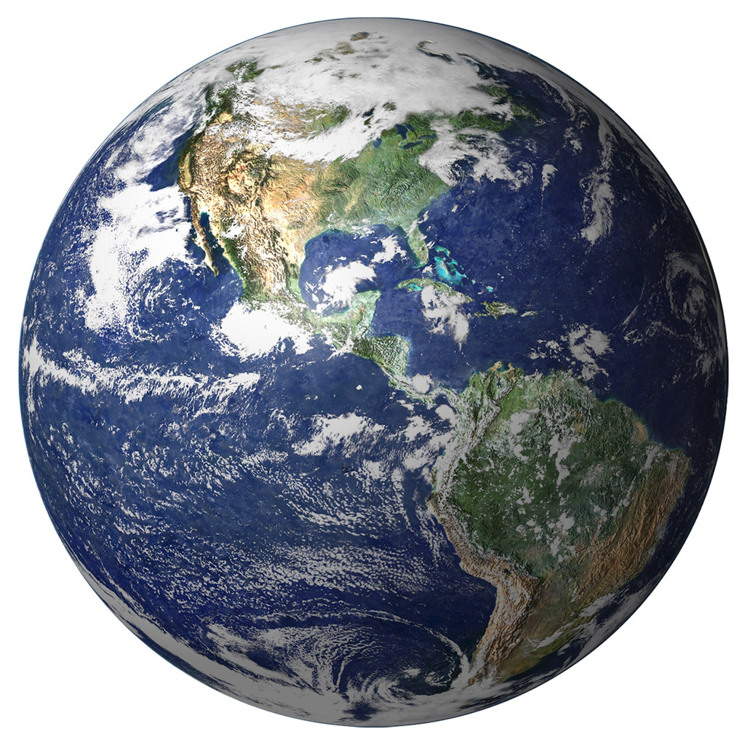
Think!
- What do we need water for?
- How much of Earth’s water is available to us and clean enough to drink?
- What kinds of water exist in/on/around Earth?

Slide 4
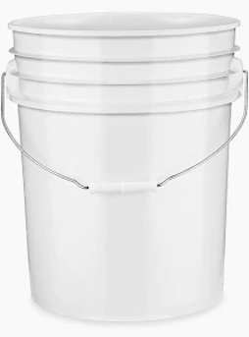
5-Gallon Bucket Model
If all of the water on our planet was represented by the water in this 5-Gallon bucket…

Slide 5
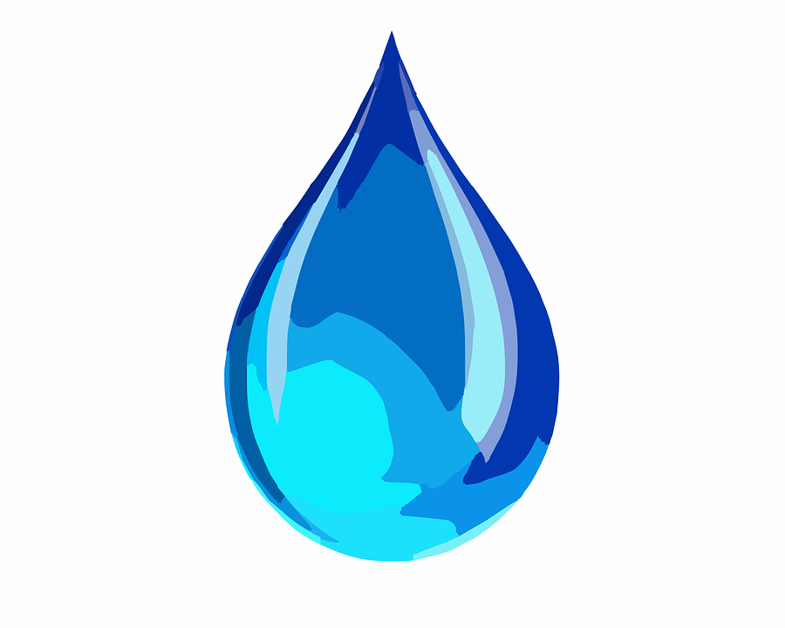
5-Gallon Bucket Model
Only one drop of water out of a whole 5-gallon bucket represents the water that is available to us and animals for drinking.
How do you feel about that?

Slide 6
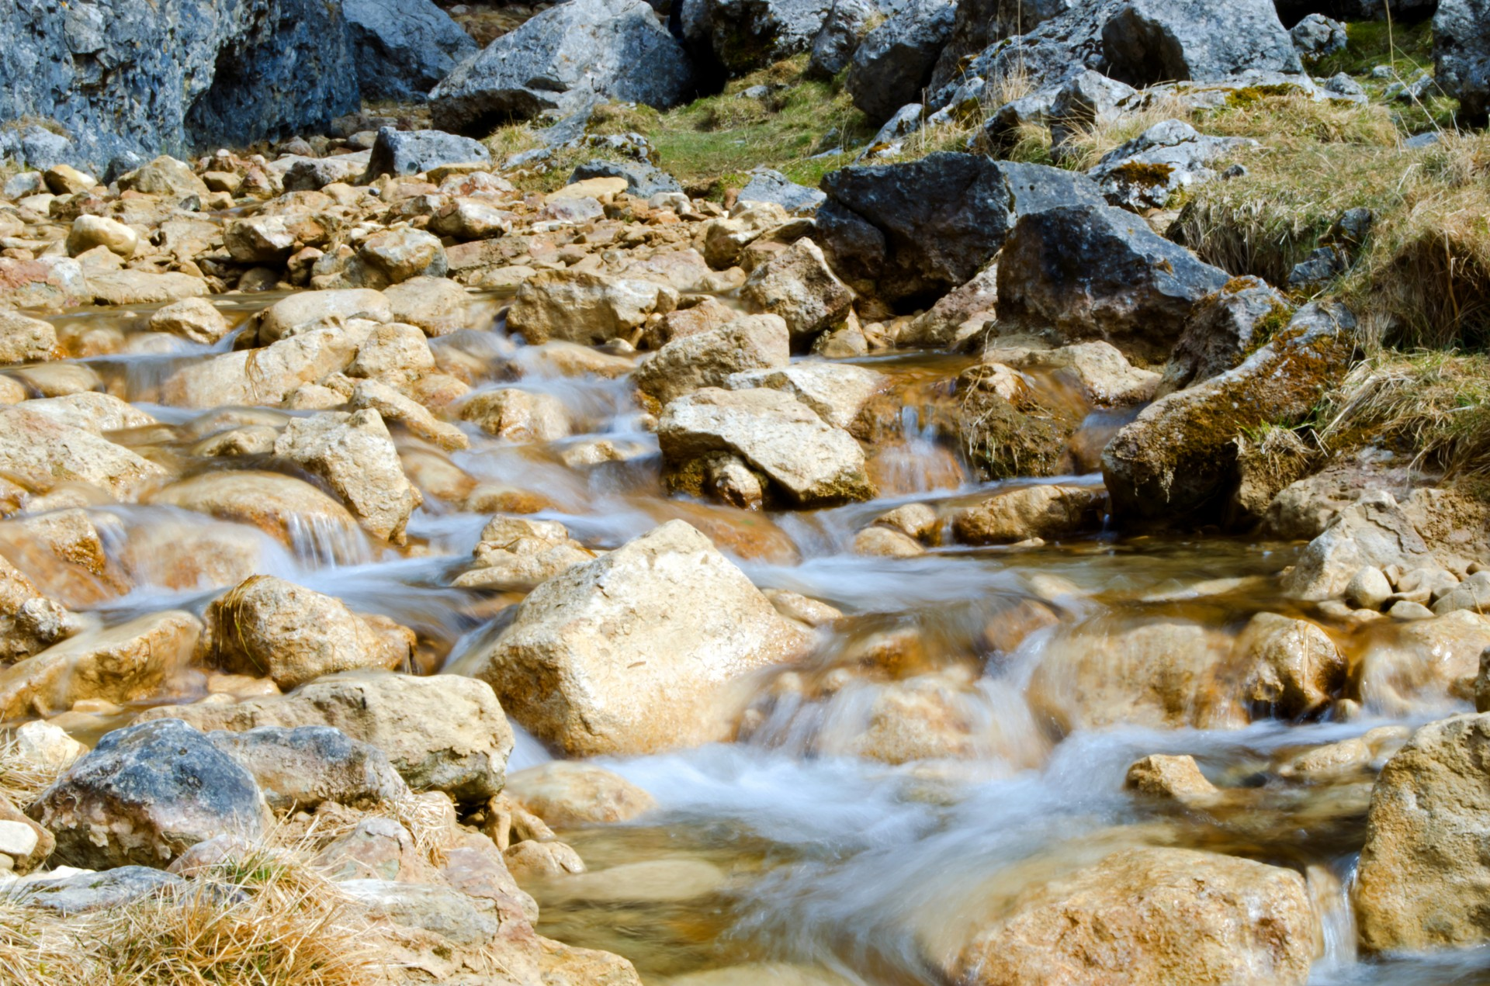
5-Gallon Bucket Model
The total amount of water on the planet is not going to change. Even though water moves around on the planet and changes from one kind to another, we will never have any more than we do right now.

Slide 7
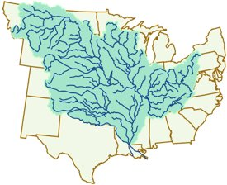
What’s a Watershed?
A watershed is an area of land that drains all the streams and rainfall to a common outlet such as the outflow of a reservoir, mouth of a bay, or any point along a stream channel.

Slide 8
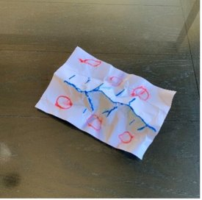
What’s a Watershed?
1. Crumble a half-sheet of paper into a tight ball.​
​
2. Once it is as tight as you want, unfold and ‘stretch’ paper out. It should not touch the surface it is placed on completely. It will resemble mountains and hills like a topographic map.​
​
3. Provide students with a few colored markers and have them ‘highlight’ the ridges. Instruct them to circle places where they think water would pool or collect with a different color.​
​
4. Using a misting bottle, spray the ‘mountain range’ until water begins to move across the paper. Alternatively, gently power a small stream of water down on the ‘mountain range’.

Slide 9
What’s a Watershed?
What do you NOTICE and what do you WONDER about what you just observed?

Slide 10
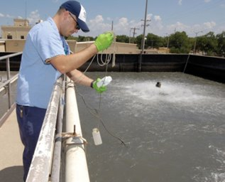
STEM Career: Wastewater Treatment Engineer
Wastewater treatment engineers play a crucial role in safeguarding our environment and public health. They are responsible for designing, implementing, and managing systems that treat and dispose of wastewater, ensuring it meets regulatory standards before returning to the environment. Wastewater treatment engineers work in various settings, including municipal water treatment plants, industrial facilities, and consulting firms.
Wastewater treatment engineers typically hold a bachelor's degree in environmental engineering, civil engineering, or a related field. Some positions may require a master's degree for advanced research or management roles. Continuous professional development and certifications are essential to stay current with evolving technologies and regulations.

