Slide 1
Rosie Revere’s Flying Machine

Slide 2
Standards
S4P3. Obtain, evaluate, and communicate information about the relationship between balanced and unbalanced forces.
a. Plan and carry out an investigation on the effects of balanced and unbalanced forces on an object and communicate the results.
b. Construct an argument to support the claim that gravitational force affects the motion of an object. c. Ask questions to identify and explain the uses of simple machines (lever, pulley, wedge, inclined plane, wheel and axle, and screw) and how forces are changed when simple machines are used to complete tasks. (Clarification statement: The use of mathematical formulas is not expected.)

Slide 3
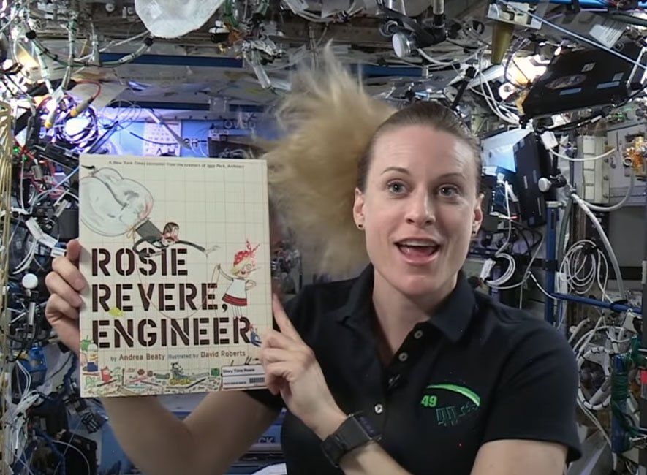
Read Aloud

Slide 4
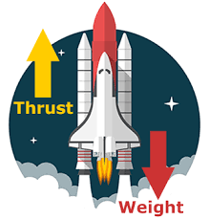
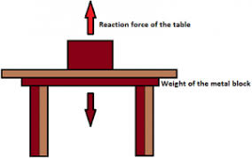
Balanced & Unbalanced Forces
An object at rest is NOT moving. But it still has forces acting on it. The strengths and directions of the forces acting on the object cancel out. These are called BALANCED FORCES.
When an object is moving, it has UNBALANCED FORCES acting on it. When unbalanced forces act on an object it may change the speed or move in a different direction.

Slide 5
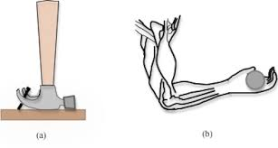
Balanced or Unbalanced Force?

Slide 6
Balanced or Unbalanced Force?

Slide 7
Balanced or Unbalanced Force?

Slide 8
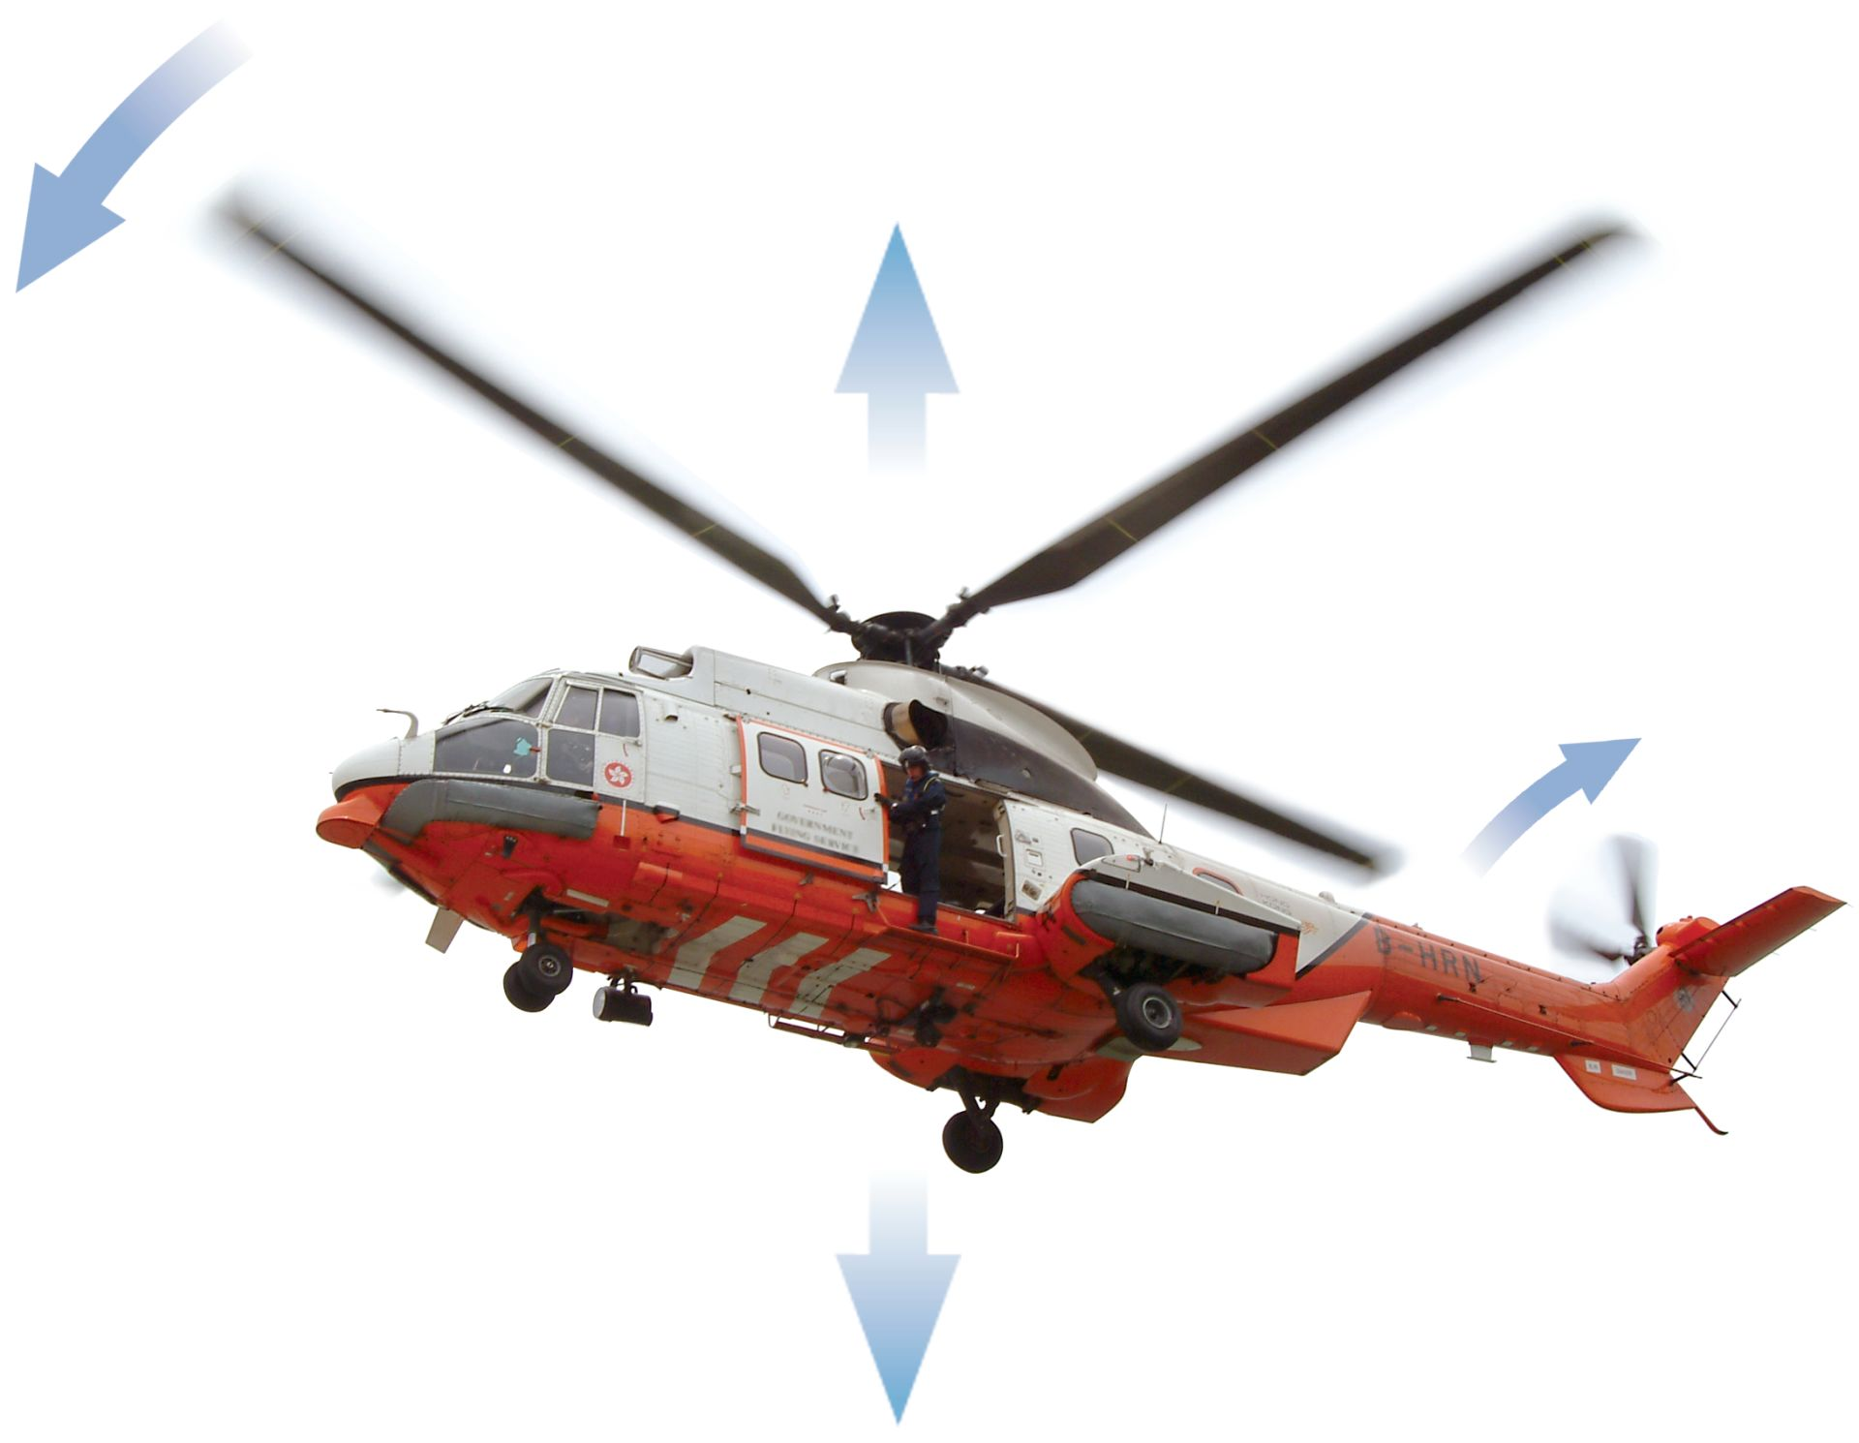
Balanced or Unbalanced Force?

Slide 9
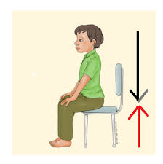
Balanced or Unbalanced Force?

Slide 10
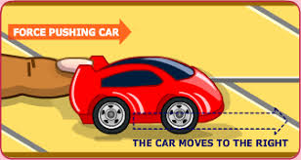
Balanced or Unbalanced Force?

Slide 11
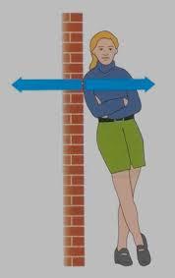
Balanced or Unbalanced Force?

Slide 12
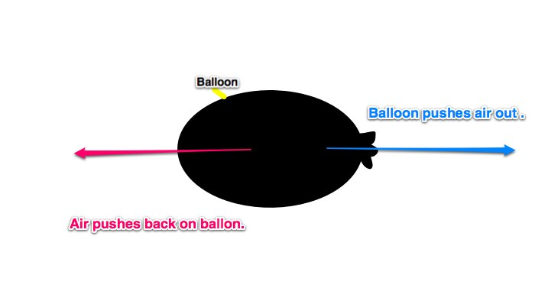
Balanced or Unbalanced Force?

Slide 13
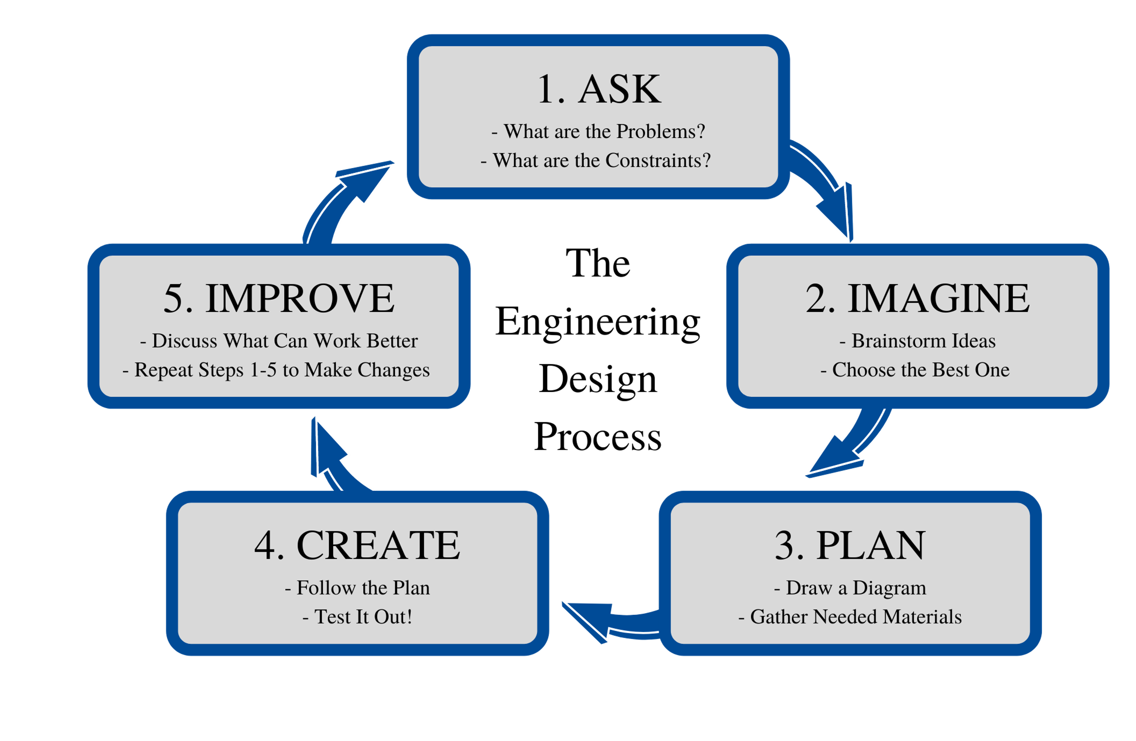
Engineering Design Process

Slide 14
Ask
Your challenge is to design a flying machine for Rosie Revere using the materials provided. Your flying machine should be able to fly down the zip line.
Materials (minimum):
balloon
straw
tape
string for the zip line

Slide 15
Imagine/Brainstorm
If the balloon acts as an engine of a rocket, which way will the balloon go if air pushes out the open end of it?
Where would you need to tape your balloon (engine) to your straw (rocket) for it to go the farthest?
What is your vision of your flying machine?

Slide 16
Plan/Design/Create/Test
Let’s begin building and testing our flying machines.

Slide 17
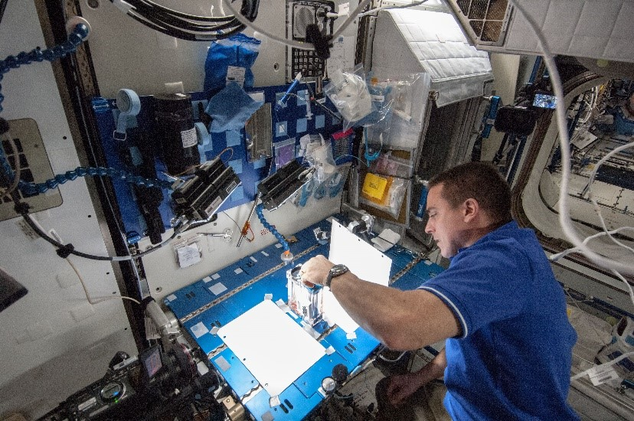
STEM Career: Engineer
An engineer is a person who designs and builds complex products, machines, systems, or structures. Engineers want to know how and why things work. They have scientific training that they use to make practical things. Engineers often specialize in a specific branch of engineering. The field of engineering is divided into branches such as civil, electrical, mechanical, and chemical engineering.
Engineering positions typically require a bachelor’s degree in engineering or a relevant field. Some engineering jobs, especially in management, require a master's degree. An engineering degree in a specialty area may qualify engineers for a career in a related field. Whatever your area of focus, an engineering degree will require a heavy dose of math and science courses.

